Slide 1
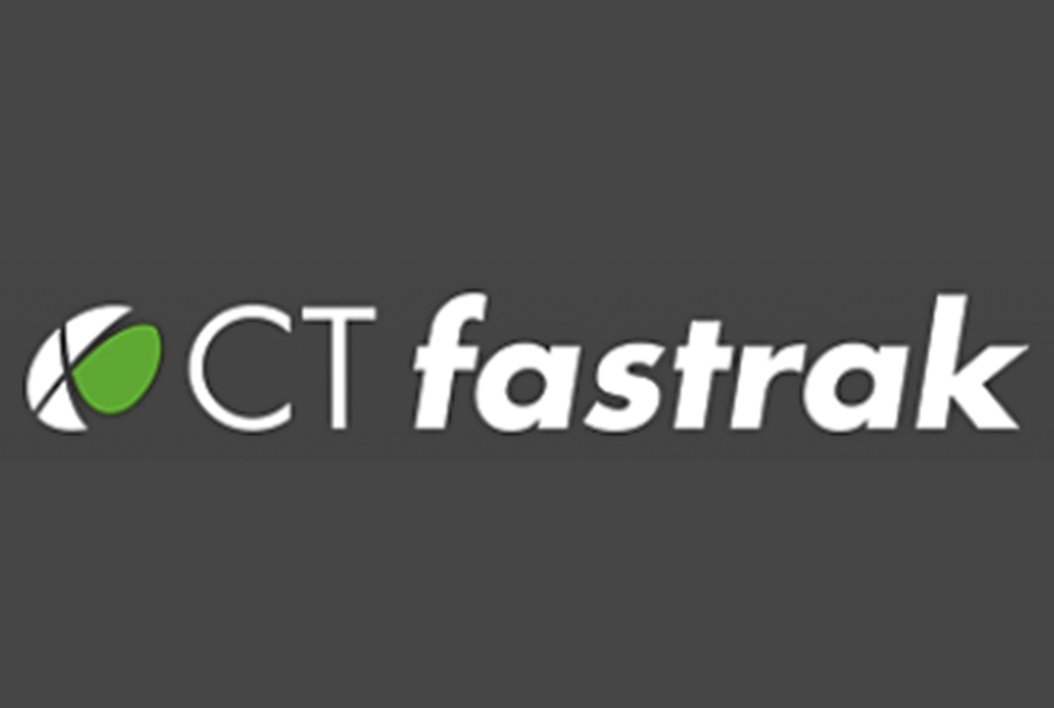
CTfastrak -- Connecticut’s First Bus Rapid Transit System
Lyle D. Wray, Ph.D. Executive Director
Capitol Region Council of Governments
Presentation to Chullonghkorn University, Bangkok Thailand
August 26, 2016

Slide 2
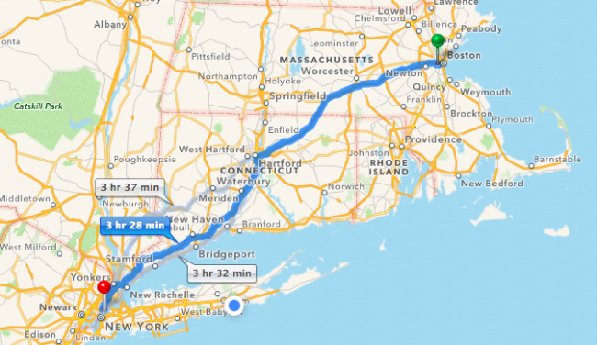

Slide 3
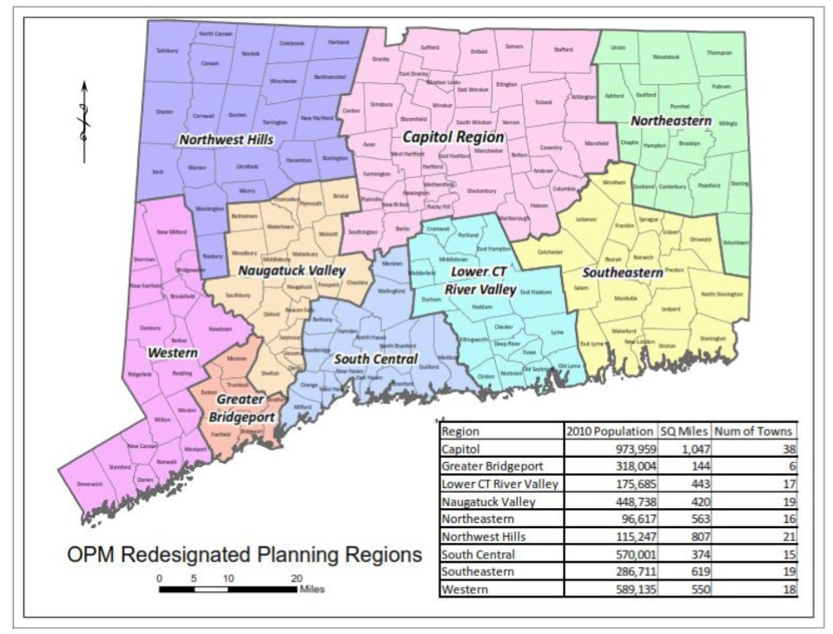

Slide 4
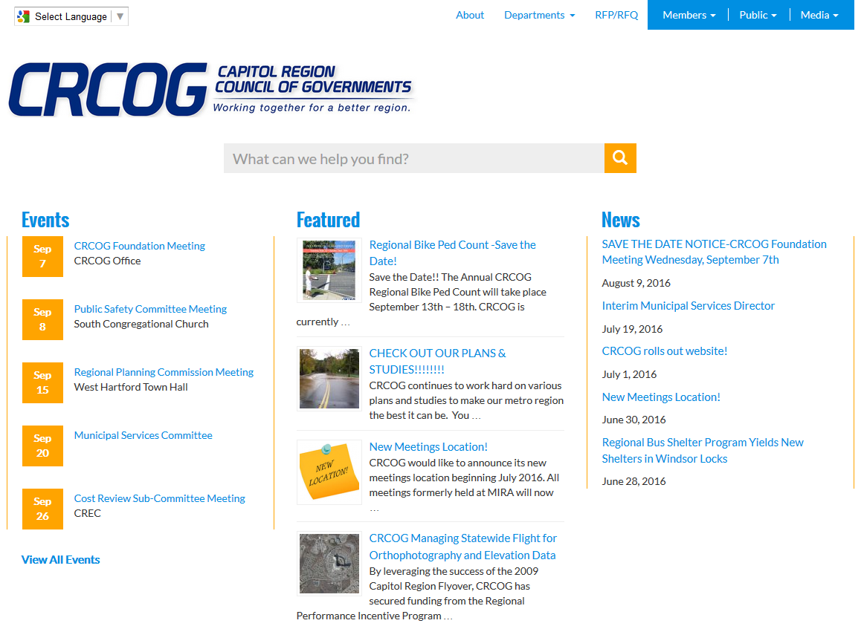

Slide 5
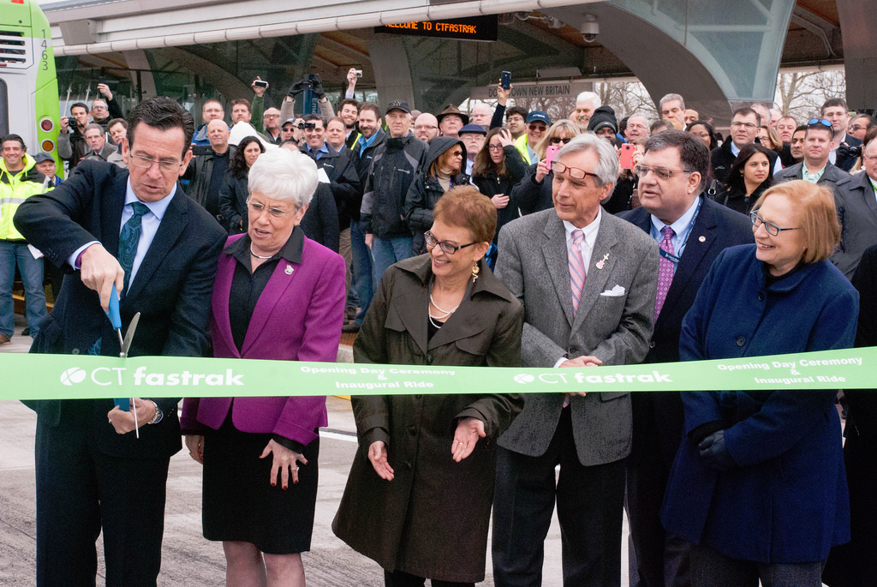

Slide 6
Background on CTfastrak BRT Project
1998: Trips to see BRT in Ottawa Canada and Pittsburgh Pennsylvania
Required studies on options: widen I-84 freeway, heavy or light rail or bus rapid transit
Cost benefit analysis: bus rapid transit won
New Starts federal program
Full funding grant agreement at $567 million, 80% federal 20% state capital funds
Opens March 2015 (17 year process)

Slide 7
CTfastrak BRT Facts
15 km exclusive guideway with 10 stations
Guideway beside most congested part of the freeway system
Railroad right of way used for guideway
Circulator routes feeding the exclusive guideway
Suburban express services using the exclusive guideway
Regular transit routes connecting at exclusive guideway stations

Slide 8
Transit Funding
Capital costs: 80% federal, 20% state
Fare box recovery or the Hartford Division is 20%. https://www.transit.dot.gov/sites/fta.dot.gov/files/docs/10048.pdf
Current fare is $1.50 valid for three hours on BRT

Slide 9
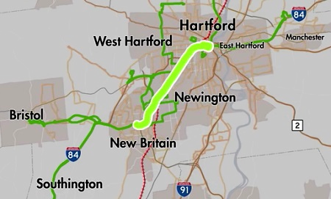

Slide 11
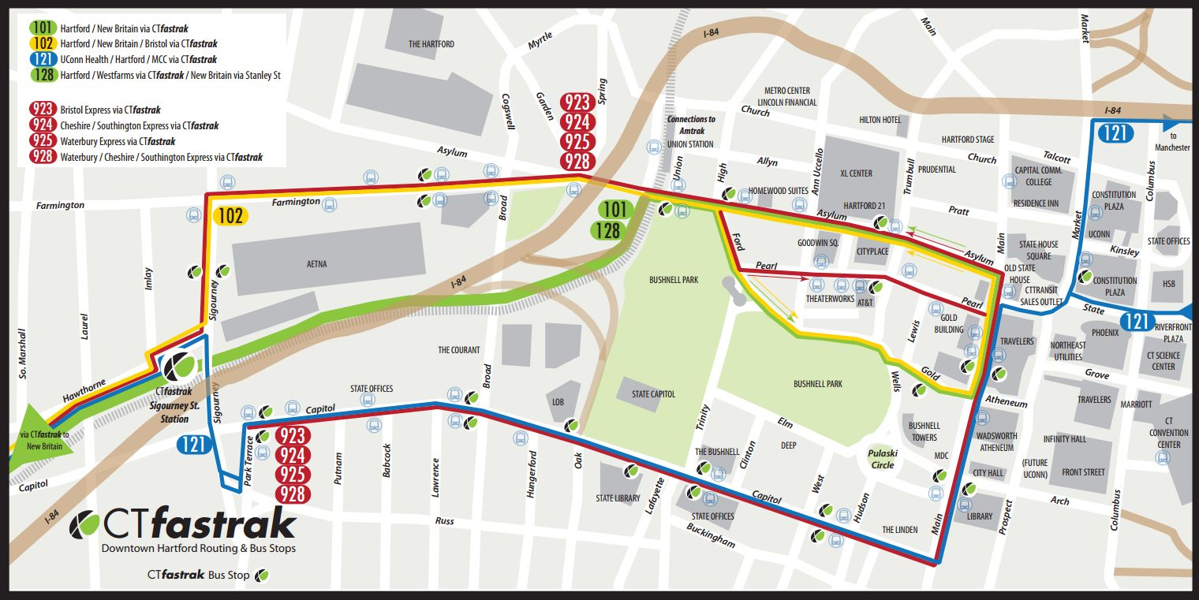

Slide 13
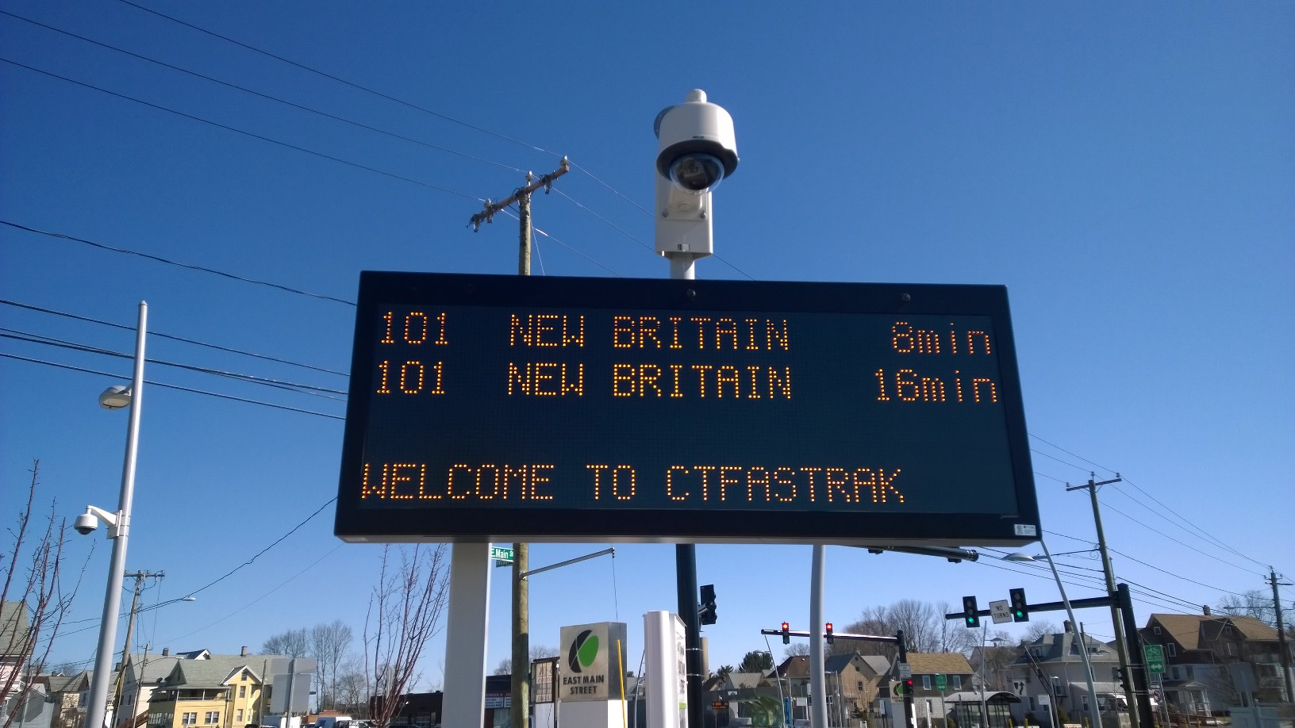

Slide 14
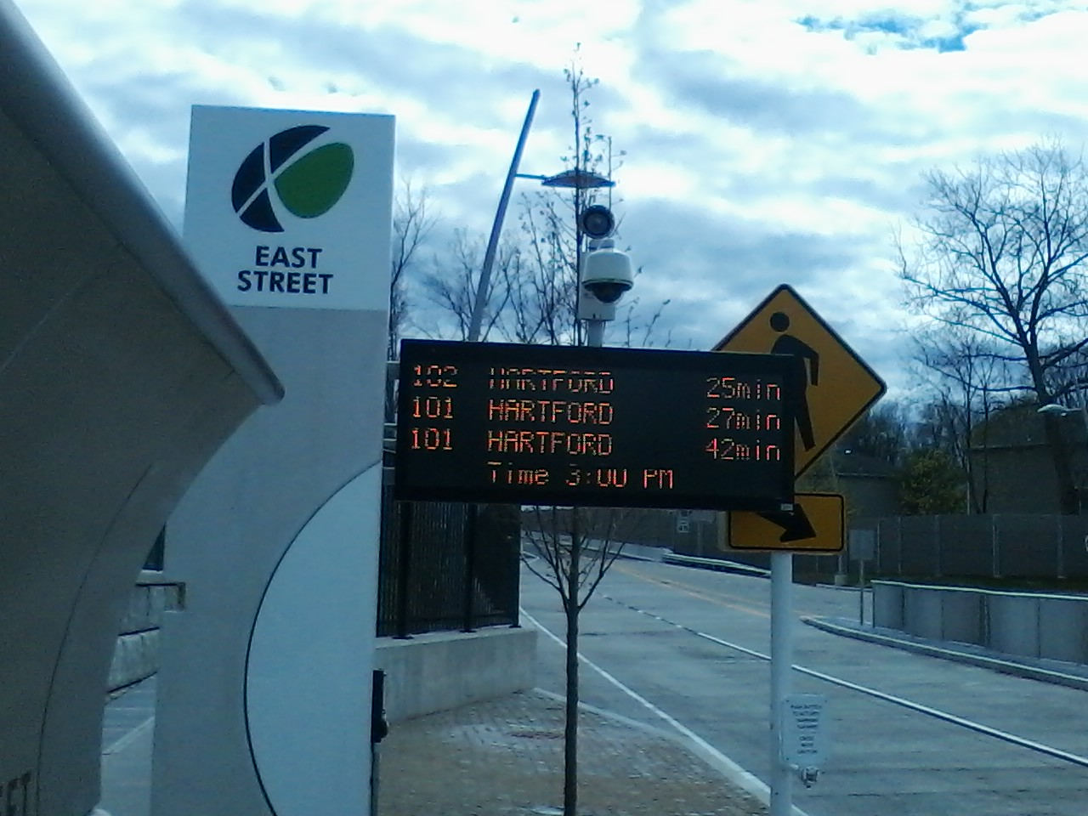

Slide 15
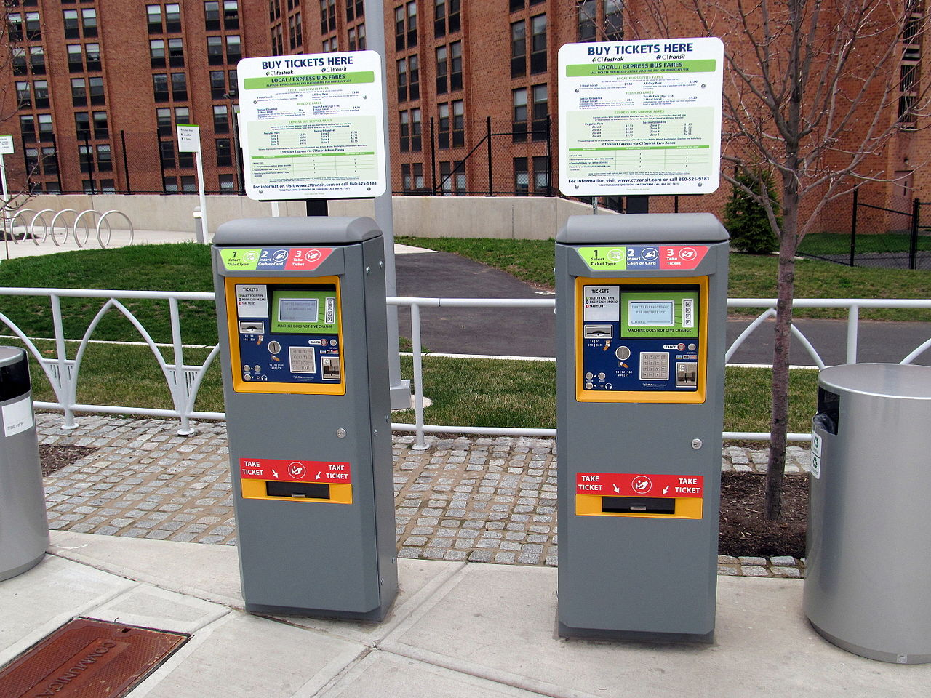

Slide 16
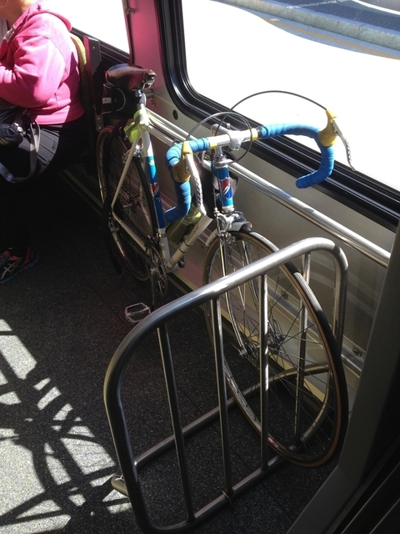

Slide 17
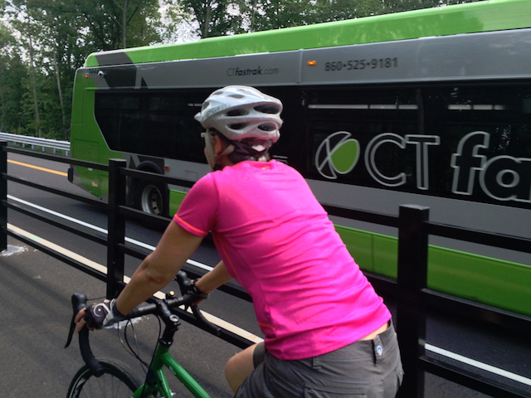

Slide 19
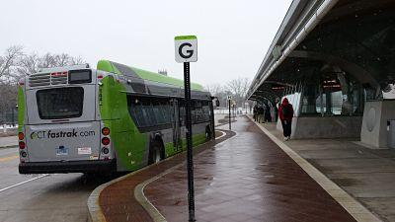

Slide 20
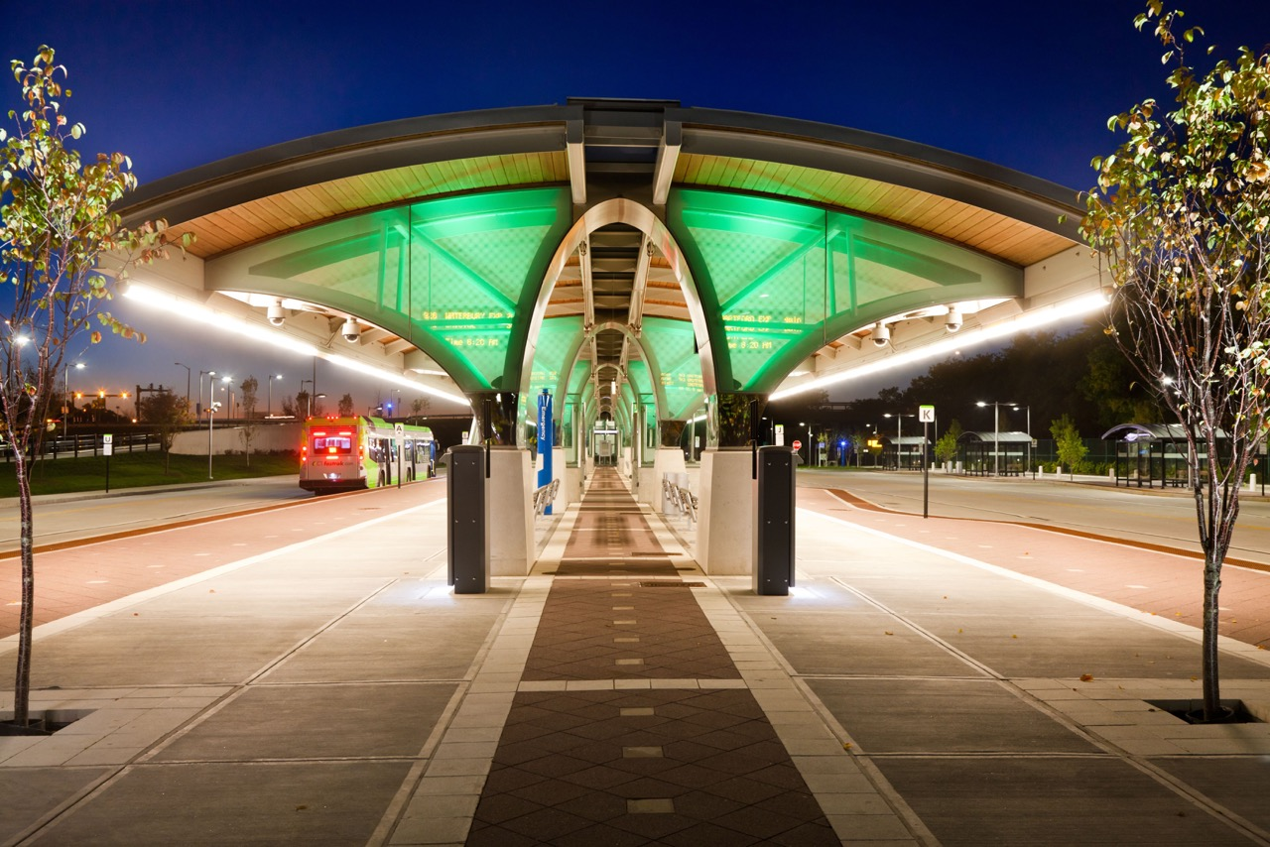

Slide 21
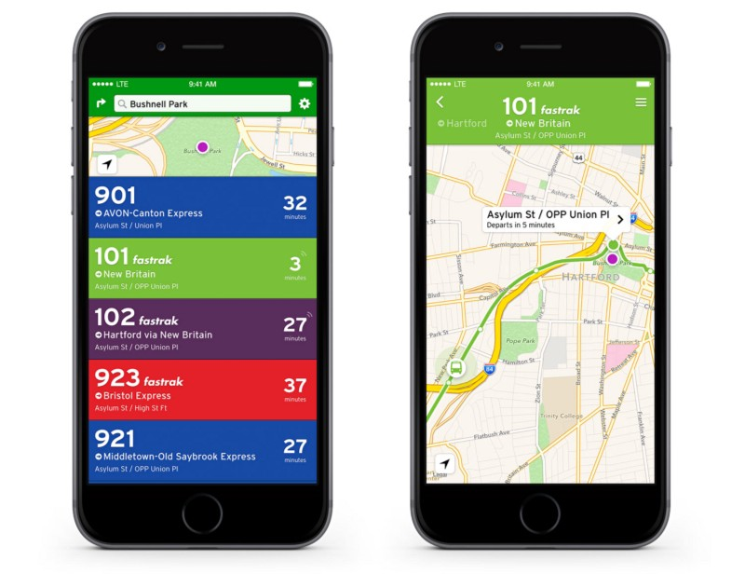

Slide 22
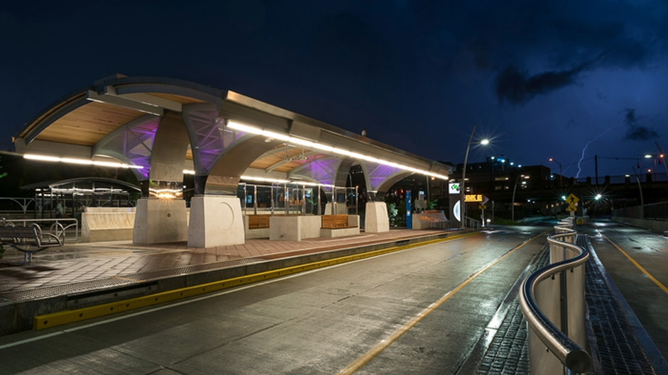

Slide 23
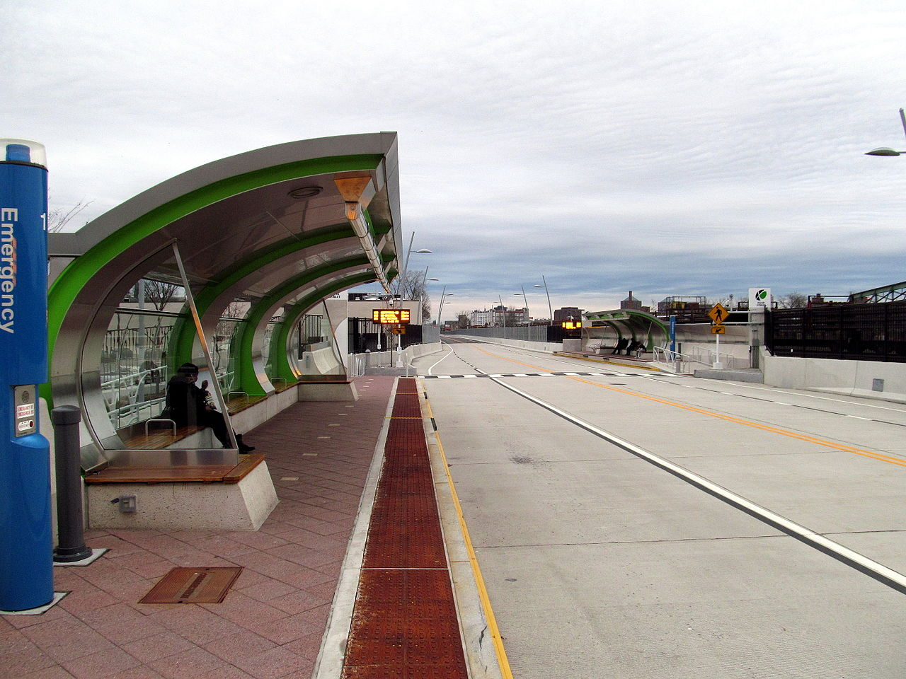

Slide 24
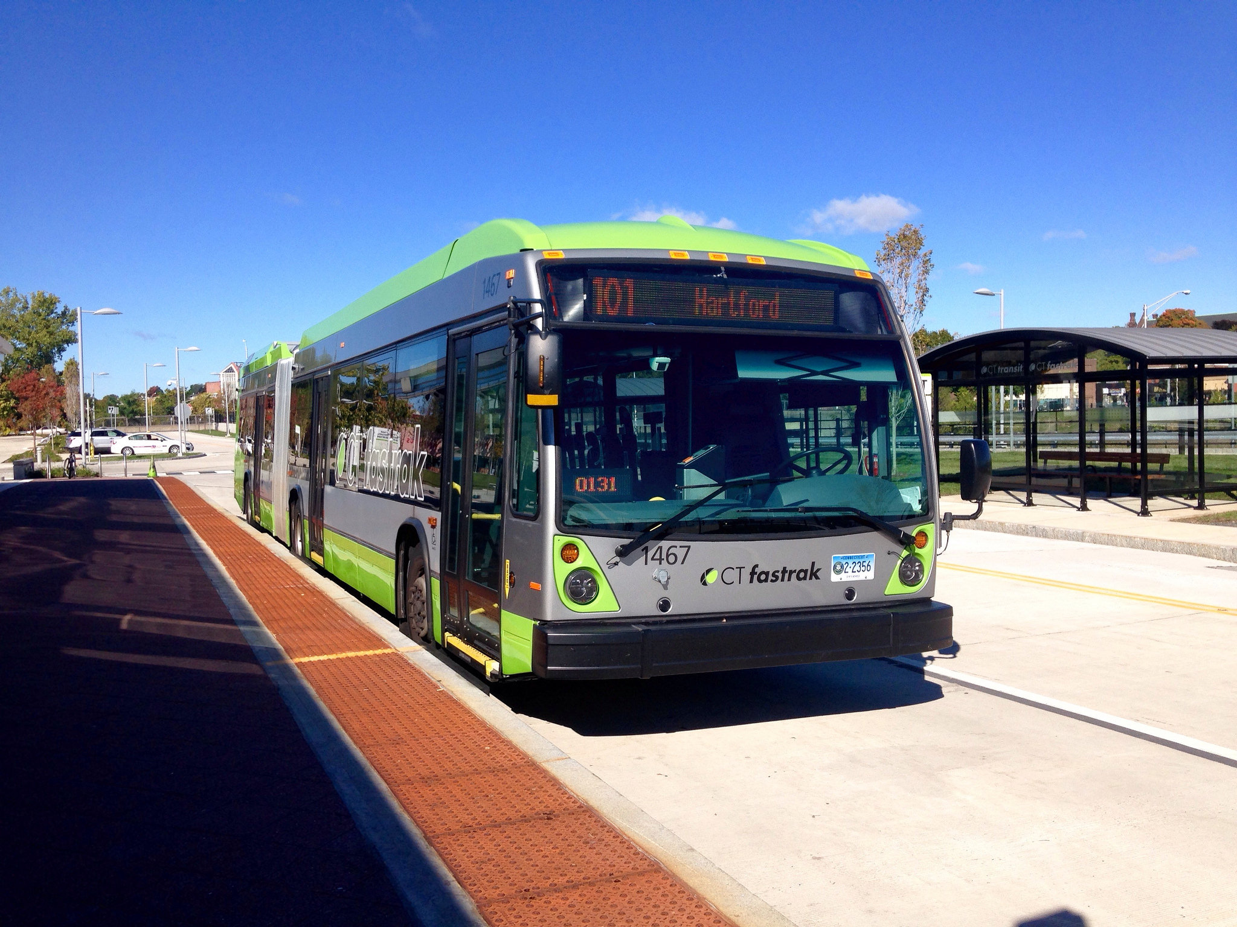

Slide 25
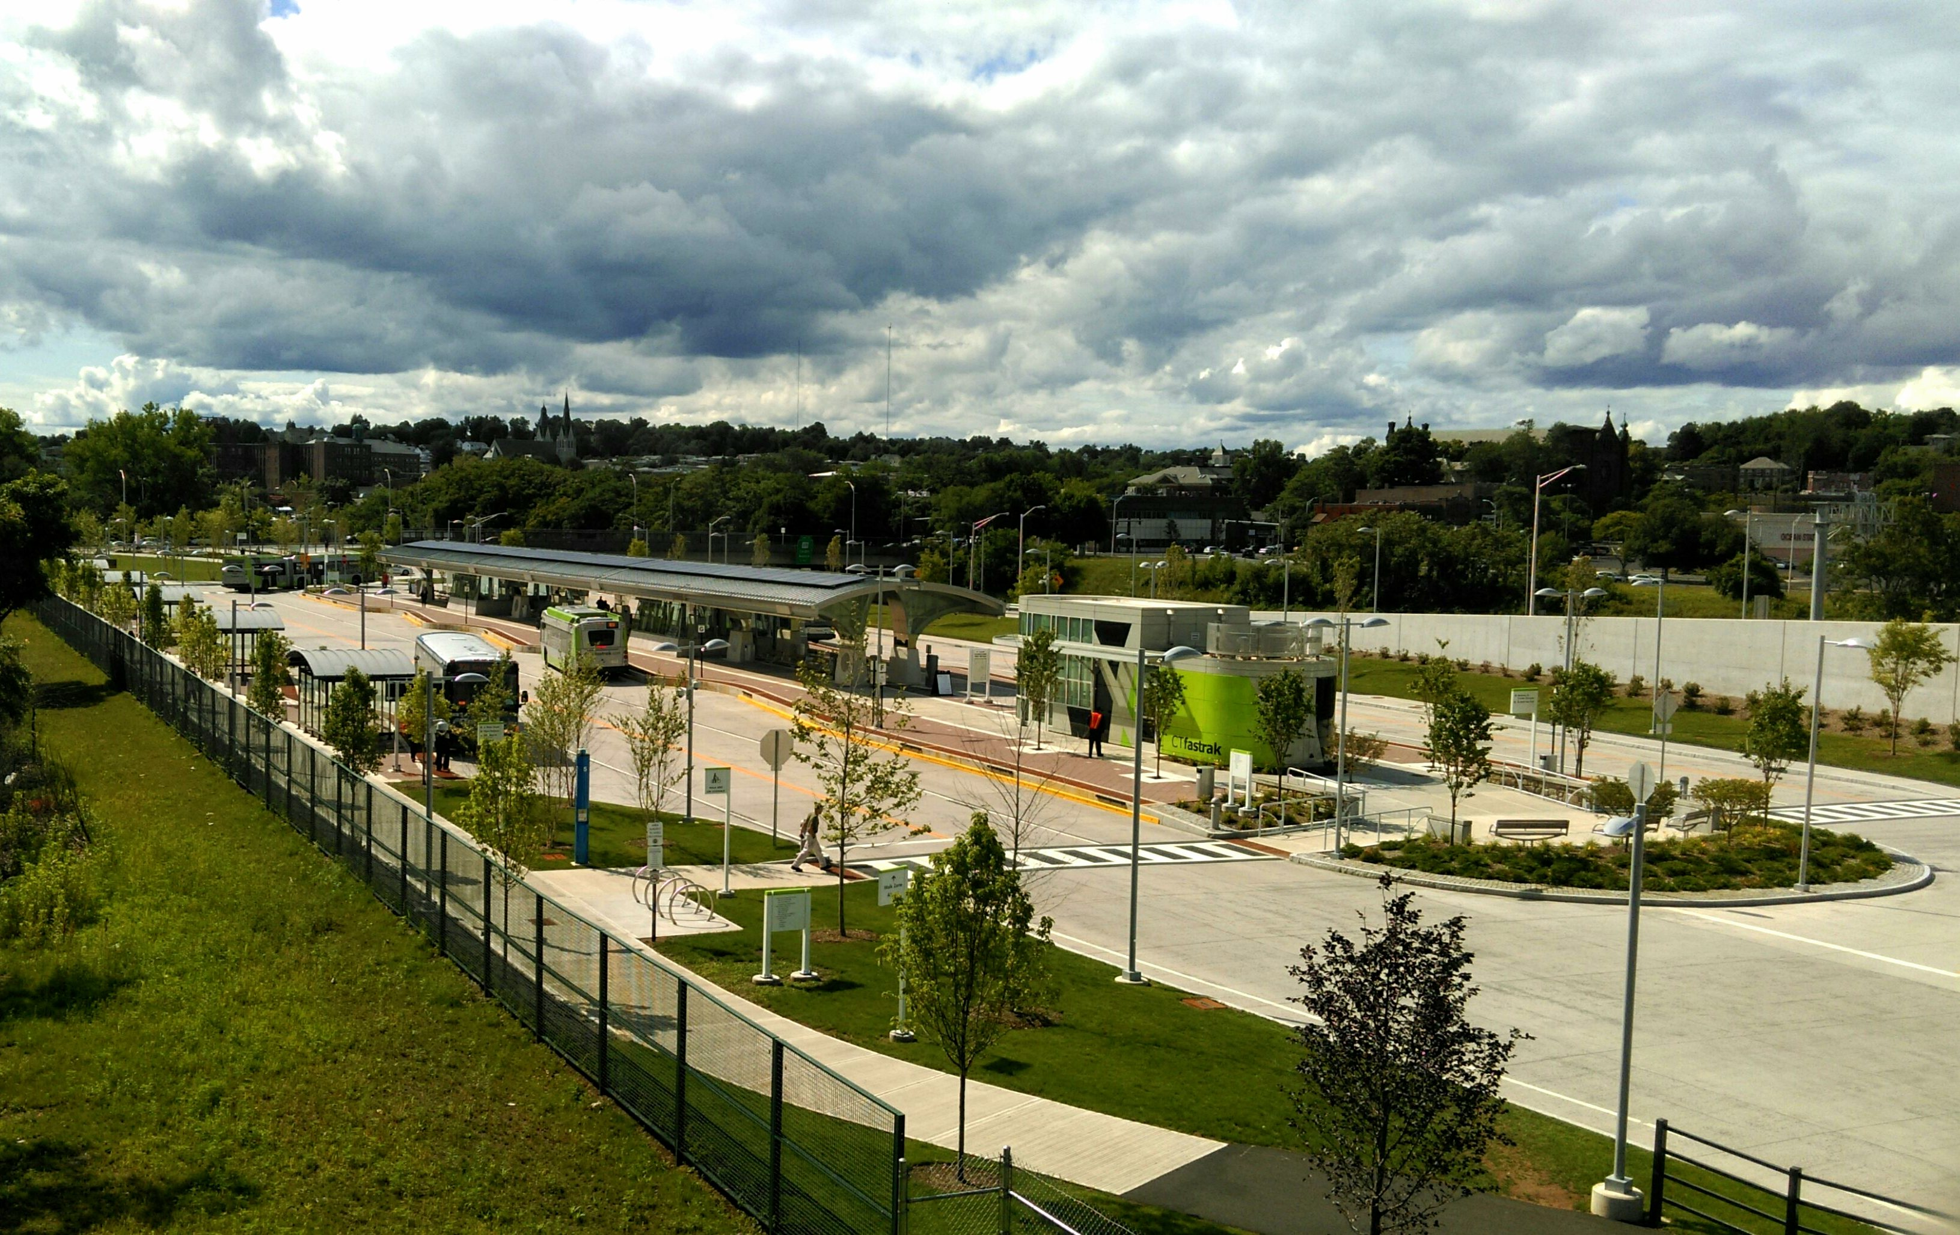

Slide 26
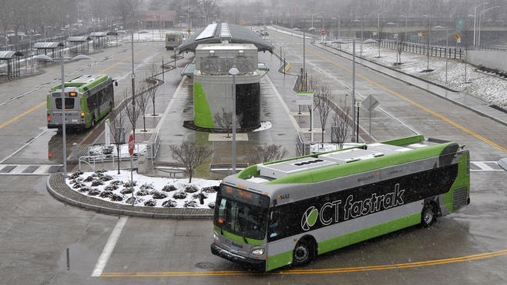

Slide 27
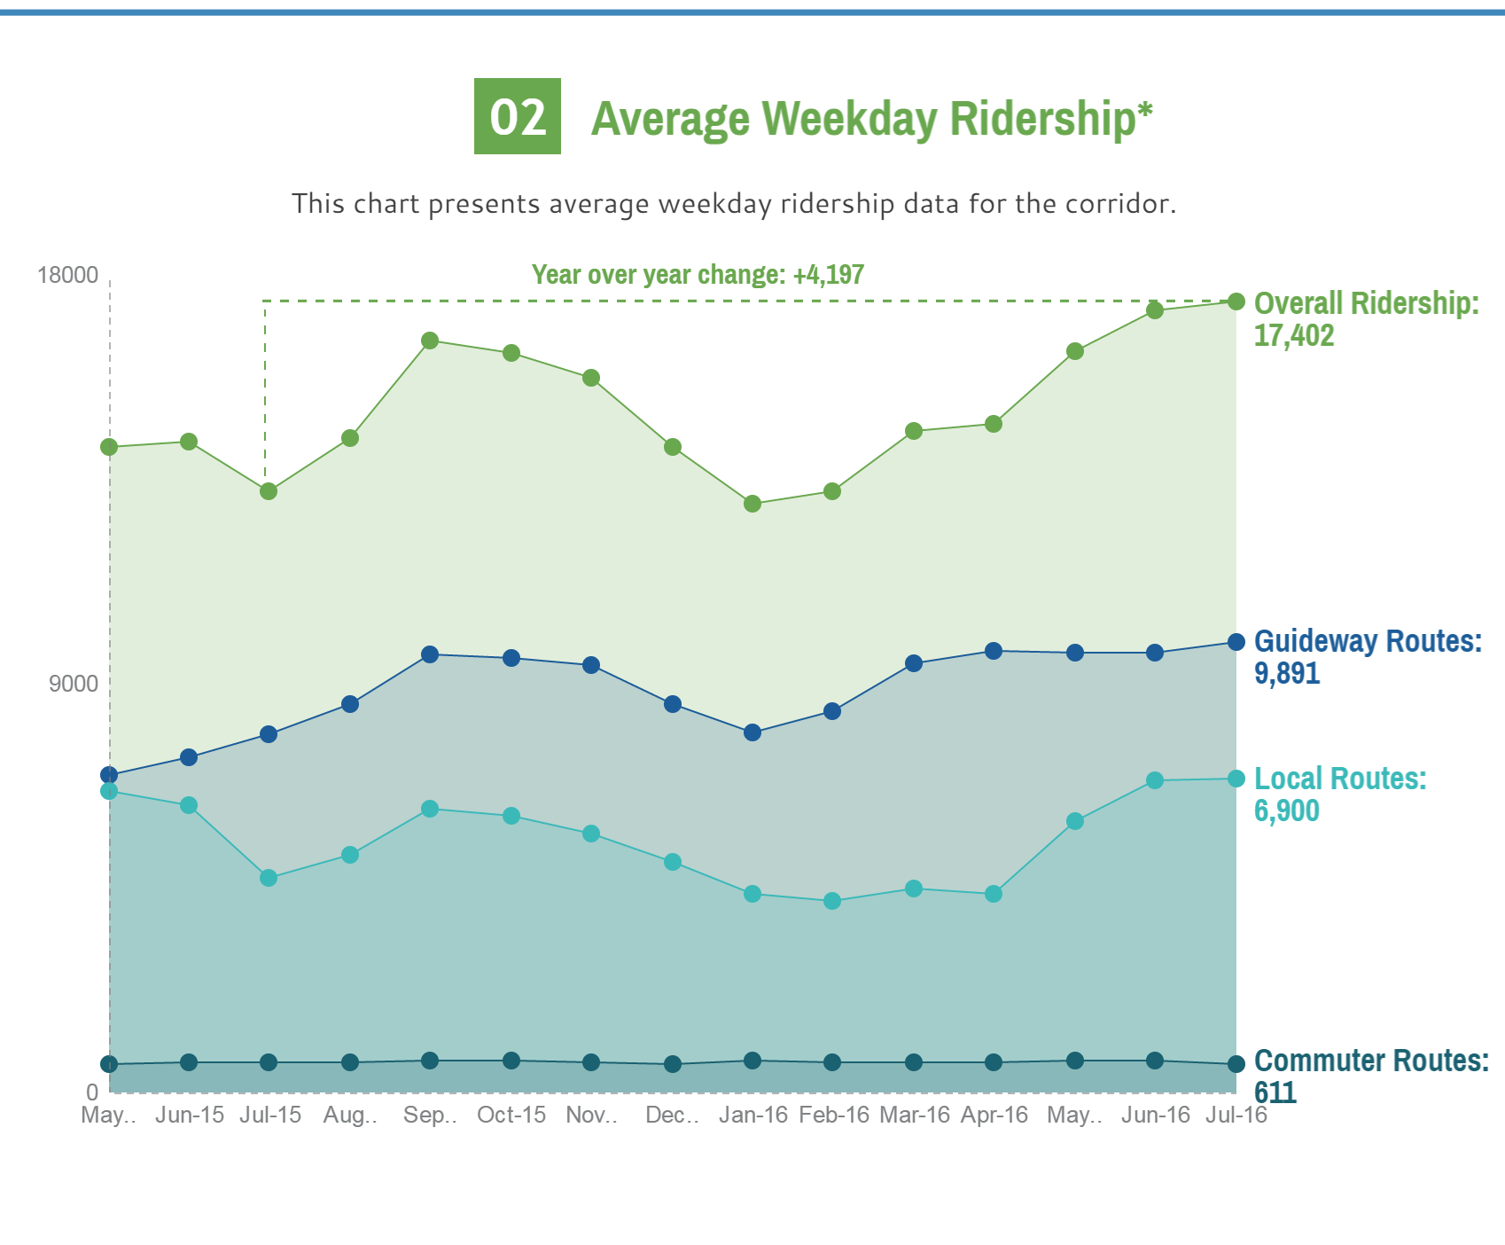

Slide 28
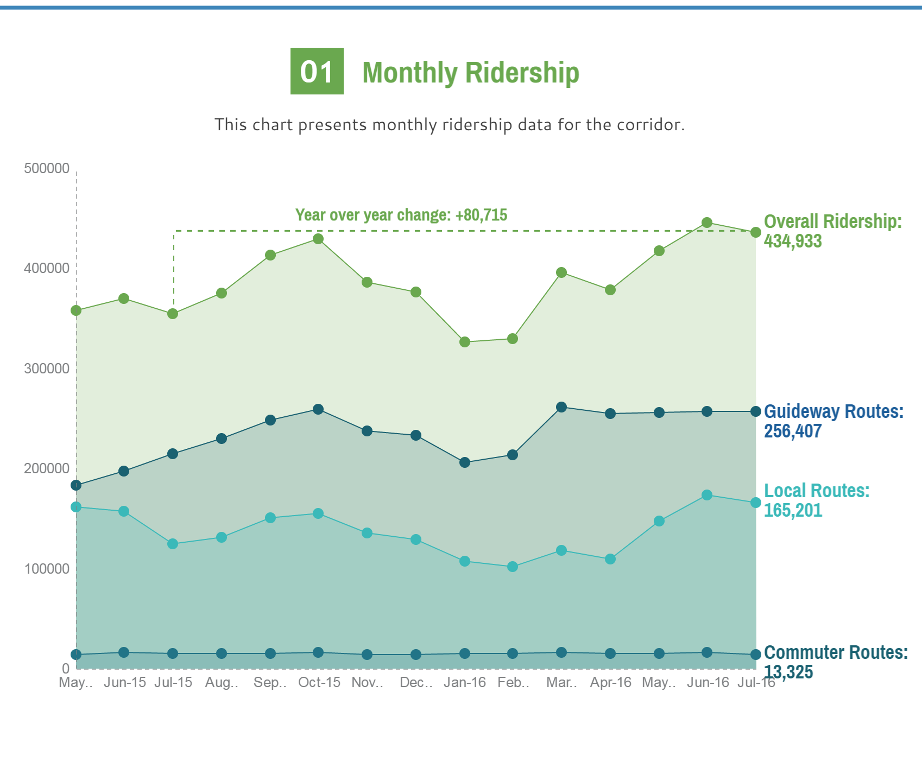

Slide 31
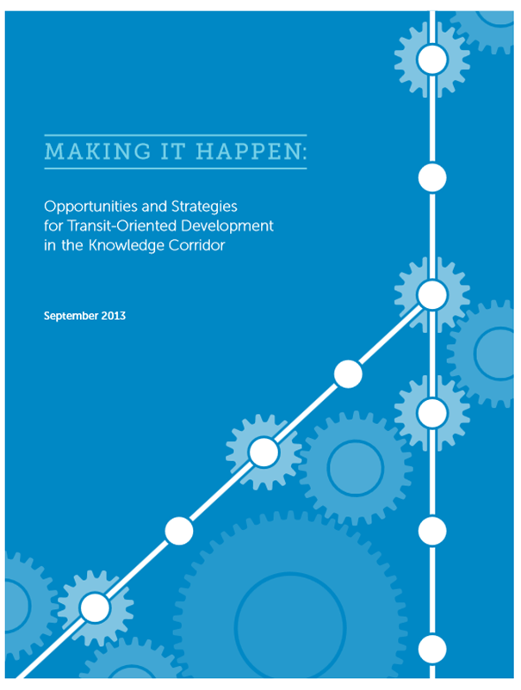

Slide 32
Transit Oriented Development Tools
TIF
Brownfields
Housing subsidies
TIF state funding

Slide 33
Opportunities for Growth around the CTfastrak Corridor
Corridor Advisory Committee
CRCOG TOD report
Station area assessments
Work in progress

Slide 34
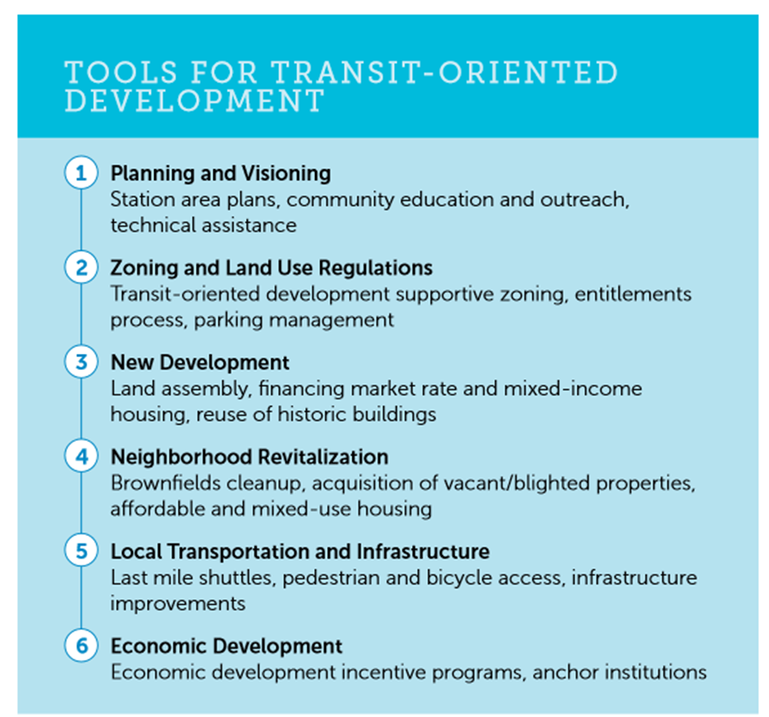

Slide 35
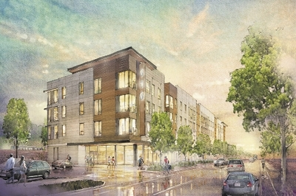

Slide 36
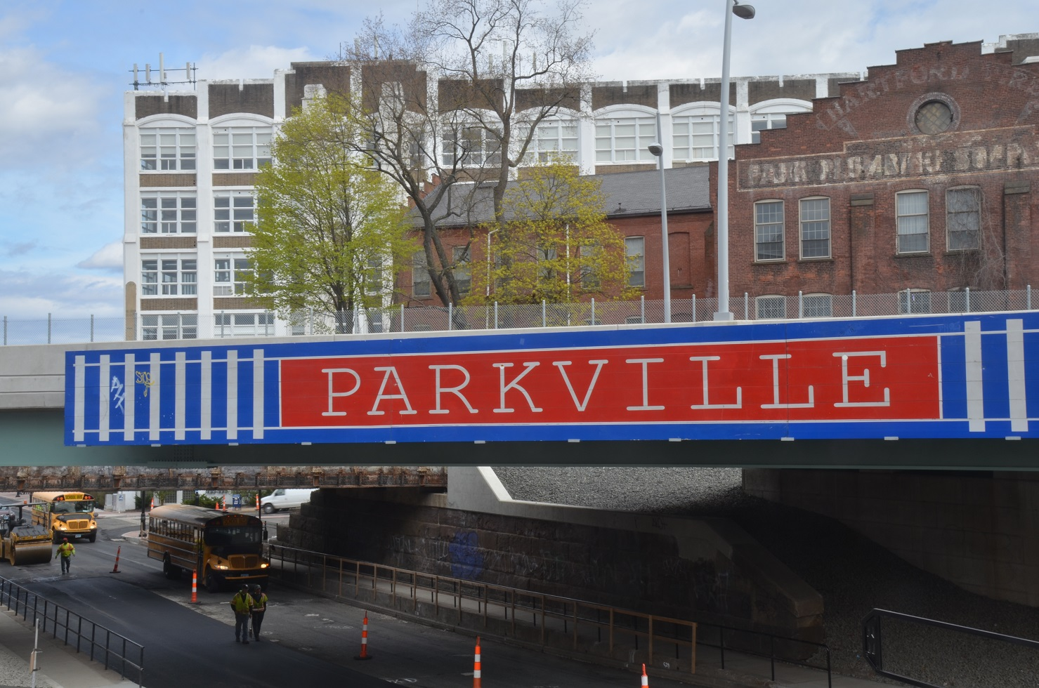

Slide 37
CTfastrak Employment Corridor
152,000 jobs in corridor from New Britain to Manchester (not including University of Connecticut) on CTfastrak or circulators
38,700 jobs west of Hartford
77,200 jobs in Hartford
36,500 jobs east of Hartford

Slide 38
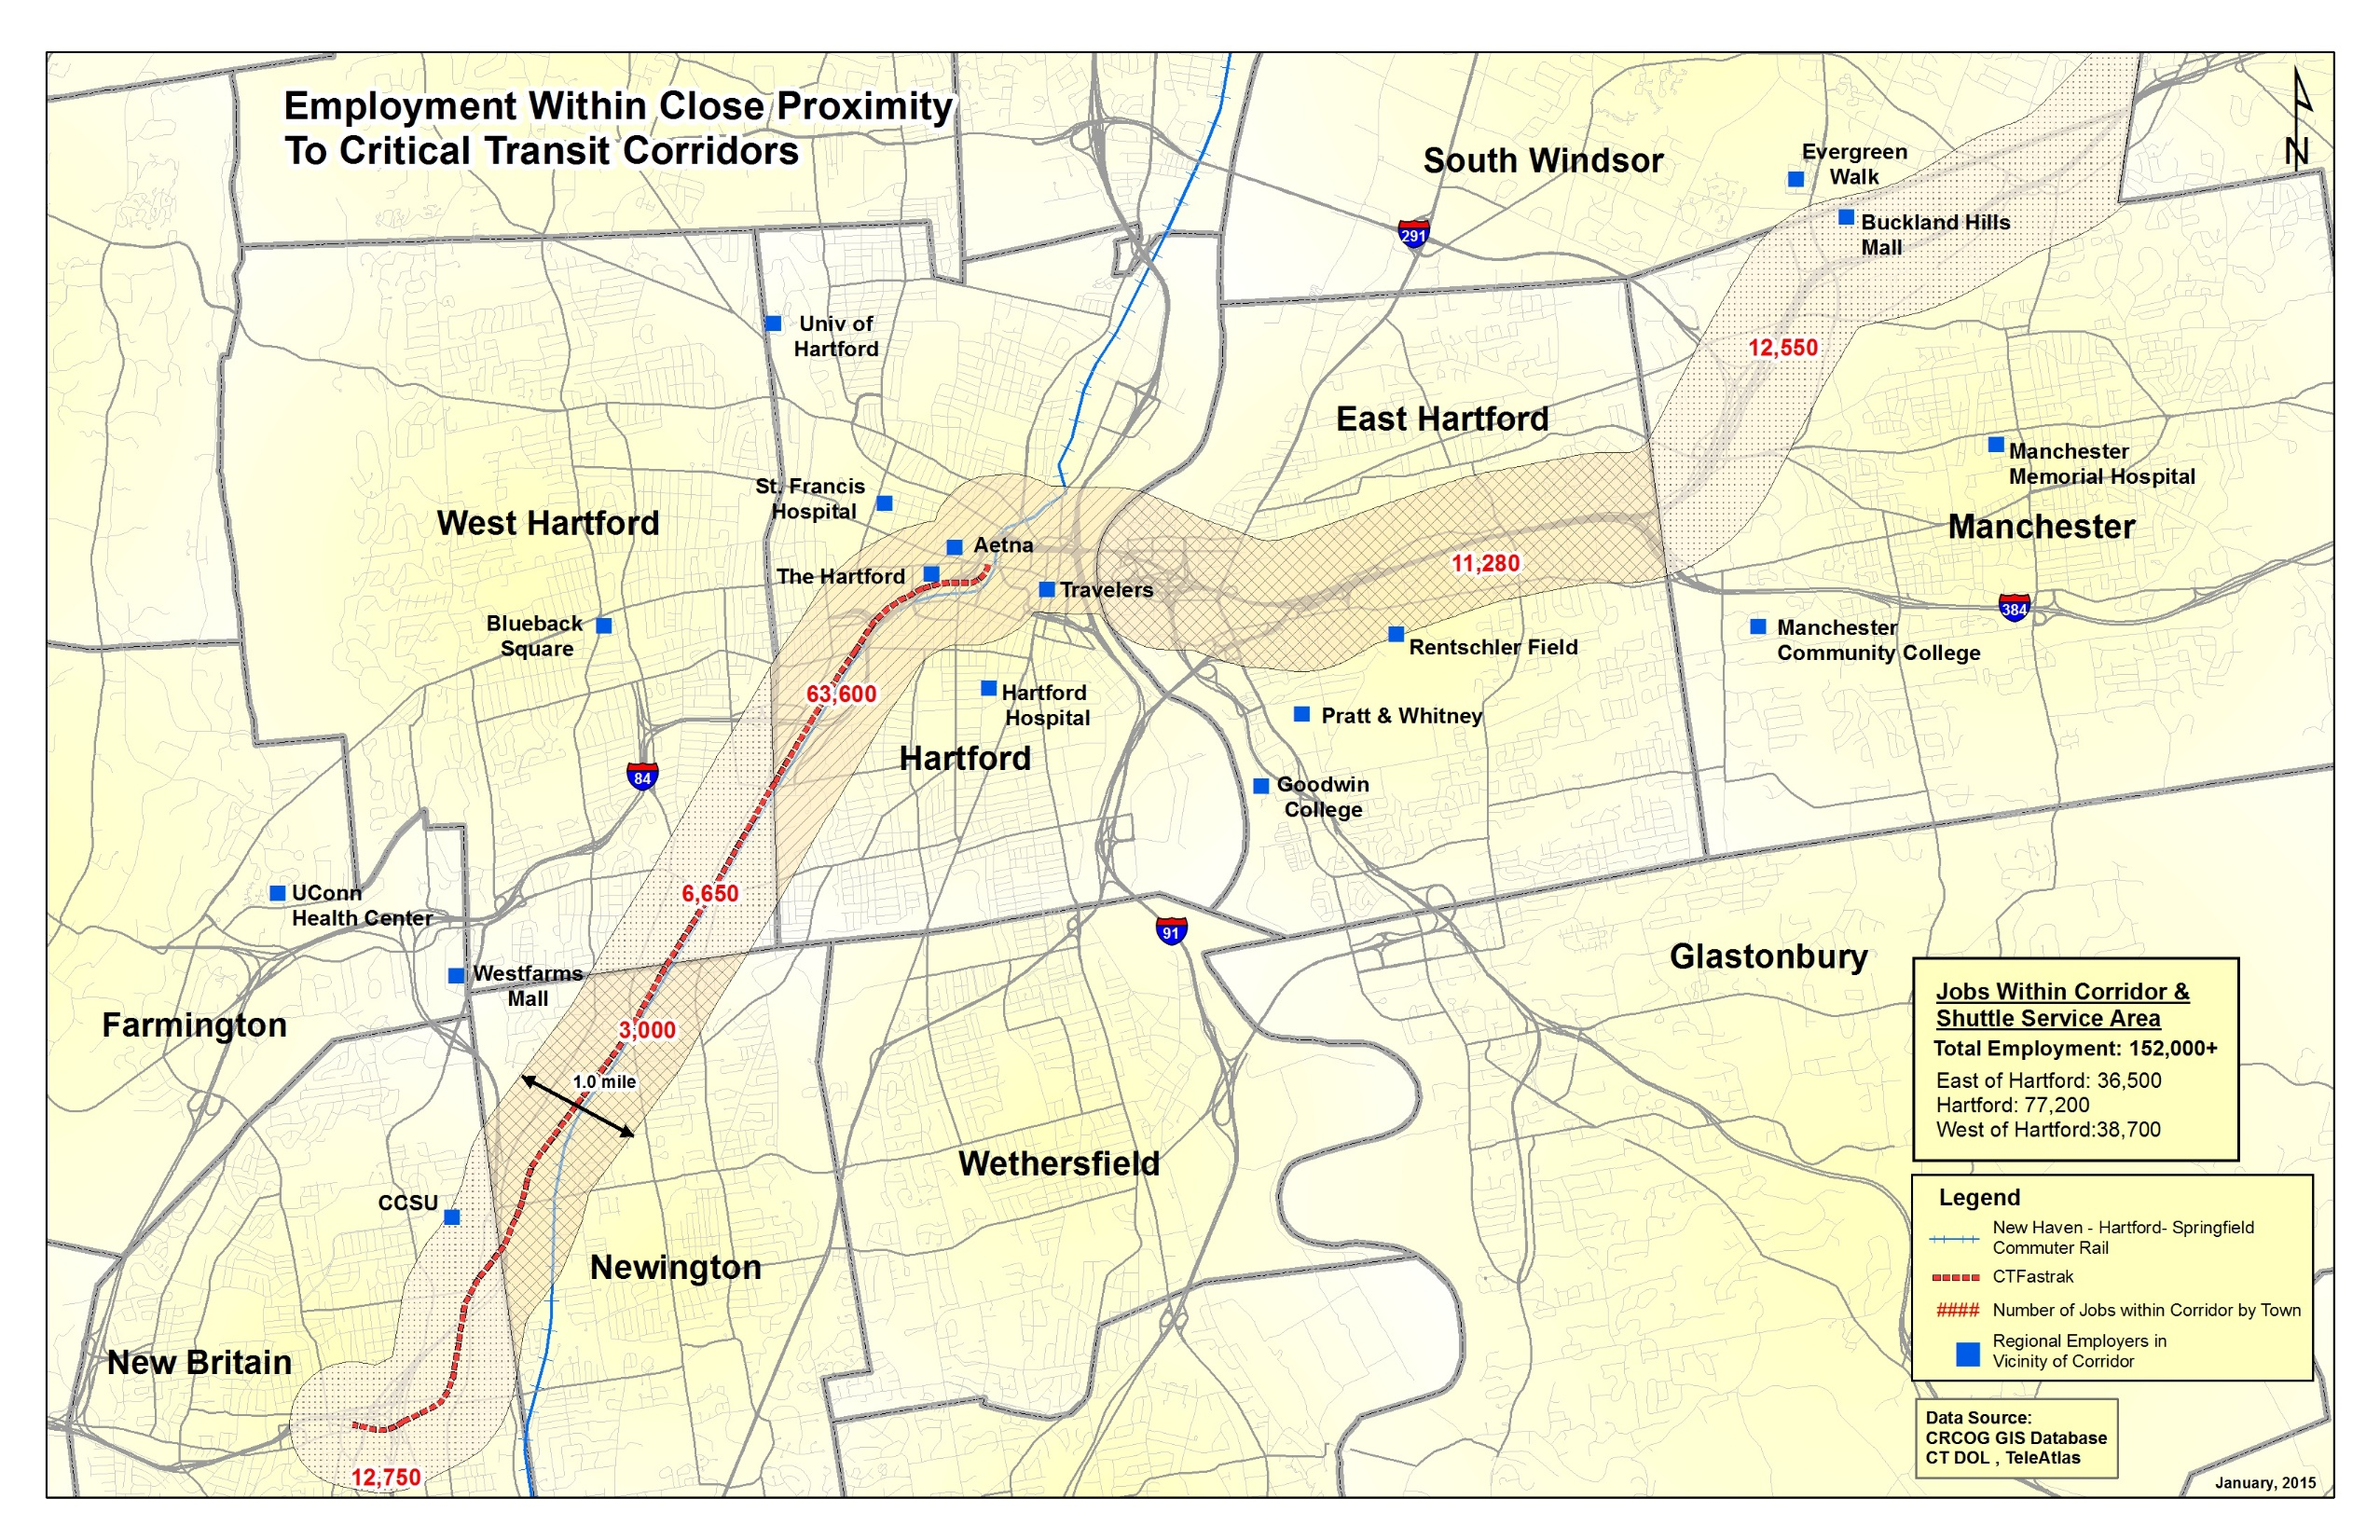

Slide 39
Major Employers in the CTfastrak Corridor
Central Connecticut State University
University of Connecticut Health Center and Medical Offices
Westfarms Mall (largest regional shopping center)
Saint Francis Hospital
Aetna Insurance
The Hartford Insurance
Travelers Insurance
CT Capitol and State Government
Pratt and Whitney Aircraft
Capitol Community College and Manchester Community College
(Buckland Hills Mall)
(University of Connecticut main campus Storrs CT 18,400 students + staff)

Slide 40
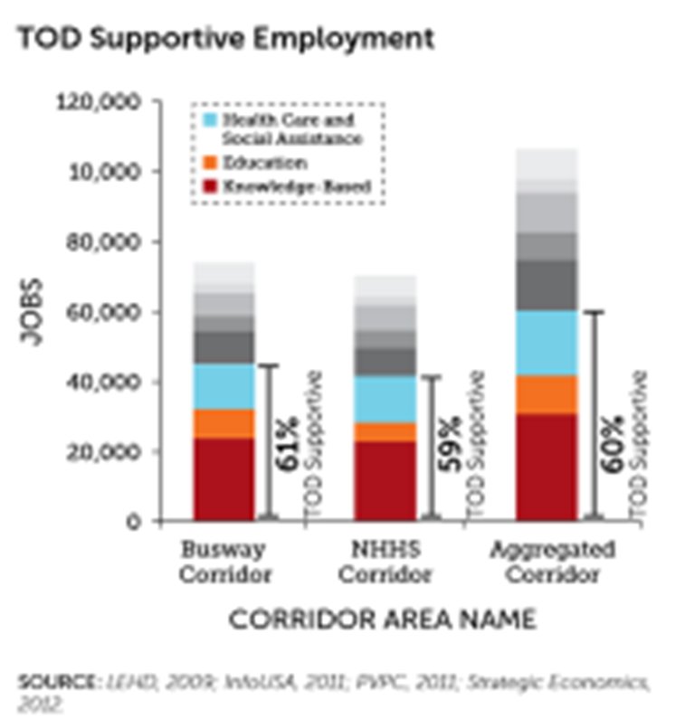

Slide 42
East of the River Expansion of CTfastrak

Slide 43
Questions and Answers?
Lyle D. Wray, PhD
Executive Director
Capitol Region Council of Governments
www.crcog.org
lwray@crcog.org

Slide 44
