Slide 1
FY 2018-2019 Budget Summary
April 25, 2018 CRCOG Policy Board

Slide 2
FY 2018-2019 Assumptions
Base Cost of Living Adjustment for CRCOG staff
State level financial pressures on CRCOG:
Transportation Match: Increased local match requirement for FHWA Planning funding (10% to approximately 14%-15%). 2018-2019 anticipated local match: $250,531.
State Funding: Staff proposes reducing funding of the CRCOG’s Regional Services Fund for 2018-2019 by 50% of what was received in 2017-2018 (to $180,292). If the funding is pulled completely, CRCOG will not fund the regional services fund and will use the contingency and unobligated amounts to make up the shortfall with no impact on the remaining budget. Within the last 10 years, CRCOG’s state funding has ranged from $9,000 to $611,980.
The outlook for FY 2022-2023 is challenging and staff recommends review and mitigation measures as necessary beginning FY2021-2022.

Slide 3
FY 2017-2018 Accomplishments
Grew IT Services Cooperative and back office services including hosting services, disaster recovery and data backup, Voice Over Internet Protocol telephone service and general IT Services. Purchasing Council saved CRCOG towns almost $1 million.
Regional Online permitting grew to 41 municipalities.
Continued support and management of federal Homeland Security projects --140 projects since inception of the program
Supported regional economic development: began the Regional Futures Initiative listening tour and sought funding for and launched with partners he regional Comprehensive Economic Development Strategy (CEDS).
Obligated approximately $19.6 million in Federal Fiscal Year 2017 STP Block Grant Funds, and worked to advance $6.4 million in LOTCIP projects for State Fiscal Year 2017. CRCOG also approved $10.9 million in new bridge projects and issued a project solicitation for $25.5 million for roadway reconstruction, pavement rehabilitation, stand-alone sidewalk, and bicycle-pedestrian projects.

Slide 4
FY 2018-2019 goals
Act on additional IT Services opportunities: Expand HR-Portal opportunities; launch Electronic Document Management System into program phase and continue expansion of existing services
Complete Comprehensive Economic Development Strategy (CEDS) and begin implementation
Finalize Long Range Transportation Plan update
Continue support of existing programs is Homeland Security, Transportation, and Metro Brownfields Program
Finalize Natural Hazard Mitigation Plan update
Finalize Complete Streets inventory and gaps and needs assessment, and action plan through the Responsible Growth Grant
Complete regional LOTCIP solicitation and continue working to program regionally significant transportation projects

Slide 5
Long Term NET Income
CRCOG may not fund the Regional Fund beginning 2019-2020
Long-term projections do not include use of the Regional Fund (projected to be $500,000)
Use of FHWA carryover funds is included beginning FY2019-2020 in the Worst Case
Includes 10% estimated health insurance increases and 2% increase of dues and base COLA increases for staff
State funding is included only as best case and at 50% of what is currently in legislation

Slide 6
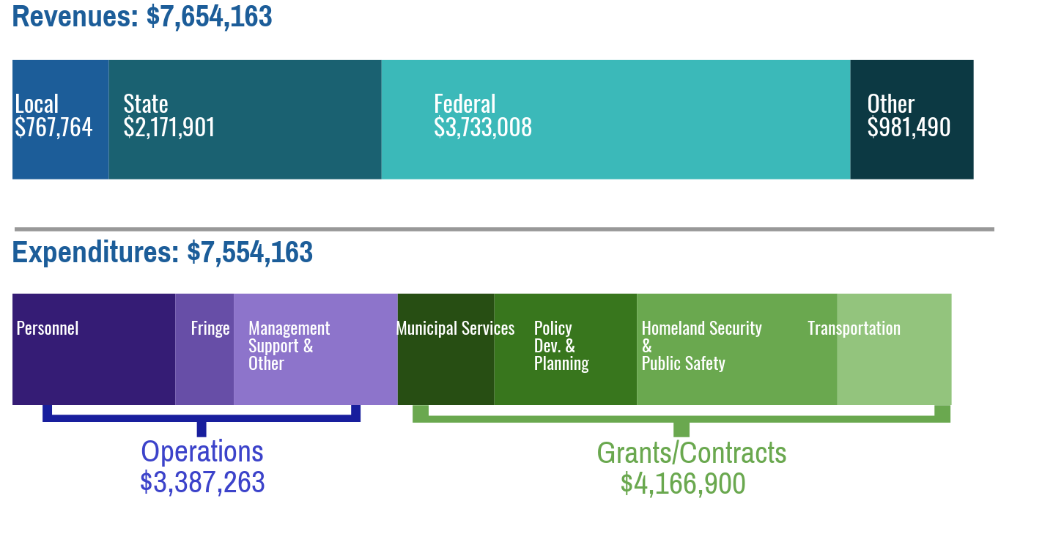
DRAFT Summary of Revenues and Expenditures
Stable Income for FY 2018-2019
Mitigation measures may be necessary beginning FY 2021-2022

Slide 7
DRAFT Budget Summary

Slide 8
Draft Budget Summary by Dept.

