Slide 1
Bike-Ped Committee
September 18, 2018

Slide 2
Updates and News
Region/State

Slide 3
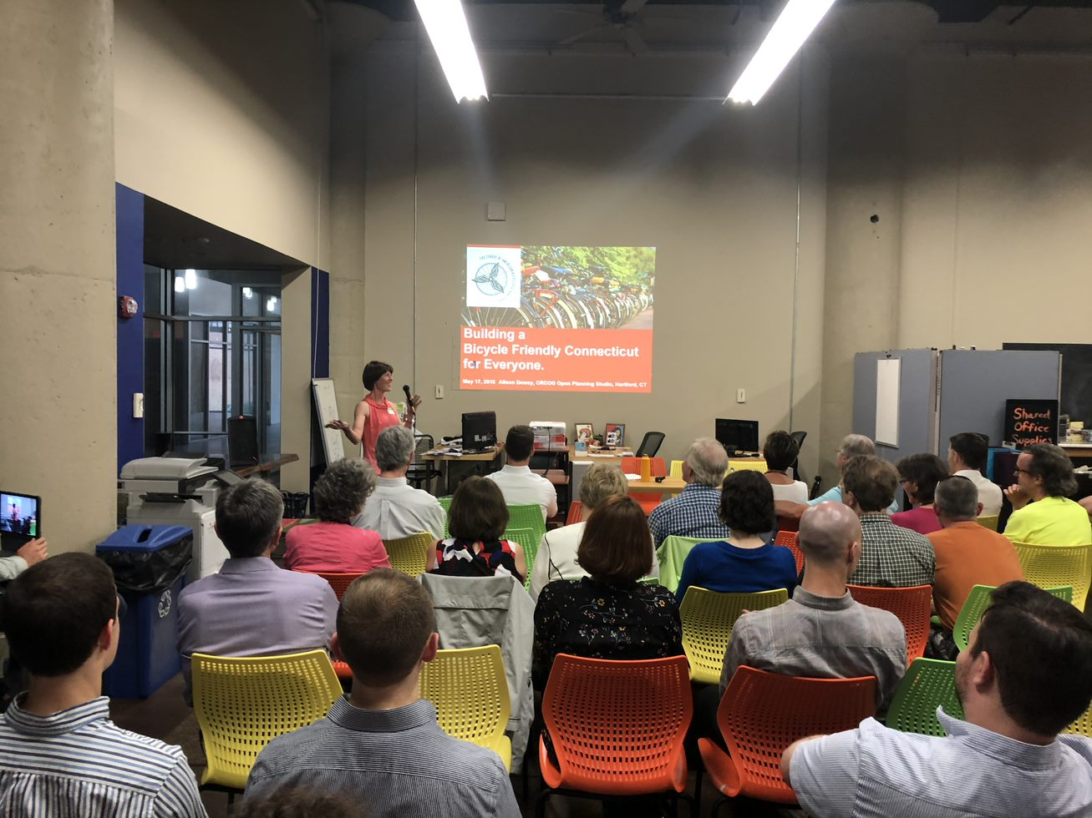
Open Planning planning studio
October 10-11, 2018
East Side Community Center, New Britain
Local Policy Workshop
Demo project
Focus groups
On site designing
Pop-ups and tours
Walk audits

Slide 4
Draft Regional Map
Draft regional network map released for public input!
http://www.crcogsurvey.com/draftregionalmap

Slide 5
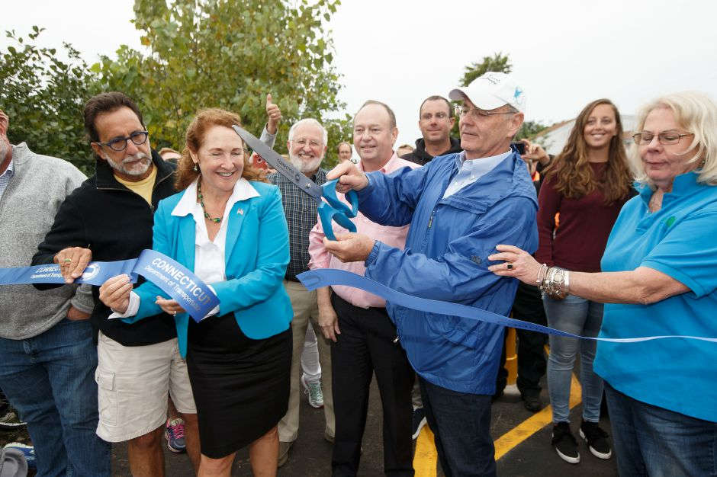
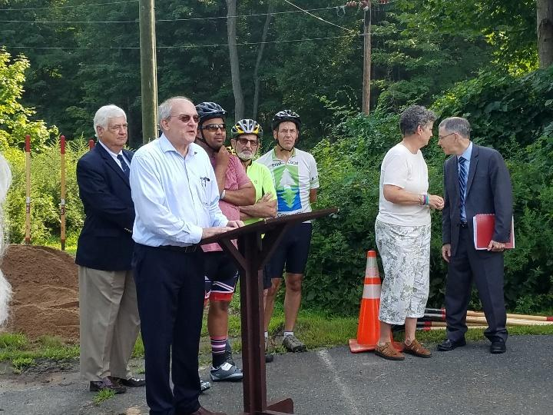
Trail News
Charter Oak/Hop River Greenway Connection Opening likely in Spring 2019
Cheshire section of the FCHT ribbon cutting on September 9
First section of Stanley Park Loop in New Britain is open

Slide 6
Funding News
CRCOG LOTCIP Project Selections Approved by Policy Board:
Rockville Center Complete Streets & Multi-Use Trail
Manchester Multi-Use Trail (Hartford Road and Bidwell)
Marlborough Blackledge River Greenway Trail Phase II
West Hartford New Park Avenue Complete Streets Improvements
New Britain Downtown Complete Streets Improvements
Windsor Locks Downtown Complete Streets Improvement
Coventry South Street Roadway/Pedestrian Improvements
Projects still need to be reviewed by CTDOT for final approval.

Slide 7
Save the Date! Upcoming workshops, Conferences, Events
Transport Hartford Multimodal and Transit Summit –Monday, November 19
2018 Discover Connecticut Bicycle Tour – Sunday, September 30, 2018 in New Britain (starting at Walnut Hill Park) from 8:30am to 2pm
Bike New Britain Community and Educational Center Grand Opening – Tuesday, September 25, 2018 at 4:00pm. 39 Bank Street, New Britain.
Bike Walk CT Fundraiser at Flatbread Company (110 Albany Turnpike #914, Canton) – Tuesday, September 25, 2018 from 5:00pm to 9:00pm
Pedestrian Awareness Event in New Britain – Wednesday, September 26, 2018 from 11:30am to 1:30pm (corner of Main and West Main)
Silver Lane Walking and Biking Audit – Wednesday, September 26, 2018 at 9:00am. Meeting at the Dunkin Donuts at 364 Silver Lane, East Hartford.
Pedal to the Medal Hartford (210 Capitol Ave) – Saturday, October 13 at 3:30am (yes, AM)
Bike Walk CT’s 14th Annual Dinner (CCSU, New Britain) – Friday, November 2, 2018 from 5:30pm to 9:00pm
Night Fall – Saturday, October 6, 2018 – Grounds open at 2pm, show starts at 6pm.

Slide 8
Annual Bike Count
2018 Count Occurred September 10-16
42 volunteers at 51 locations
Count forms are still coming in

Slide 9
Nathan Hale GReenway
Coventry and Bolton

Slide 11
What’s New in your town?
A time to share information around the table.

