Slide 1
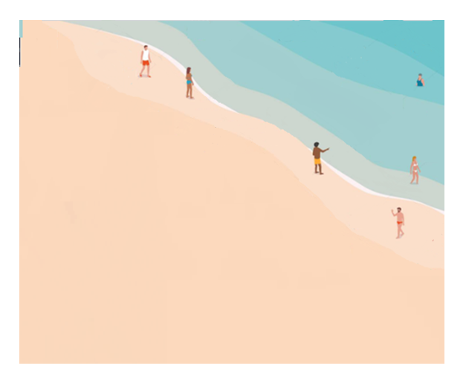

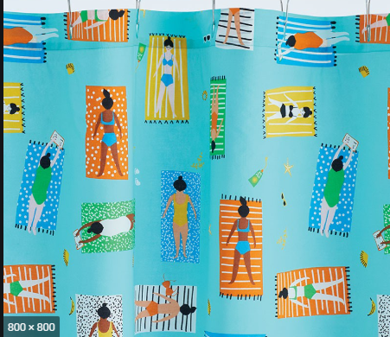
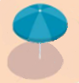

Keep Your Distance
on the Beach!
6’
3 foot Walkway
15 feet
between
blankets
6’
Please:
* Groups of 5 people maximum (immediate family only)
* Masks recommended when moving about
* Keep social distance of 15 feet between blankets & chairs

