Slide 1
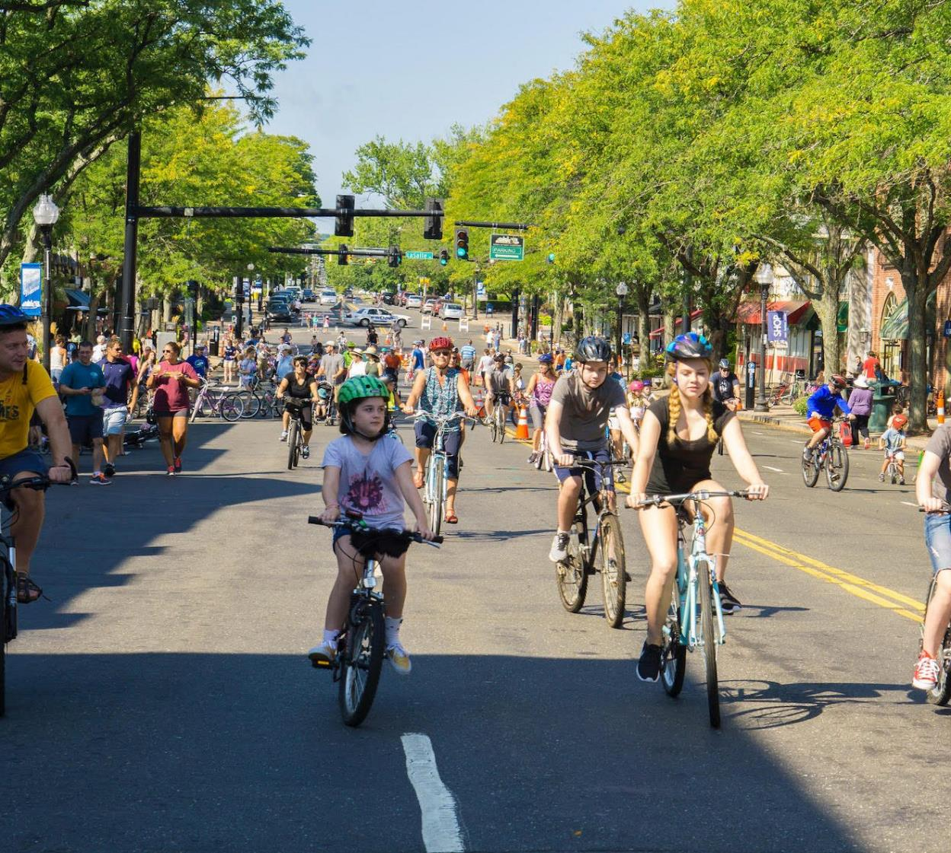
CRCOG
Bikeshare
Feasibility
Study
CRCOG Policy Board Meeting
October 26, 2022
Image Source: Bike West Hartford

Slide 2
Agenda
Background
Study Findings
Implementation Recommendations
Next Steps

Slide 3
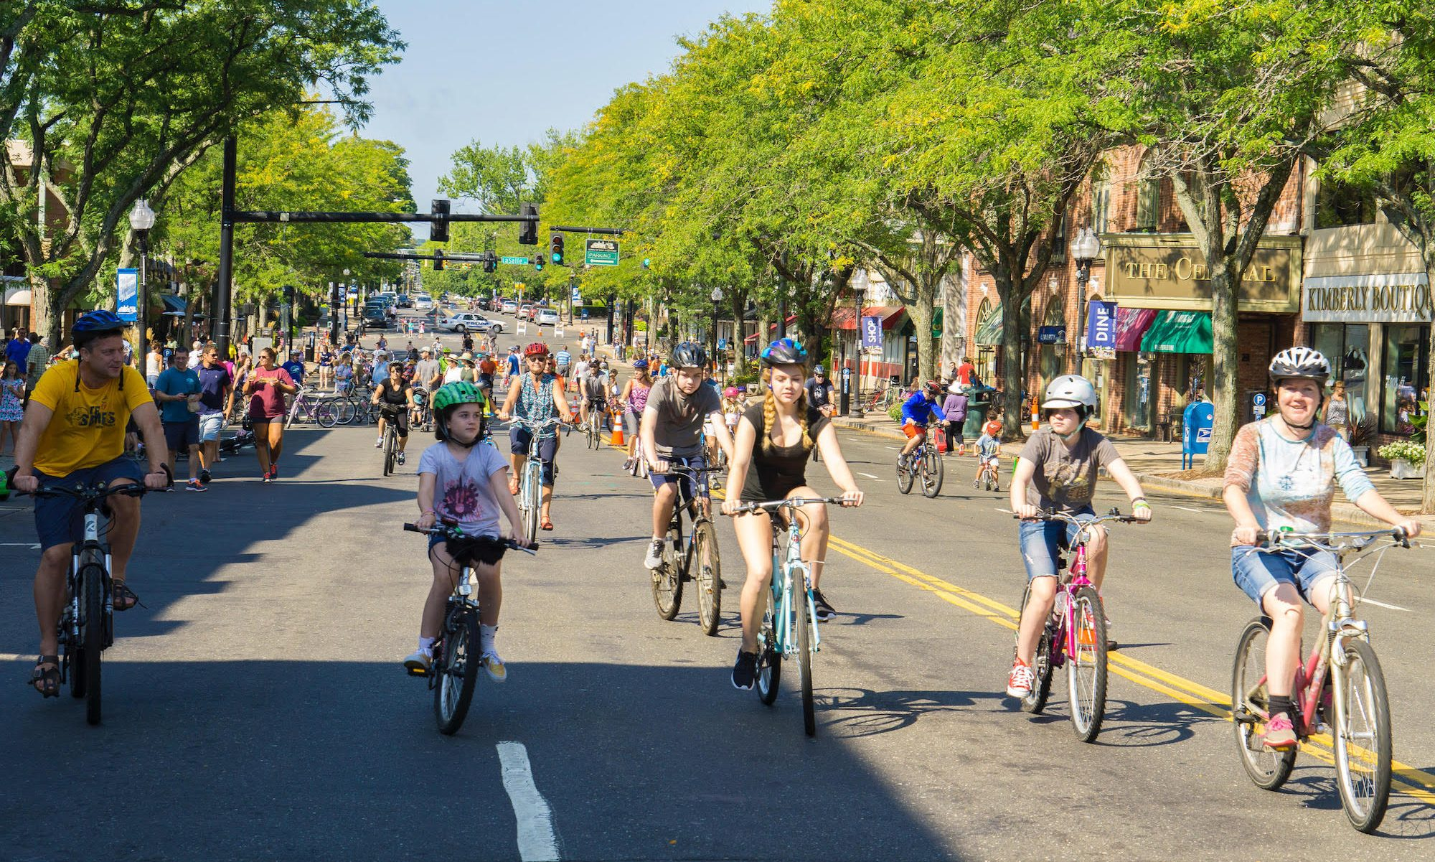
Background
Image Source: Bike West Hartford
Notes:
Andy to present

Slide 4
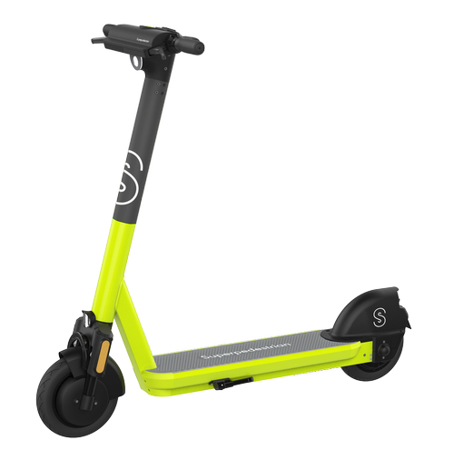
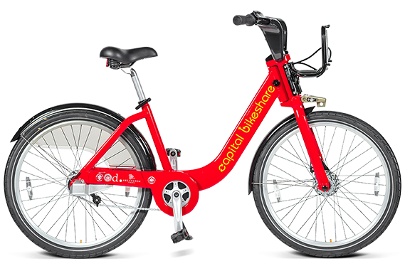
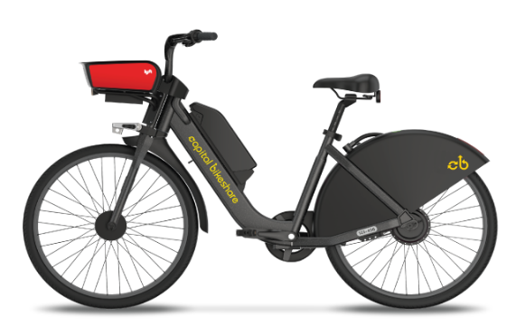
What is Micromobility?
Pedal Bike
E-Bike
E-Scooter
Small, lightweight personal mobility devices that are either self or electrically powered.

Slide 5
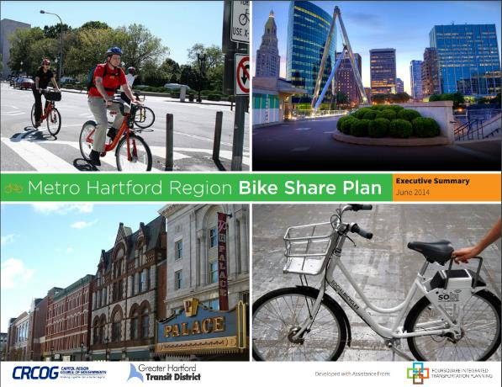
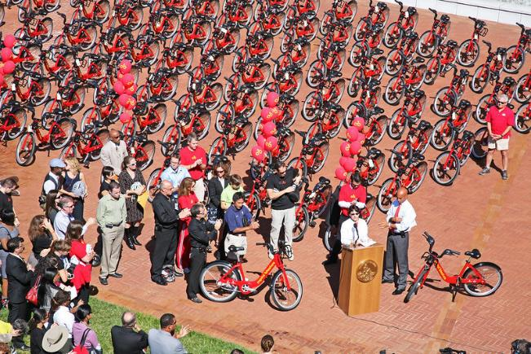
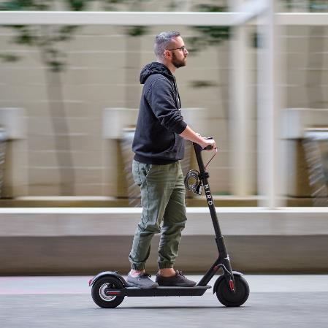
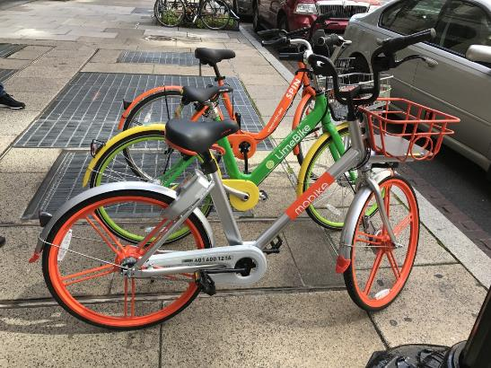
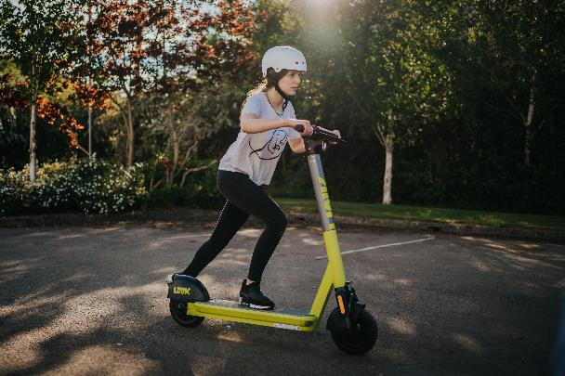
A Rapidly Growing Mode
Bikeshare:
18 million trips
Scootershare:
0 Trips
Bikeshare:
35 million trips
Scootershare:
0 Trips
Bikeshare:
66 million trips
Scootershare:
62 million Trips
2010
2014
2017
2018
2021
First large scale bikeshare programs open in the US
CRCOG completes bikeshare feasibility study
Rapid growth in private dockless bikeshare systems
First scooter programs open
Superpedestrian launches operations in Hartford

Slide 6
Industry Future
Projected Growth
New Modes and Solutions
Regulatory Catch-Up
Global micromobility market forecasted to quadruple in size in the next decade
Urban cargo?
Multi-passenger?
Solutions customized to different climates and speeds?
Introduction of regulatory and oversight structures that can adapt to a changing market
Consolidation and better operations should result in greater market stability
Notes:
Sources: Growth stat: Allied Market Research

Slide 7
Study Intent
Update portions of the 2014 Metro Hartford Bike Share Plan
Investigate the feasibility of a micromobility program for CRCOG's 38 member municipalities
Propose a solution for regional program management

Slide 8


A region where both residents and visitors of all incomes and abilities can travel in a convenient and sustainable way that benefits environmental and personal health.
Vision
To provide a high quality micromobility program that is safe, reliable, affordable, accessible, equitable, and flexible, connecting users to where they want to go.
Mission
Statement

Slide 9
Study Findings
Image Source: Bike West Hartford

Slide 10
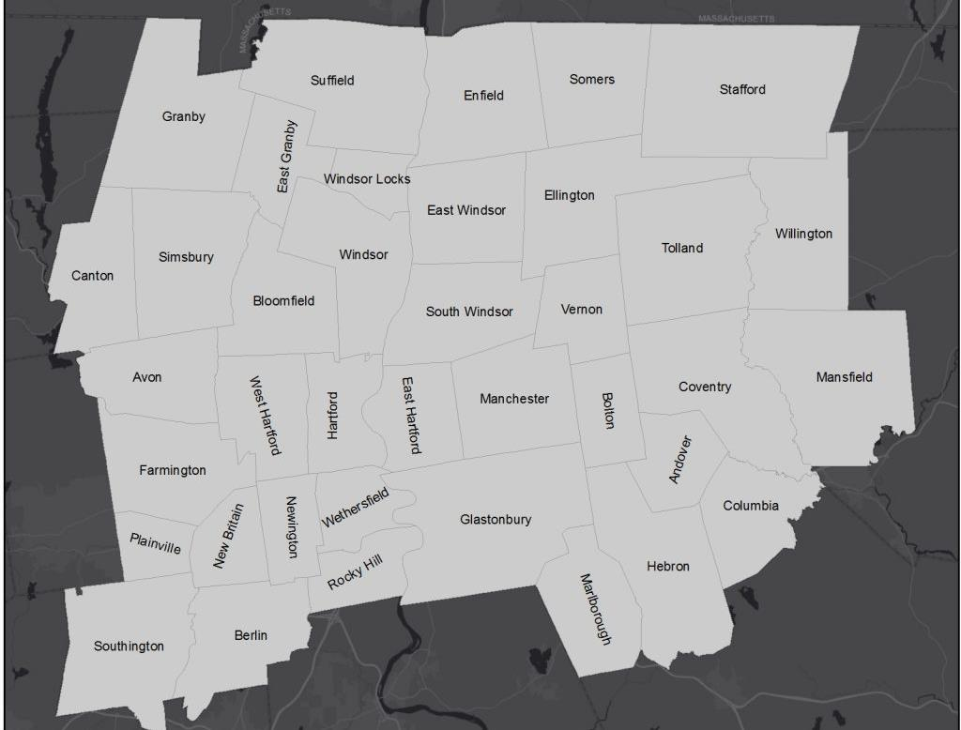
Market Analysis Findings
Community | Vehicle Numbers
Hartford | 500
Storrs/ Mansfield | 100
East Hartford | 100
West Hartford | 125
New Britain | 200
Manchester | 50
East Hartford
Hartford
West Hartford
Manchester
Mansfield (Storrs)
New Britain

Slide 11
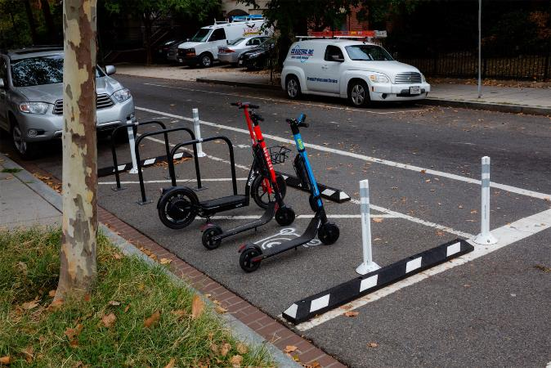
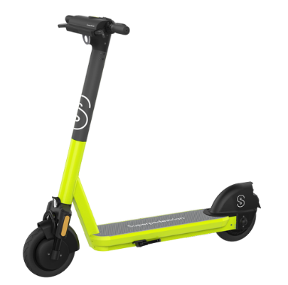
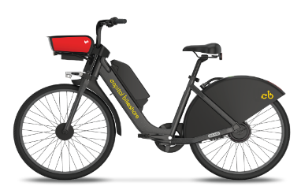
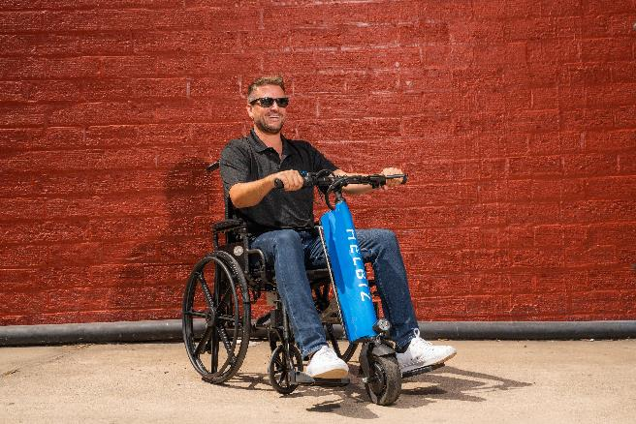
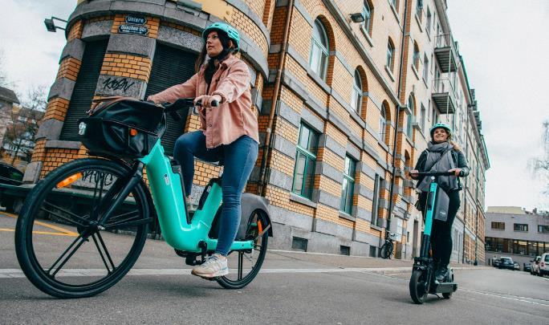
Proposed System Type
E-Bike
E-Scooter
Battery Powered Electric Vehicles
Dockless
Adaptive Options
Privately Owned and Operated

Slide 12
Implementation Recommendations
Image Source: Bike West Hartford

Slide 13
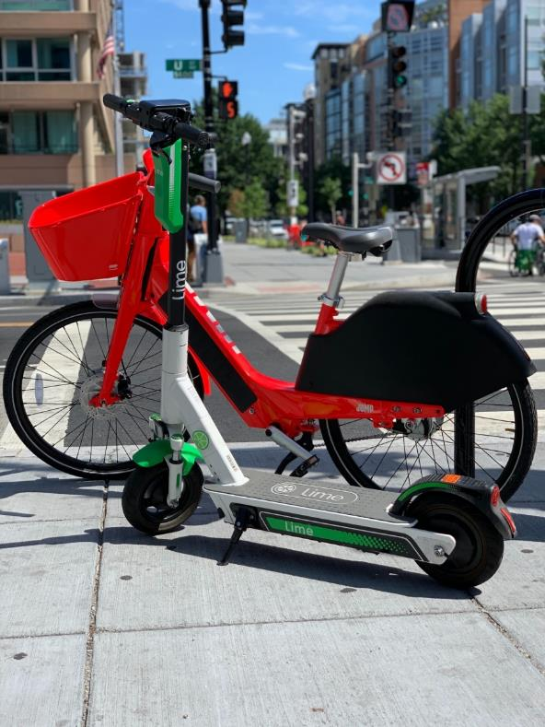
Key Considerations
Builds on successful model seen in Hartford
Removes barriers to travel defined by jurisdiction borders.
Scalable
Minimizes public liability, cost, and risk exposure
Reduces burden on individual jurisdictions
Creates greater predictability for operator

Slide 14




Recommendation: Pilot a Regional “Mobility Collective”
Governed by a Committee Consisting of Participating Jurisdictions
Centrally Managed by Program Manager
Limited-Period Pilot Program
RFP Procurement of Vendor
Notes:
Mention here that we looked at other models but ultimately focused on this one.

Slide 15
Centralized Program Manager
Primary Responsibilities | Secondary Responsibilities
Pre-Procurement | Program Monitoring and Data Management: Act as central repository for micromobility data and reply to data requires from stakeholders. Support reporting and program monitoring. Procure monitoring software for the system.
Procurement: Develop and execute the procurement of one or more program operators | Marking and Community Engagement: Lead marketing and engagement or supplement work being dome by program operator. Range of functions from equity-focused community engagement to integration of micromobility into existing transportation demand management activities.
Coordination: Establish a forum for participating jurisdictions to help participants come to collective decisions | System Planning: Support siting of micromobility hubs or stations. Work with jurisdictions on planning and implementing supporting infrastructure.
Contract Management: Manage operator contracts and serve as a centralized point-of-contact for the vendor | Fundraising and Grant Management: Prepare grant applications and manage received grants. Oversee acquisition of sponsors and advertisers.
Manage Issues: Act as an interface between the operator and jurisdictions if any operating issues arise. Work with the operator to resolve issues.
Public Communication: Limited public engagement related to the core function of the program, such as attending public meetings at the behest of jurisdictions, drafting press releases, and managing press inquiries.
Resources Needed
Where would it be housed?
Key Responsibility
Estimated as 1 Full-Time Equivalent (FTE) staff person
Variety of options identified. CRCOG is one potential organization but not the only one
Interjurisdictional facilitation
Procurement
Contract management
Public communication
Program monitoring
Grant management

Slide 16
Program Cost
Limited direct costs for the jurisdictions
  Private provider bears the cost of the equipment and day to day operations
  Public entity provides oversight and enforcement to a limited degree
Permitting fees can provide some revenues for the jurisdictions, but level of fees is a negotiating point for the Collective
Need to determine how we can utilize public money for such a program.
  Public funding for:
    Infrastructure (bike lanes or mobility hubs)
    Equity programs and passes
    Directly subsidize operations (e.g., guaranteed minimum revenue)
  Question to resolve: legality of subsidizing private operators?

Slide 17
Next Steps
Image Source: Bike West Hartford

Slide 18
Implementation Process
Identify program manager
Define pilot geography and est. governance committee
Establish committee bylaws, ILAs, and management processes
Identify seed funding for program
Finalize program requirements and procure vendor

Slide 19
Outstanding Issues
Who will be the lead entity in the mobility collective?
Will there be a single operator or multiple?
Which communities are willing to join the collective?
Are there mechanisms to use public funding for a private system?

Slide 20

Discussion
Do you have any remaining questions for us?

Slide 21

Thank
You.
You.

Slide 22
Insert photo here…
Full half page,
Multiple, etc.
DON’T FORGET TO
DELETE THIS TEXT
BOX THOUGH!
Title of this page
Caption you photo here. Remember to credit your image if applicable.

Slide 23
Staff Capacity
Implementing a micromobility program requires commitment and involvement from staff to manage the day-to-day of the program
Responsibilities can vary based on the collective needs of the system
Program management and administration responsibilities can be delegated to one person or spread across multiple staff people
The time commitment needed by program staff grows as responsibilities expand, but is usually limited one full-time equivalent (FTE) of staff resources
A regional micromobility program typically requires the equivalent on one FTE to manage the day-to-day operations of the program and coordination with the program operator. Responsibilities can be shared across jurisdictions or delegated to one FTE.

Slide 24
Safety Concerns
Micromobility services bring with them a certain amount of risk for both users of these services and the public
Safety requirements, such as helmet use, are difficult to implement and enforce
System users have personal responsibility to ride safely
Improvements in technology have helped address some safety issues
  Geofencing technology can enforce speed limits, slow zones, no-ride zones, and no-parking zones
Infrastructure, like bike lanes, can help limit interactions between micromobility users and cars and micromobility users and pedestrians
A regional system should incorporate the latest technologies to regulate where and how fast users should ride. Any operator should have an adequate insurance policy and indemnify host jurisdictions of liability. User engagement can increase awareness of safe rider practices.

Slide 25
Liability Concerns
Most micromobility operators indemnify host jurisdictions of liability in case of accident, injury, or insurance claims
Minimum acceptable insurance levels varies by state and local codes, but usually includes:
  General Liability Insurance
  Hired and Non-Owned Auto Insurance
  Umbrella Insurance

Slide 26
Secondary Approach
Regional Publicly-Owned Bikeshare
Public ownership and control of the system
Requires guaranteed funding for capital and operating needs form system owner
Assumed to be limited to bikeshare as there are few peer examples of publicly owned scootershare programs
Typically third-party vendor operates system for a fee.
Vendor indemnifies public owner of liability

Slide 27
Equity Considerations
Barrier | Definition | Solution
Physical Barriers | Such as when there are not enough vehicles located in equity areas or not sufficient bike or pedestrian infrastructure in equity areas | Ensure vehicles and stations are located in a diverse range of neighborhoods
Cost Barriers | Lower-income users tend to be more price sensitive than higher-income users | Subsidize the price for all users or make available discounted fares for low-income individuals (often tied to state or federal assistance programs)
Payment System Barriers | Some equity populations are less likely to have access to a smartphone or credit card to use app-based micromobility | Ensure system is accessible without access to a credit card by allowing payment through other platforms
Knowledge Barriers | A lack of familiarity with the system itself or the ability to ride a standard bike or scooter. | Ensure the public is aware of the system and knows how to use it. Establish a program of system ambassadors and support rider education.
Incorporate equity and accessibility requirements into a micromobility program’s regulatory framework and agreements with vendors. The success of the existing program in Hartford is a good match to expand on.

Slide 28
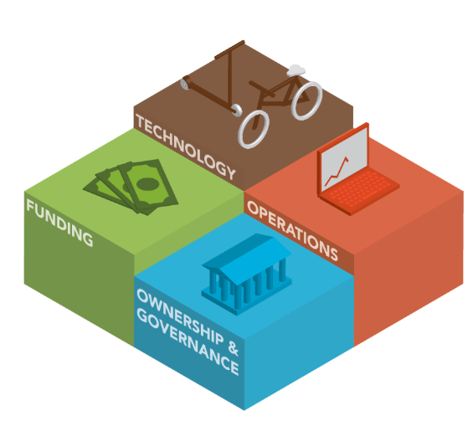
Micromobility Business Models
Technology
What type of vehicles and stations will be used?
What method is used by riders to access equipment?
What kind of technology is used to monitor the program?
Operations
How are program operations structured?
Is the program operated by the program owner, or is a third-party responsible for day-to-day operations?
Ownership and Governance
Who owns the equipment and holds the financial risk?
Who is responsible for oversight and decision making, including system size, operating structure, and user costs?
What ownership model will be used (for-profit, public, or non-profit)?
Will the system be directly operated or contracted out to a third party?
Funding
How are operations and capital costs funded?
What are the program funding needs?

Slide 29
Proposed: Regional Mobility Collective
Technology
Scooters and e-bikes
Operations
  Private operator selected through competitive procurement
Ownership and Governance
Capital assets owned by private operator
Region collectively manages program. Pools resources for program oversight and contract management
Funding
Private capital for equipment
User revenue
Targeted public funding

Slide 30
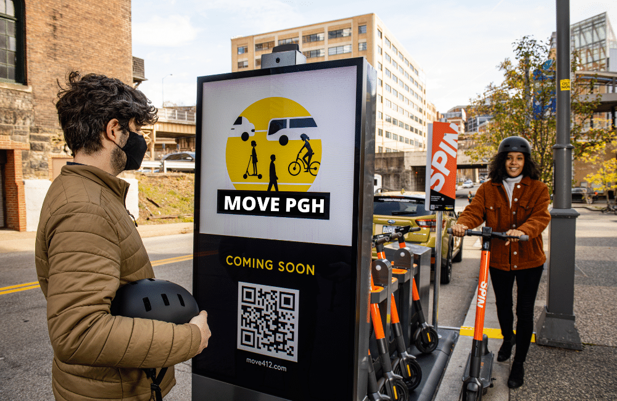

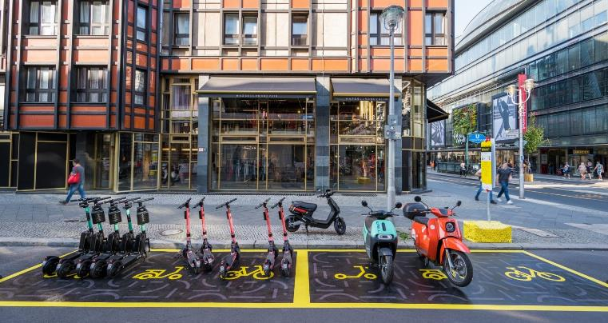
Regulatory Framework
Governed by participating jurisdictions
Harmonized permit program with jurisdictions.
Collective negotiation with operator(s)
Collective can determine program features, such as:
  Cap on number of operators
  Limitations on vehicle types (e.g., e-bikes, and scooters only)
  Oversight and enforcement expectations
  Data sharing requirements
  Permitting fees
  Parking and station/hub requirements and locations

Slide 31
Contents
Use to highlight text heavy content. You can adjust columns and font size as needed. Don’t forget to delete this box.
Gitat remolup iendias iminul lorem ut accum alitat fugiti do-lorem fugia quia cora dolorit
Con et volupicietur sandiciae re magnatios con res unt, con exerrume vollupta vollupta voloremquo molelaborepe mol-laborepe ver-ferem sitiore poressi tor artiae non ese et ium quaest, simi, qui sum et late.
Gitat remolup iendias iminul lorem ut accum alitat fugiti do-lorem fugia quia cora dolorit
Con et volupicietur sandiciae re magnatios con res unt, con exerrume vollupta vollupta voloremquo molelaborepe mol-laborepe ver-ferem sitiore poressi tor artiae non ese et ium quaest, simi, qui sum et late.
Gitat remolup iendias iminul lorem ut accum alitat fugiti do-lorem fugia quia cora dolorit
Con et volupicietur sandiciae re magnatios con res unt, con exerrume vollupta vollupta voloremquo molelaborepe mol-laborepe ver-ferem sitiore poressi tor artiae non ese et ium quaest, simi, qui sum et late.
Gitat remolup iendias iminul lorem ut accum alitat fugiti do-lorem fugia quia cora dolorit
Con et volupicietur sandiciae re magnatios con res unt, con exerrume vollupta vollupta voloremquo molelaborepe mol-laborepe ver-ferem sitiore poressi tor artiae non ese et ium quaest, simi, qui sum et late.

Slide 32
[place and image here]
DON’T FORGET TO
DELETE THIS TEXT
BOX THOUGH!
What’s this page going to be about…
There are two
Columns here to automate spacing between rows of text. Can use like bullets with one “idea” per column or continuous “paragraph format.
Alibus adio.
Optaturiam ratem
Aut anda venim
Volorum quation ea ventia voloreptate
Solorrum cori
Consentotat.

Slide 33
Page contents
Place images/graphics above the line. Caption your photo or add description below the line. Remember to credit your image if applicable.
Alternatively, can treat these like bullet points.
Also, a great option for speaker photos/names, etc.

Slide 34
[place image here]
What’s this page going to be
about…
[place image here]
You’ve caught their attention with bold text, additional
Supporting text can go here. Size 24 font recommended, do not go smaller than 20.
[place image here]

Slide 35
Have charts or maps? Before/after comparisons? Remember to
Format your graphs. Etc., with CRCOG colors.
Title or caption for your
map/graph
Title or caption for your
map/graph

Slide 36
[place image here]
What’s this page going to be
about…
[place image here]
You’ve caught their attention with bold text, additional
Supporting text can go here. Size 24 font recommended, do not go smaller than 20.
[place image here]

Slide 37
What’s this page going to be
about…
Need to say a little bit more and the caption text is too small of an option? Place it here.
[place image here]
[place image here]
[place image here]
Gitat remolup iendias iminullorem ut accum alitiat fugiti dolorem tiae non esed et ium quaest, simi, qui sum
Gitat remolup iendias iminullorem ut accum alitiat fugiti dolorem tiae non esed et ium quaest, simi, qui sum
Gitat remolup iendias iminullorem ut accum alitiat fugiti dolorem tiae non esed et ium quaest, simi, qui sum

