Slide 1
Regional Planning Commission
Welcome to a CRCOG Zoom Meeting
We have muted attendees upon entrance. We will unmute people either individually or for everyone depending on the situation.
For our public meetings, we will be taking a roll-call of attendance based on who we identify as being on the call and then ask those we cannot identify to state their name and town.
Each time you speak, you must identify yourself with your name and town prior to making your point.
If you are abstaining or objecting to an action item, please state your name and town.
Meeting materials are available at CRCOG.org

Slide 2
Regional Planning Commission
Welcome and Introductions
Adoption of Minutes: November 17, 2022(posted)
Public Act 21-29 Regional Survey
Land Use Commissioner Training Discussion
Presentation – Regional Plan of Conversation and Development update and process
Report on Zoning & Subdivision Referrals
What's New in My Town
Other Business

Slide 3
1. Welcome & Introductions

Slide 4
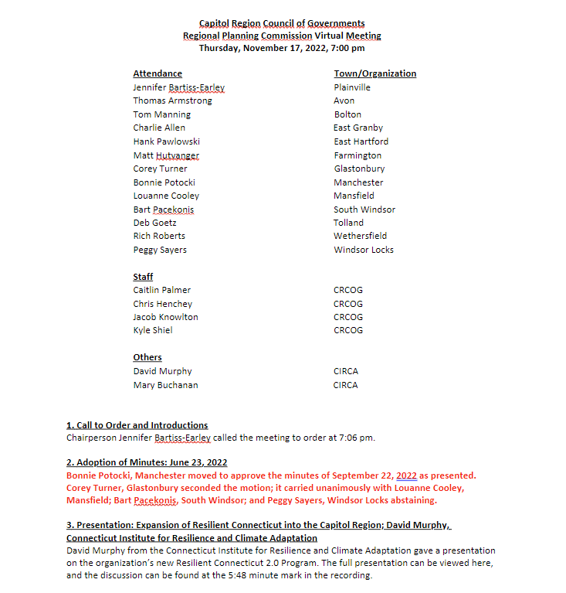
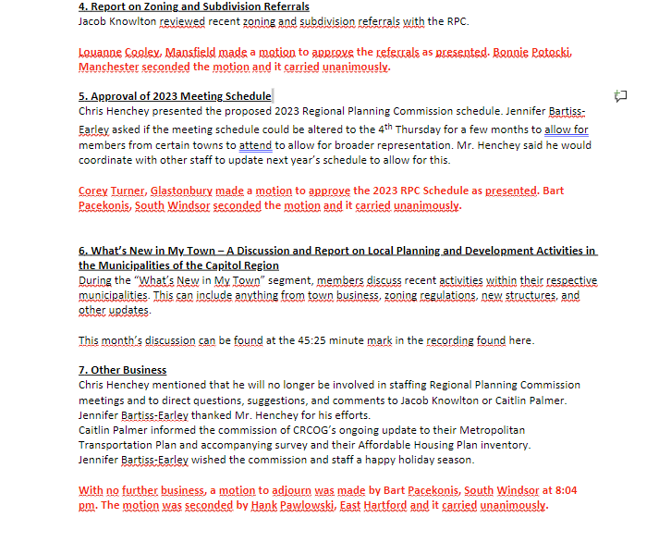
2. Adoption of Minutes: 11/17/2022

Slide 5
Public Act 21-29 Municipal Opt-Out Responses
3.
March 2023

Slide 6
Public Act 21-29
Full Name: “An Act Concerning the Zoning Enabling Act, Accessory Apartments, Training for Certain Land Use Officials, Municipal Affordable Housing Plans And a Commission On Connecticut’s Development and Future.”
Contained numerous land use reforms, including new requirements* for:
Accessory Dwelling Units
Parking Minimums
Land Use Commissioner training
*Statute provided option for municipal opt-out

Slide 7
Survey
Determine how communities across the Capitol Region approached municipal opt-out provisions
Sent to all area planning directors late December-early January

Slide 8
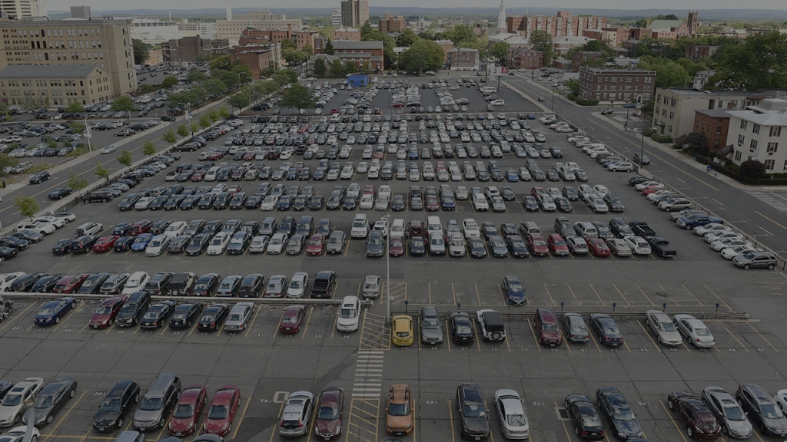
Parking
Reduced parking requirements: PA 21-29 requires that zoning must not require parking in excess of 1 space per studio or 1-bedroom unit, or 2 spaces for larger housing units.
A municipality may opt out of this requirement.

Slide 9
Parking
Many municipalities already have similar standards
Several have reduced parking minimums even further than the bill requirements
“Current regulations of our community go beyond the provisions of PA 21-29 in terms of reducing parking requirements.”
-Somers

Slide 10
Accessory Dwelling Units
Accessory Dwelling Units: PA 21-29 establishes default provisions that allow construction of Accessory Dwelling Units (ADUs) on lots accompanying single-family homes, unless a municipality chooses to opt-out of this provision by January 1, 2023.
Has your community chosen to:
Opt-Out
Opt-In (or take no action)

Slide 11
Accessory Dwelling Units
22 Communities Opted-Out
Andover
Avon
Berlin
Bloomfield
Bolton
East Granby
East Hartford
Enfield
Farmington
Glastonbury
Granby
Mansfield
New Britain
Newington
Plainville
Simsbury
Somers
South Windsor
Southington
Stafford
Windsor Locks
Willington

Slide 12
ADU Opt-Outs
Nearly all opt-out communities allow ADUs in some form
Preference to develop own local regulations
Primary concerns:
Small lot sizes
Wanted to maintain Special Exception/Permit process
Concerns about detached units

Slide 13
ADU Opt-Outs - Comments
“Our community drafted our own customized ADU ordinance to encourage construction of in-law-style units and prohibit stand-alone structures; our average single-family lot size is significantly smaller than 95% of the municipalities in CT and the community felt that stand-alone structures were inappropriate on small single-family lots.”
-New Britain
“The Commission decided to change their regulations which are more in line with the provisions outlined in PA 21-29 but wanted to continue to require special permit approval for detached apartments (attached is permitted by right).”
-Granby
“The PZC believed that we had certain high-density neighborhoods that the ADUs would not properly fit into.
We are going to be re-writing our zoning regulations, and plan on allowing ADUS in certain areas.”
-Enfield
“Bloomfield has strict regulations at the moment, but wants to create more relaxed customized regulations, without being bound to the state statutes.”
-Bloomfield

Slide 14
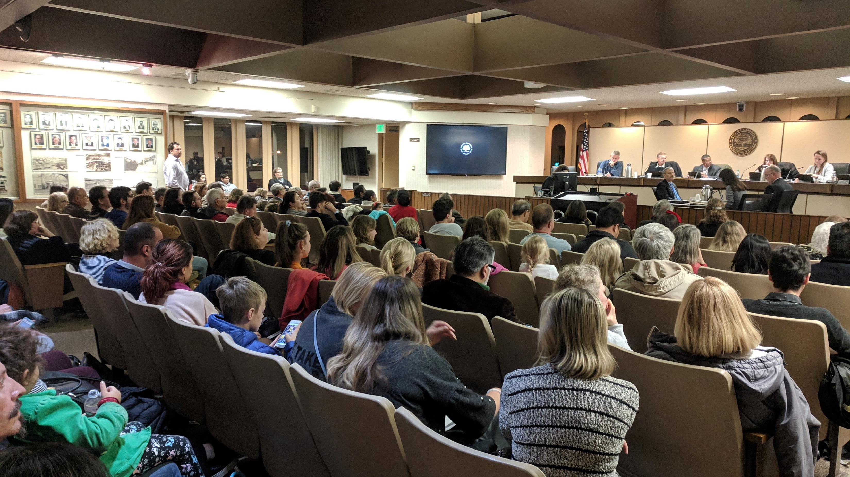
4. Land Use Commissioner training
Commissioner Training Requirements: PA 21-29 establishes ongoing training requirements for land use commissioners. Beginning January 1, 2023, each member of a land use commission shall complete at least four (4) hours of training. At least one hour must address affordable and fair housing policies
Asked which category of training would be most helpful:
Process & Procedures (Commissioner Roles & Responsibilities)
Site Plans, Surveys, Maps & Architectural Conventions (Reading & Interpreting Maps)
Environment, Agriculture, & Historic Resources

Slide 15
Land Use Commissioner training

Slide 16
Land Use Commissioner training - Comments
“I'm concerned about commissioners doing the training. Convenience is key. If training is offered online and commissioners can complete it at their own pace I think it would most beneficial.”
“Public volunteers serving on these boards have considerable authority and influence over private property rights. Training is warranted.”
“We have no budget to accomplish this in time to meet the mandated requirements and fear attrition on an already short staffed commission if additional evenings or weekends are required for training purposes.”
“It would be helpful to provide a more detailed training on special permit/site plan applications and what discretion the Commission has when voting.”

Slide 17
5.
POCD 2024
Update

Slide 18
State Growth Principles
Growth Principle #1
Redevelop and Revitalize Regional Centers and Areas with Existing or Currently Planned Physical Infrastructure
Growth Principle #2
Expand Housing Opportunities and Design Choices to Accommodate a Variety of Household Types and Needs
Growth Principle #3
Concentrate Development around Transportation Nodes and Along Major Transportation Corridors to Support the Viability of Transportation Options
Growth Principle #4
Conserve and Restore the Natural Environment, Cultural and Historical Resources, and Traditional Rural Lands
Growth Principle #5
Protect and Ensure the Integrity of Environmental Assets Critical to Public Health and Safety
Growth Principle #6
Promote Integrated Planning across all Levels of Government to Address Issues on a Statewide, Regional, and Local Basis

Slide 19
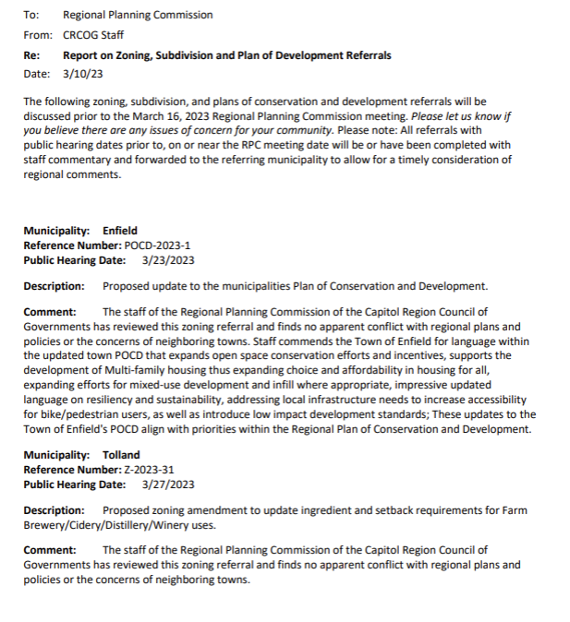
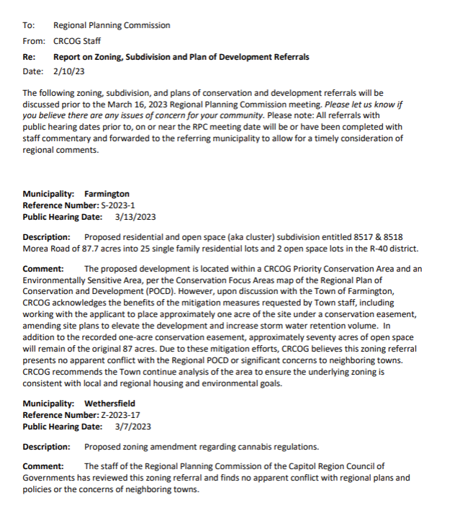
6. Report on Zoning and Subdivision Referrals
Notes:
Enfield: Utalized the sustainability triangle to form a resiliency chapter with language that was extremely validating of the human experience, covering equity very well: I'm excited to see how it applies to their land-use decisions in the future.

Slide 20
7. What’s New in My Town

Slide 21
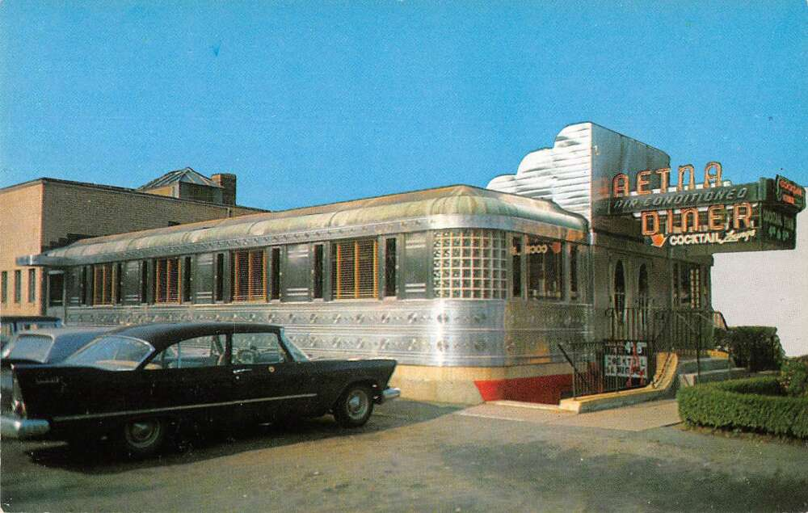
8. Other Business

