Slide 1
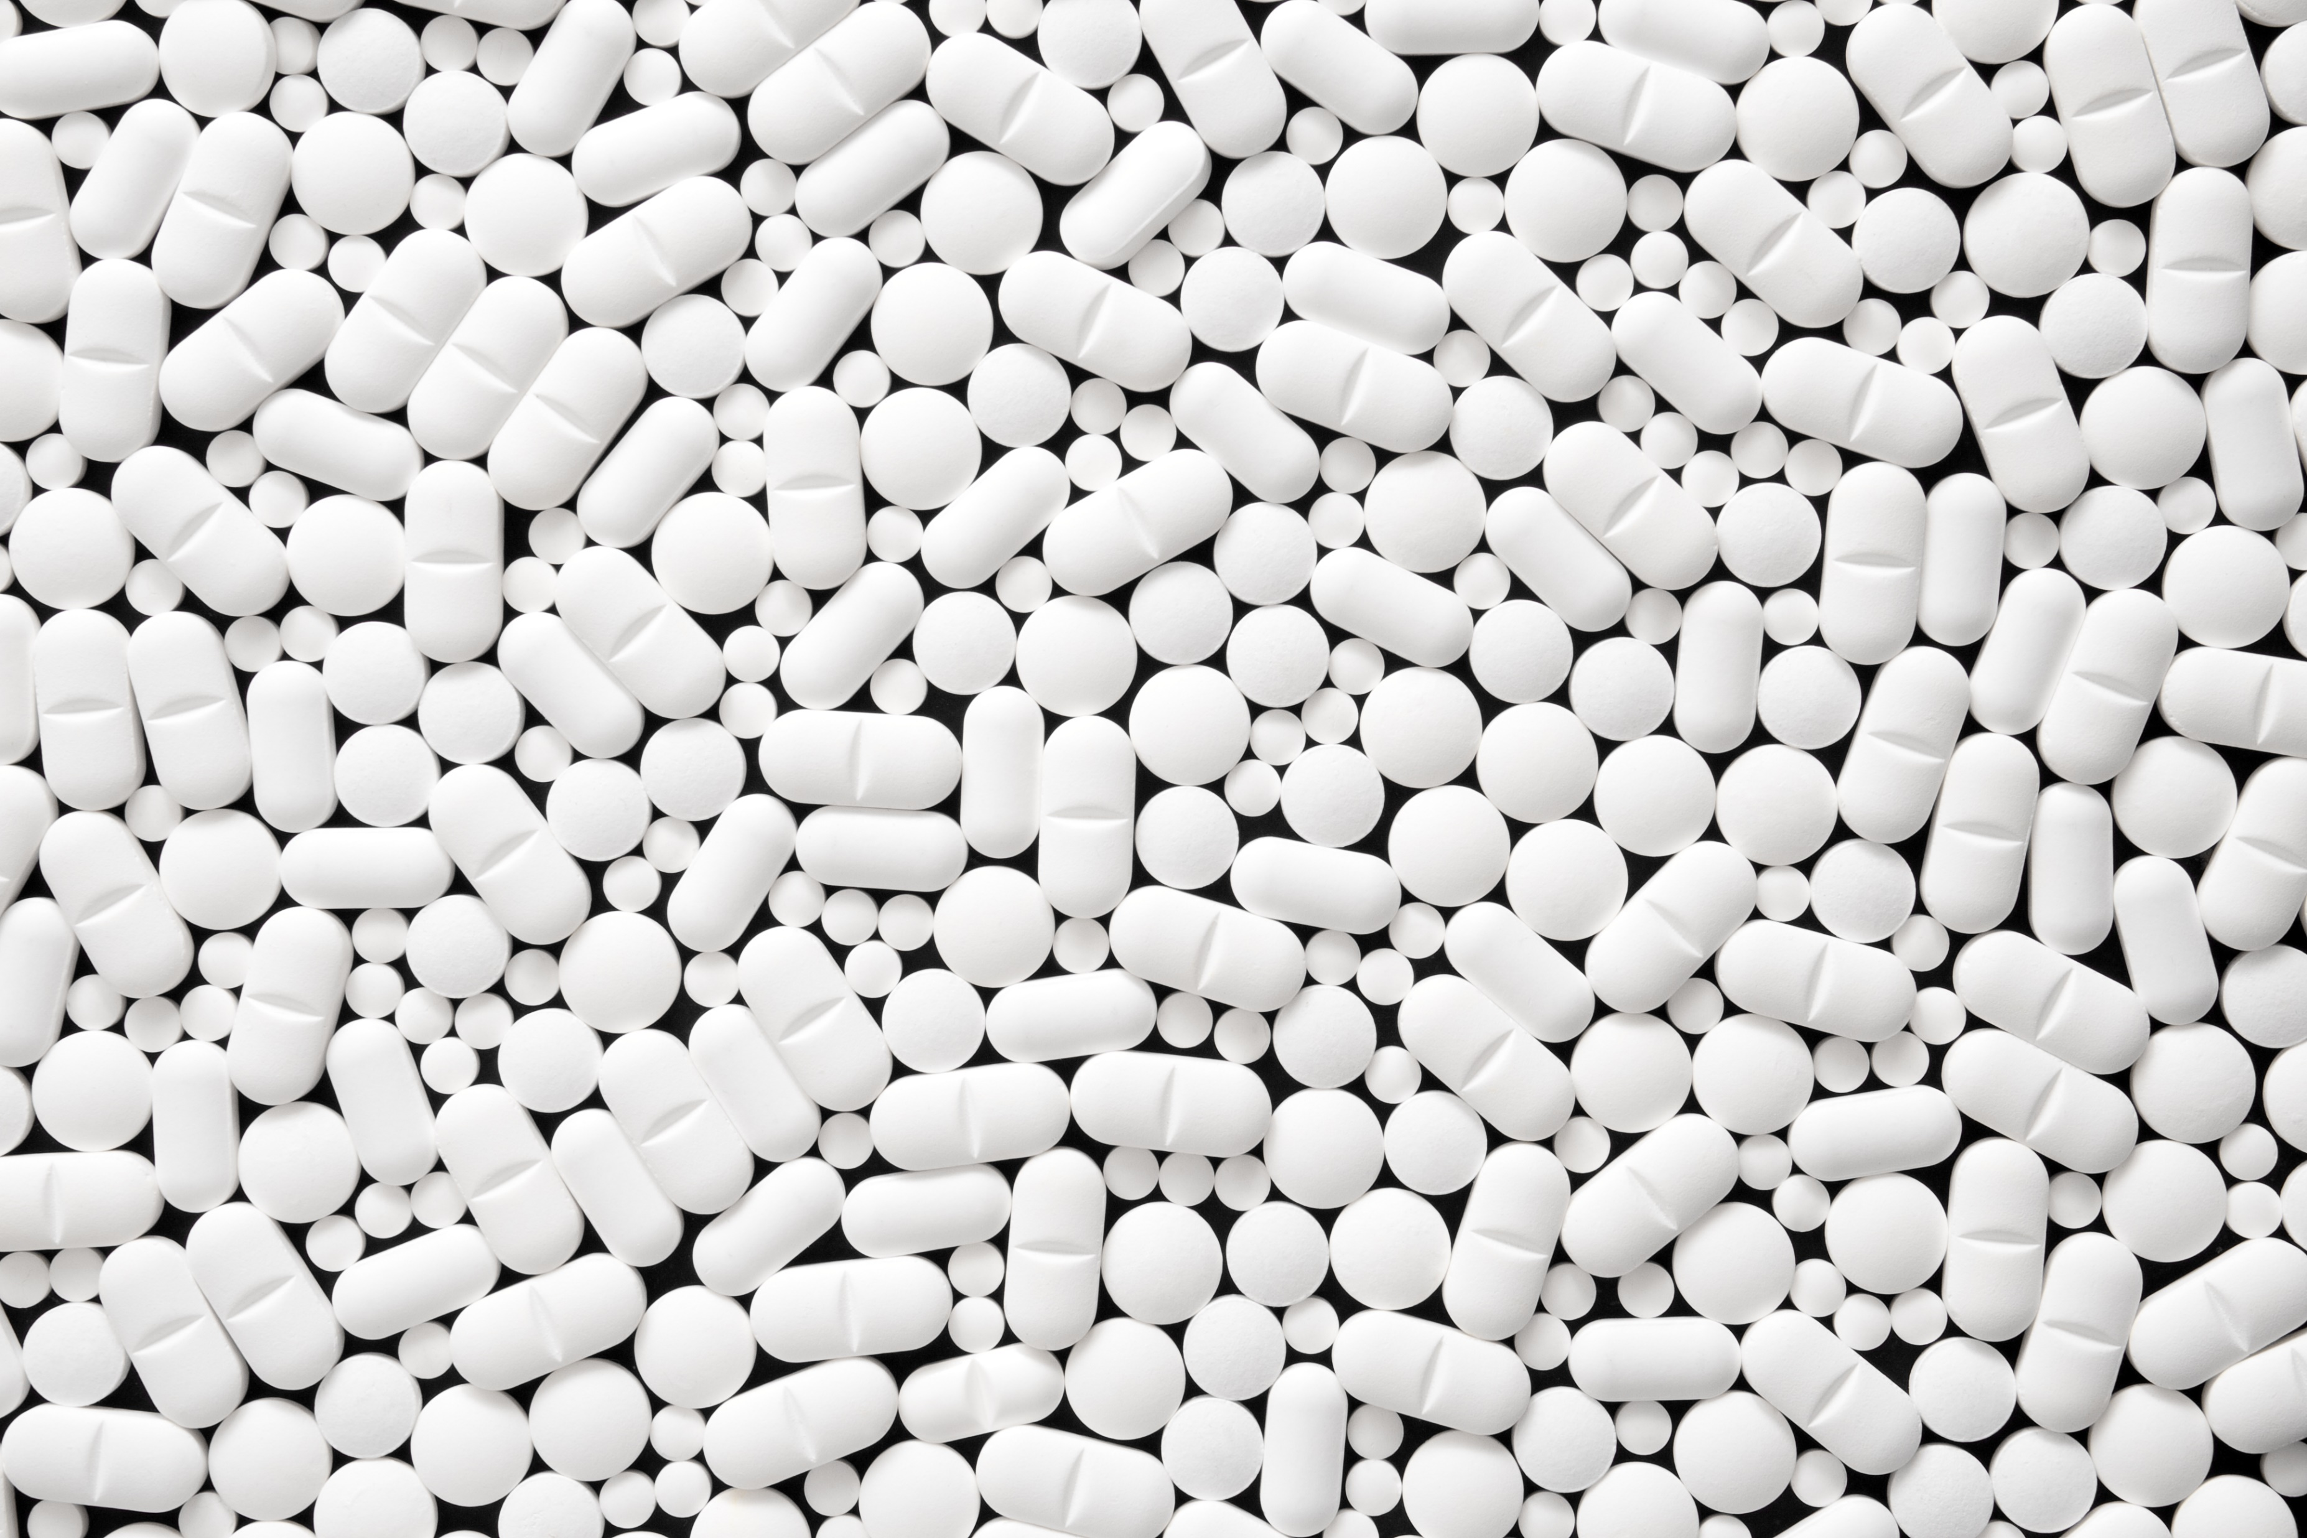
Human Services Coordinating Council
(HSCC)
The Opioid Settlement and how it impacts programs and services in your community
June 27th, 2023
Notes:
Task II - Short Term Disposal and Diversion Options/Strategies (1 to 5 yrs.) and Next Steps

Slide 2
Today’s Agenda
Call to Order
Welcome and Introductions
Public Comment
Discussion - Opioid Settlements in CT
CLASS – Cindy Guerreri, MSW – Director of Social Services, Enfield, CT
CT Attorney General’s Office – Matthew Fitzsimmons, CIPP/US, Chief Counsel
Amplify – Allyson Nadeau, MPA, Executive Director
Q&A
Establishment of Meeting Schedule
Information Sharing
Next Steps
Adjournment

Slide 3
1. Call to Order

Slide 4
2. Welcome and Introductions

Slide 5
3. Public Comment

Slide 6
4. Guest Speaker Panel Discussion
Cindy Guerreri, MSW
CLASS (CT Local Administrators of Social Services), President
Matthew Fitzsimmons, CIPP
Chief Counsel, Office of CT Attorney General
Allyson Nadeau, MPA
Executive Director, Amplify, Inc.

Slide 7
Guest Speaker
Cindy Guerreri, MSW
CLASS (CT Local Administrators of Social Services), President
Enfield Department of Social Services Director of Social Services Phone: 860-253-6394
E-Mail: cguerreri@enfield.org
OUR VISION A community where residents' health, safety, and stability is assured

Slide 8
What is CLASS?
Connecticut Local Administrators of Social Services that unites professionals from Connecticut towns, cities, and organizations to:
Goal: Improve social services for all residents in the State by providing direct service and advocacy
Mission: Support municipal social workers with the resources and tools they need to build safer, healthier and more secure communities
Membership: All social services personnel from municipalities, organizations, and charities in Connecticut are welcome to become members
http://a20.af0.myftpupload.com/wp-content/uploads/2021/05/Membership-Application-FY-2020-2021-.pdf

Slide 9
CLASS ORGANIZATIONAL STRUCTURE
Executive Board
OFFICERS & CHAIRS
Governance NOMINATING/BYLAWS
Marketing & Communications TECHNOLOGY/WEB/ SOCIAL MEDIA PLATFORMS
Membership RECRUIT/TRAIN/RETAIN
Policy
LEGISLATION
Professional Development PROGRAMS/TRAININGS/ANNUAL CONFERENCE

Slide 10
CLASS Executive Board - Officers

Slide 11
Guest Speaker
Matthew Fitzsimmons
Chief Counsel, Office of CT Attorney General
165 Capitol Ave, Hartford, CT 06106 Office: +1 860-808-5318
Direct: +1 860-808-5004
Fax: +1 860-808-5387
URL: https://ct.gov/ag/
E-Mail: Matthew.Fitzsimmons@ct.gov

Slide 12
4. Discussion - Opioid Settlements in CT
Over $50 billion nationwide to fight the opioid epidemic to date
CT to receive more than $600 million to date
Funds come from multitude of settlements
Funds to be distributed over varying periods (e.g., 2 to 18 yr. annual distributions)
Funds to be used for opioid remediation, including expanding access to opioid use disorder prevention, intervention, treatment, and recovery.
Fifteen percent (15%) of the non-bankruptcy settlement funds go directly to cities and towns
Remaining 85 percent (85%) goes to State of CT

Slide 13
4. CT Opioid Settlement Advisory Committee (OSAC)
Act establishes a new Advisory Committee (co-chaired by DMHAS and municipal reps) to manage opioid fund allocations
https://cga.ct.gov/2022/ACT/PA/PDF/2022PA-00048-R00HB-05044-PA.PDF
Proceed Uses:
substance use disorder abatement infrastructure, programs, services, supports
resources for prevention, treatment, recovery, and harm reduction
Addtl. uses TBD by municipal needs

Slide 14
4. Opioid Settlement Amounts
Settlement | Global Value | Total CT Settlement Value | Payment Made to State of CT (Feb. 2023) – not including direct payments to municipalities | Next Payment Amount
Distributors | $21.1B | $240M over 17 yrs. | $25.5M | 6/2023 - $11M
Sacklers | $271M | $21.1M over 15 yrs. | $0 | TBD
McKinsey | $573M | $7.5M over 5 yrs. | $6.8M | 4/24 - $321K
Janssen | $5B | TBD (approx. 57M over 9 yrs.) | $43.1M | 2026
Purdue | $6B | TBD (up to $72M over 18 yrs.) | $0 | TBD
Mallinckrodt | $1.6B | $13.9 over 9 yrs. | $1.9M | 2024
CVS | $5B | $62M over 10 yrs. | $0 | 2023
Walgreens | $5.7B | $67M over 15 yrs. | $0 | 2023
Walmart | $3.1B | $45M over 2 yrs. | $0 | 2023
Teva | $4.25B | $47M over 13 yrs. | $0 | 2023
Allergen | $3.7B | $28M over 7 yrs. | $0 | 2023
Endo |  | $6M | $0 | 2023
NOTE: Total amounts are estimates of maximum recovery, dependent upon variables such as nationwide participation, participation of municipalities, and sale of international companies. Addtl. factors could impact amounts listed here, including required court approvals.

Slide 15
4. Opioid Settlement Information
CT Attorney General’s Office, Governor’s Opioid Settlement Advisory Committee, and other organizations providing information and assistance on opioid settlement funding and distribution
https://portal.ct.gov/AG/General/opioidsettlement
National Opioid Settlement Info. (please see Appendix)
CRCOG Member Town Approx. Distributions & % (please see Appendix)

Slide 16
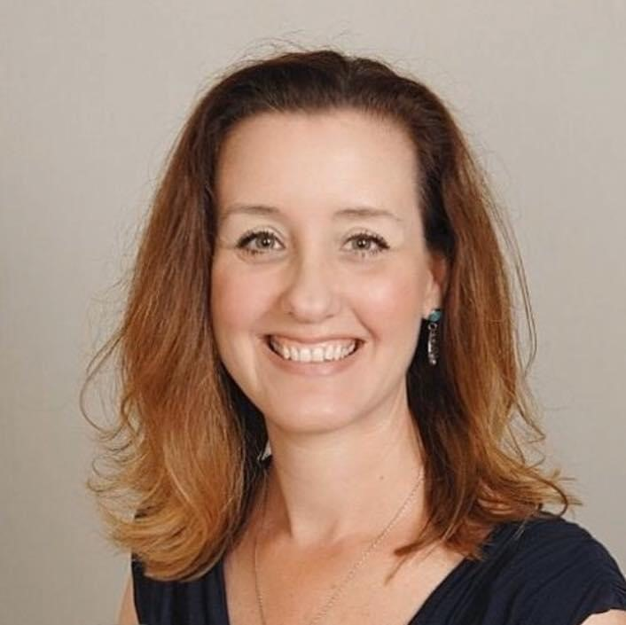
GUEST SPEAKER
Allyson Nadeau, MPA
Executive Director, Amplify, Inc.
178 Oakwood Drive
Glastonbury, CT 06033
Phone: (860) 267-5439
(860) Amp-lify
Web: amplifyct.org
E-Mail: anadeau@amplifyct.org

Slide 17
What is Amplify, Inc.?
What is Amplify?
Mission: Strengthen the ability of our region to assess needs, develop plans, and advocate for strategies and resources to advance healthy communities.
What do we do? We amplify best practices to make sure the best prevention, treatment, and recovery supports are available to everyone.
Mental Health Substance Use Suicide Prevention Problem Gambling

Slide 18
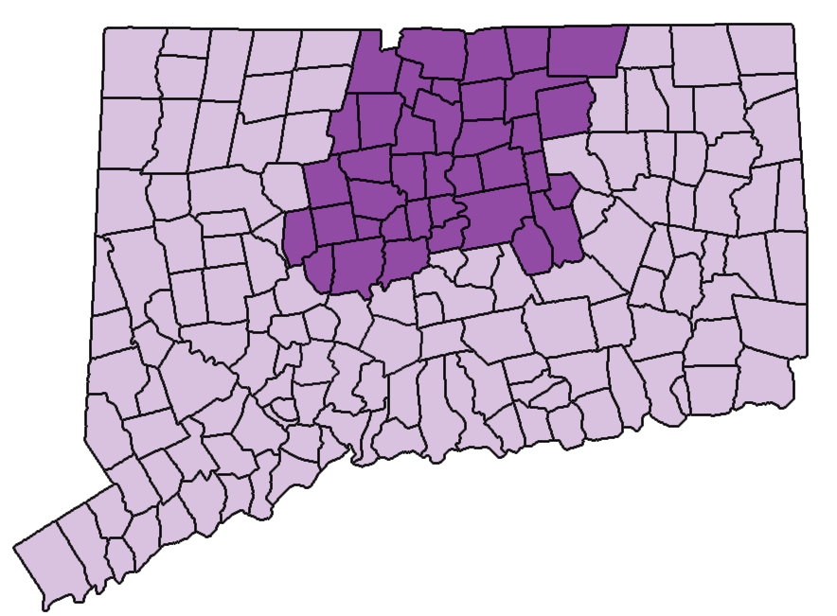
Amplify, Inc. Region 4
Geographic Scope:
Amplify is contracted to serve the 37 towns in North Central CT.
Thirty-four Local Prevention Councils work at the grassroots level to raise awareness of substance misuse prevention and early intervention services.
Towns are combined into Six Catchment Areas that receive behavioral health services.
Regional/State Opioid Response
North Central Regional Suicide Advisory Board
Regional Problem Gambling Awareness Team

Slide 19
5. Questions and Answers (Q&A)

Slide 20
6. Establishment of HSCC Meeting Schedule

Slide 21
7. Information Sharing

Slide 22
8. Next Steps

Slide 23
9. Adjournment

Slide 24
Additional Resources/Appendix
CT Opioid Settlement Advisory Committee
https://portal.ct.gov/DMHAS/Newsworthy/News-Items/CT-Opioid-Settlement-Advisory-Committee
Opioid Services Overview
https://portal.ct.gov/-/media/DMHAS/UpcomingEvents/Opioid-Services-Overview-May-2023.pdf
CT Opioid Response (CORE) Strategic Plan
https://portal.ct.gov/-/media/DMHAS/UpcomingEvents/5_9_23-CT-OSAC-Meeting_Yale-Slides_Final250.pdf
CT Opioid Response Initiative Report
https://portal.ct.gov/CORE
Opioid Remediation Uses
https://portal.ct.gov/-/media/DMHAS/UpcomingEvents/Exhibit-E-Final-Distributor-Settlement-Agreement-8-11-21.pdf
Opioids and Drug Overdose Prevention
https://portal.ct.gov/dph/Health-Education-Management--Surveillance/The-Office-of-Injury-Prevention/Opioids-and-Prescription-Drug-Overdose-Prevention-Program
Current Opioid Laws and Regulations
https://portal.ct.gov/DPH/Health-Education-Management--Surveillance/The-Office-of-Injury-Prevention/Current-Laws-related-to-Opioids-Overdose-Prevention

Slide 25
CT Distributions/Allocations of National Opioid Settlements
Qualifying CRCOG Town % Total Funding Allocation
Andover, CT 0.0513214640%
Avon, CT 0.5494886534%
Berlin, CT 0.5215629385%
Bloomfield, CT 0.4888368136%
Bolton, CT 0.1520831395%
Canton, CT 0.2669011966%
Columbia, CT 0.1005666237%
Coventry, CT 0.3460011479%
East Granby, CT 0.1455975170%

Slide 26
CT Distributions/Allocations of National Opioid Settlements
Qualifying CRCOG Town % Total Funding Allocation
East Hartford, CT 1.2645454069%
East Windsor, CT 0.2419743793%
Ellington, CT 0.4010047839%
Enfield, CT 0.9173431190%
Farmington, CT 0.6572091547%
Glastonbury, CT 1.0420644550%
Granby, CT 0.2928405247%
Hartford, CT 5.3268549899%
Hebron, CT 0.1593443254%
Manchester, CT 1.3929765818%
Mansfield, CT 0.3058754037%

Slide 27
CT Distributions/Allocations of National Opioid Settlements
Qualifying CRCOG Town % Total Funding Allocation
Marlborough, CT 0.0766010346%
New Britian, CT 1.5740557511%
Newington, CT 0.7132456565%
Plainville, CT 0.3937549612%
Rocky Hill, CT 0.3929175425%
Simsbury, CT 0.6988446241%
Somers, CT 0.2491740063%
South Windsor, CT 0.7310935932%
Southington, CT 0.9683065927%
Stratford, CT 0.9155695700%
Suffield, CT 0.3402792315%

Slide 28
CT Distributions/Allocations of National Opioid Settlements
Qualifying CRCOG Town % Total Funding Allocation
Tolland, CT 0.4342020371%
Vernon, CT 0.7027162157%
West Hartford, CT 1.6216697477%
Wethersfield, CT 0.6208707168%
Willington, CT 0.0975268185%
Windsor, CT 0.7548324123%
Windsor Locks, CT 0.3174167624%

Slide 29
Janssen Opioid Settlement
Janssen Settlement Allocation Agreement (see Appendix)
Connecticut’s Total: $42,786,144.11
Distributed as follows:
15% to the State Fund
70% to the Abatement Accounts Fund
15% to the Subdivision Fund, to be paid directly to the Subdivisions

Slide 30
Janssen Opioid Settlement Amounts
Qualifying CRCOG Town Amount of Janssen Funds (2022 amounts)
Andover, CT $3,273.30
Avon, CT $35,046.70
Berlin, CT $33,265.58
Bloomfield, CT $31,178.29
Bolton, CT $9,699.94
Canton, CT $17,023.11
Columbia, CT $6,414.18
Coventry, CT $22,068.13
East Granby, CT $9,286.29

Slide 31
Janssen Opioid Settlement Amounts
Qualifying CRCOG Town Amount of Janssen Funds (2022 amounts)
East Hartford, CT $80,653.41
East Windsor, CT $15,433.25
Ellington, CT $25,576.30
Enfield, CT $58,508.64
Farmington, CT $41,917.17
Glastonbury, CT $66,463.44
Granby, CT $18,677.52
Hartford, CT $339,749.76
Hebron, CT $10,163.06
Manchester, CT $88,844.82
Mansfield, CT $19,508.89

Slide 32
Janssen Opioid Settlement Amounts
Qualifying CRCOG Town Amount of Janssen Funds (2022 amounts)
Marlborough, CT $4,885.66
New Britian, CT $100,394.14
Newington, CT $45,491.20
Plainville, CT $25,113.91
Rocky Hill, CT $25,060.50
Simsbury, CT $44,572.70
Somers, CT $15,892.45
South Windsor, CT $46,629.54
Southington, CT $61,759.12
Stratford, CT $58,395.54
Suffield, CT $21,703.20

Slide 33
Janssen Opioid Settlement Amounts
Qualifying CRCOG Town Amount of Janssen Funds (2022 amounts)
Tolland, CT $27,693.64
Vernon, CT $44,819.64
West Hartford, CT $103,431.00
Wethersfield, CT $39,599.48
Willington, CT $6,220.31
Windsor, CT $48,143.64
Windsor Locks, CT $20,245.01

Slide 34
Thank
You.
You.

