Slide 1

Joey Listro, Executive Director & Founder
September 19, 2023
CRCOG Human Resources Coordinating Council

Slide 2
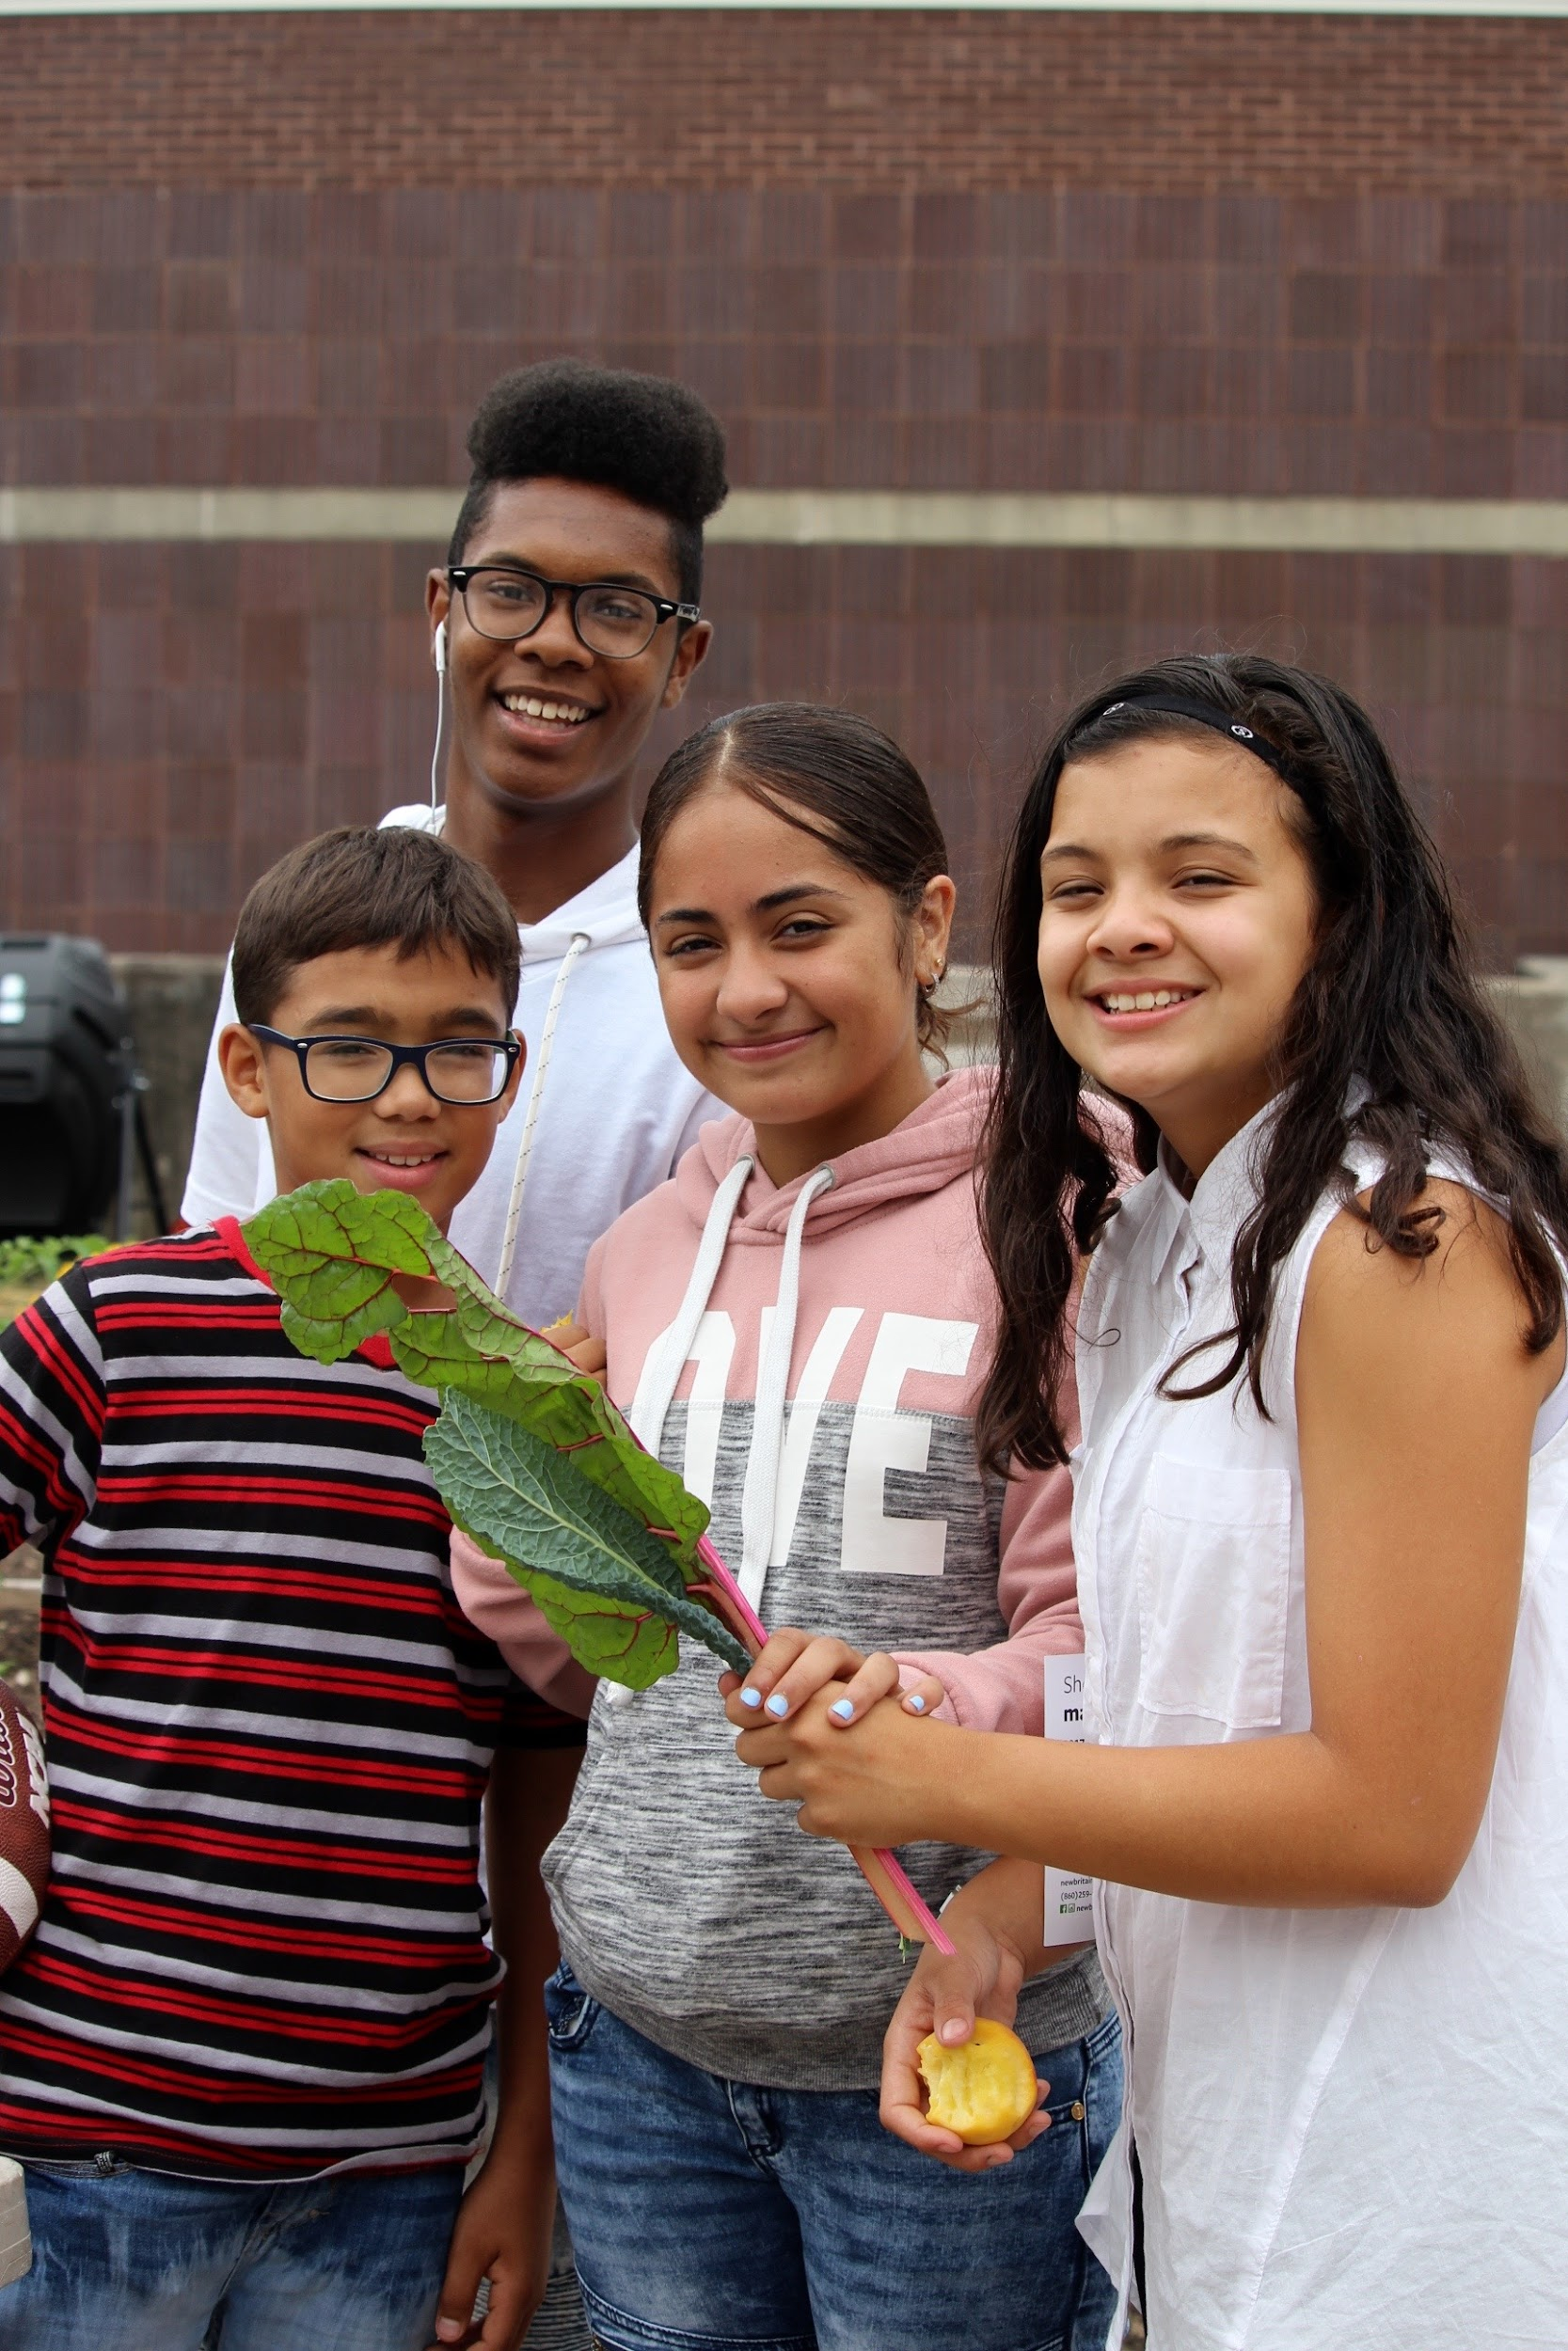
Mission:
WE CULTIVATE COMMUNITY CONNECTIONS AND EQUITABLE ACCESS TO QUALITY FOOD THROUGH EMPOWERMENT AND LEARNING WITH THE PEOPLE WHO GROW, PREPARE, AND EAT FOOD IN NEW BRITAIN.

Slide 3
Food Security
Our Three Fold Mission
Education
After-School K-8 Program
City Growers - Youth Apprenticeship Program
Summer Camp
Senior Center Garden & Cooking Club
Farmers’ Markets
Mobile Market
SNAP/EBT Match
Produce Donations
Urban Agriculture
Community gardens
School gardens and Greenhouses
Elevated Raised Beds

Slide 4
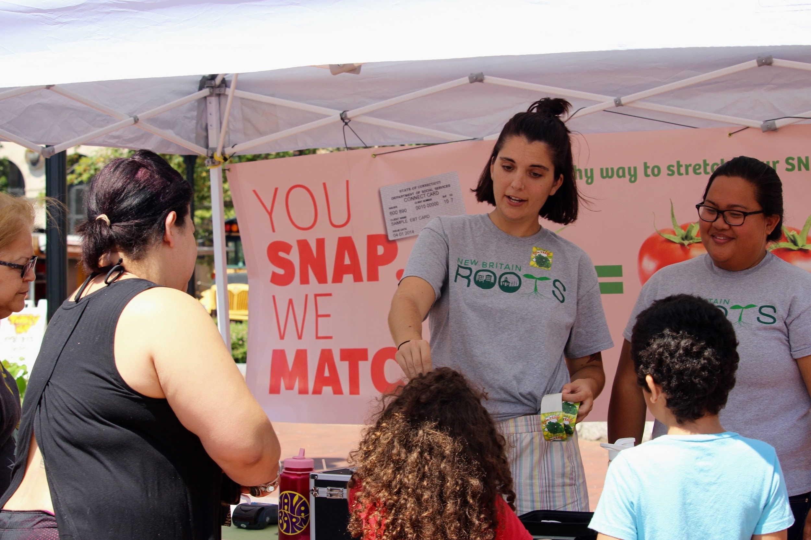
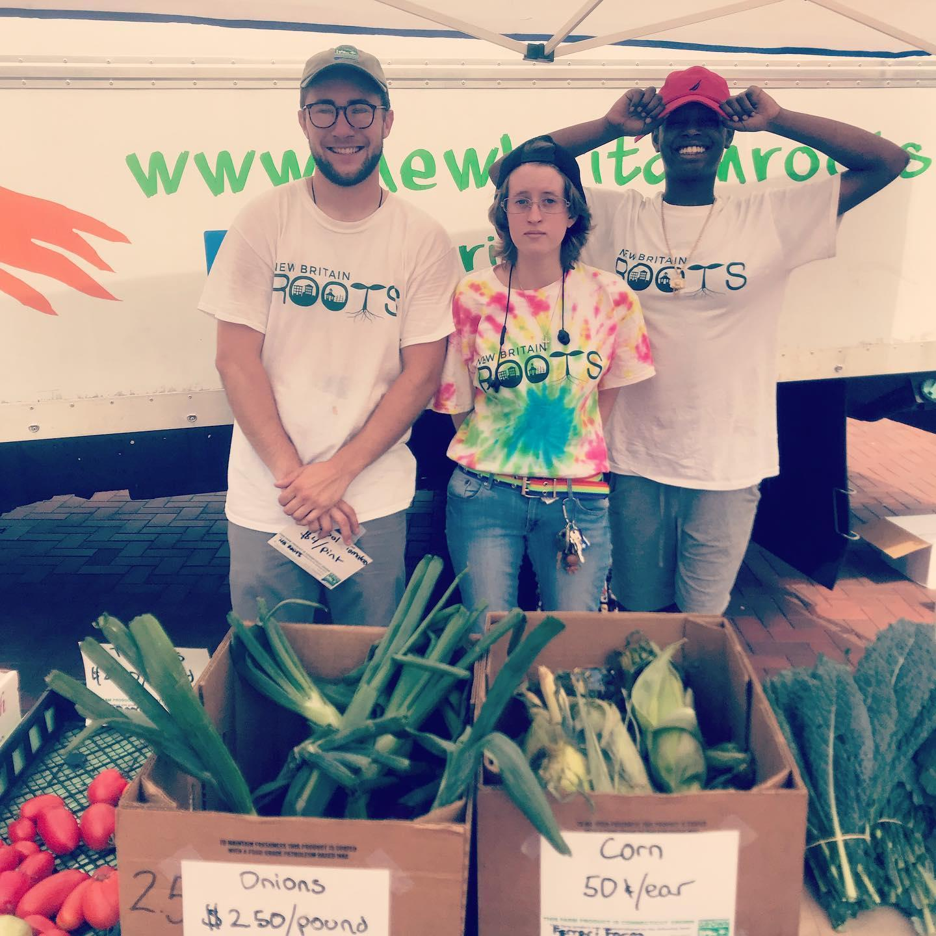
Food Security
Local Food Access through our mobile market
SNAP/EBT Match
Produce Donations

Slide 5
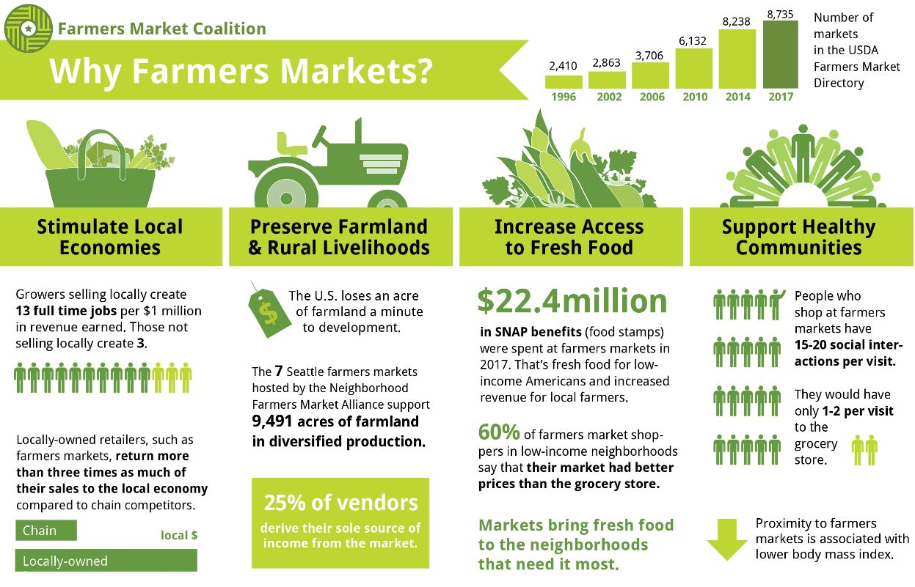

Slide 6
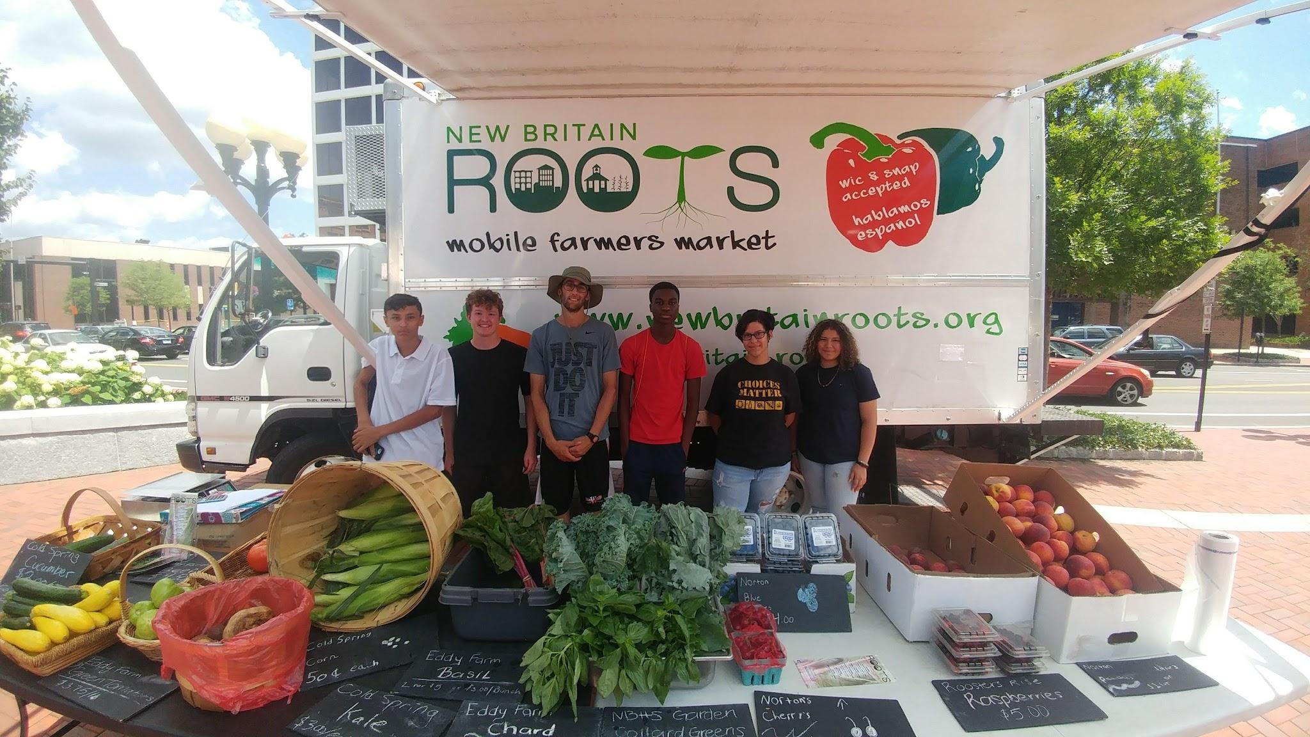

Slide 7
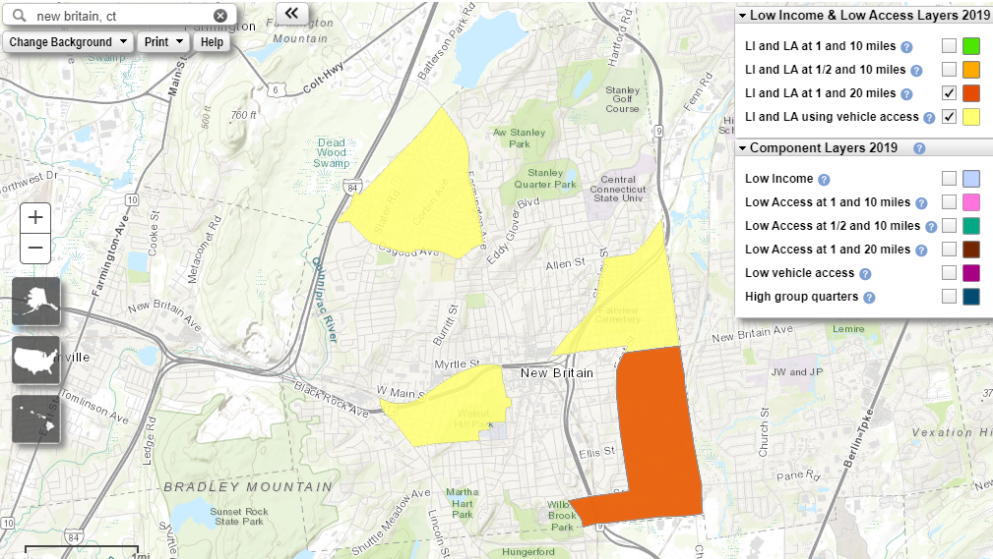
USDA Food Access Research Atlas

Slide 8
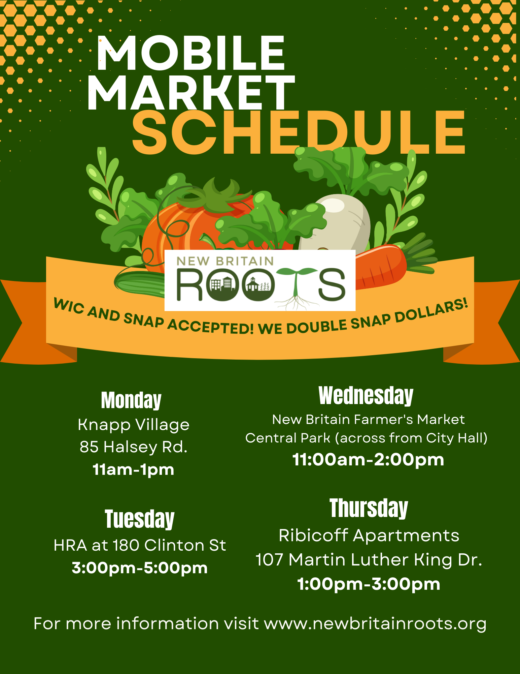

Slide 9
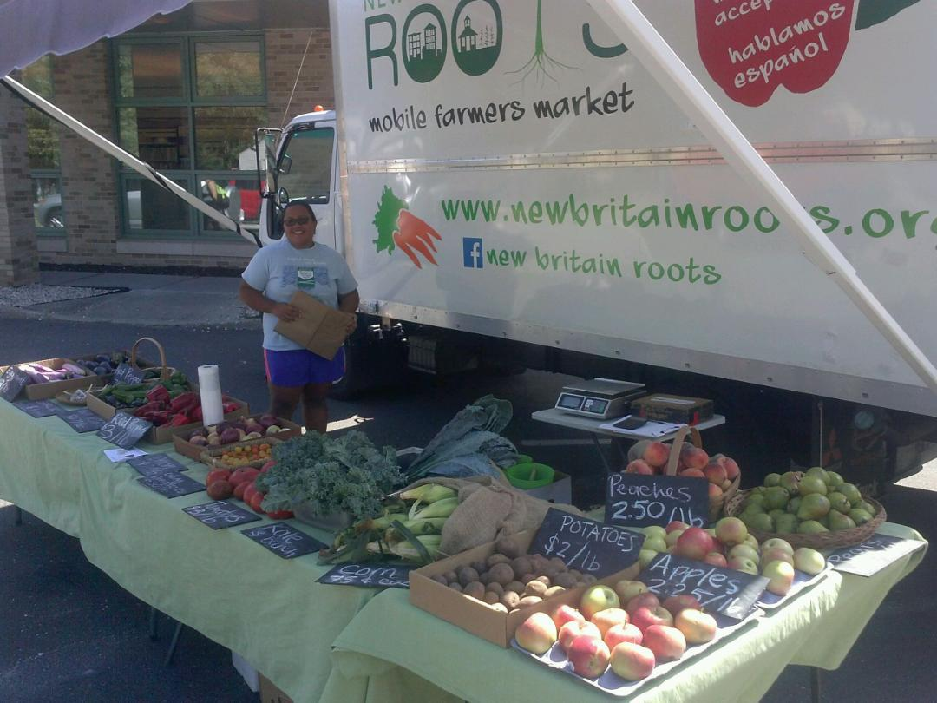
What’s on the market
ROOTS mobile market provided fresh, affordable, CT Grown produce. From apples, garlic, kale, tomatoes, herbs, squash, eggplant, onions, & honey. We source from several farms in Connecticut:
Cold Spring Brook Farm, Berlin
Eddy Farm, Newington
Rogers Orchards, Southington
Hilltop Apiaries, Simsbury
Walsh Farm, Simsbury
….and New Britain School Gardens!

Slide 10
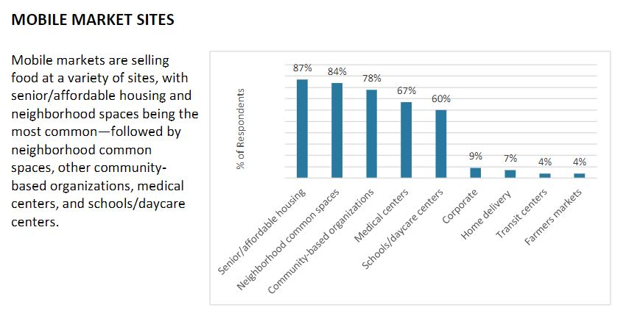
2019 Mobile Market Summit Survey Report

Slide 11
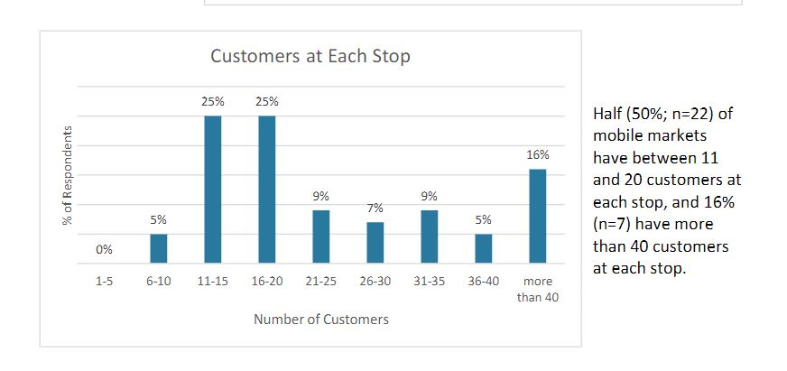
2019 Mobile Market Summit Survey Report

Slide 12
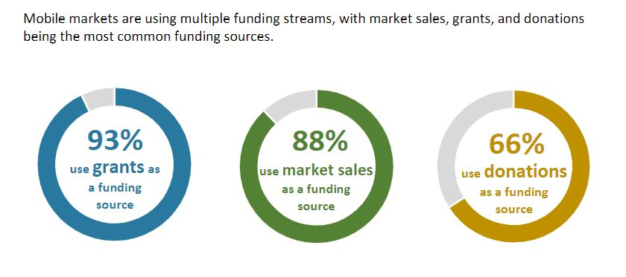
2019 Mobile Market Summit Survey Report

Slide 13
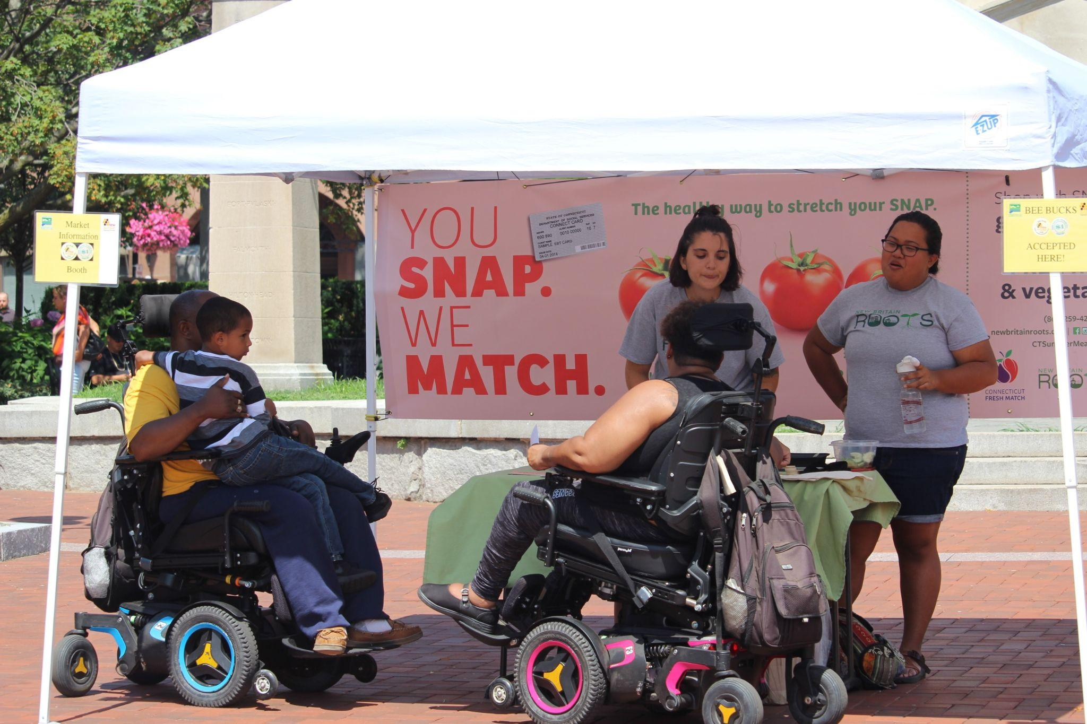

Slide 14
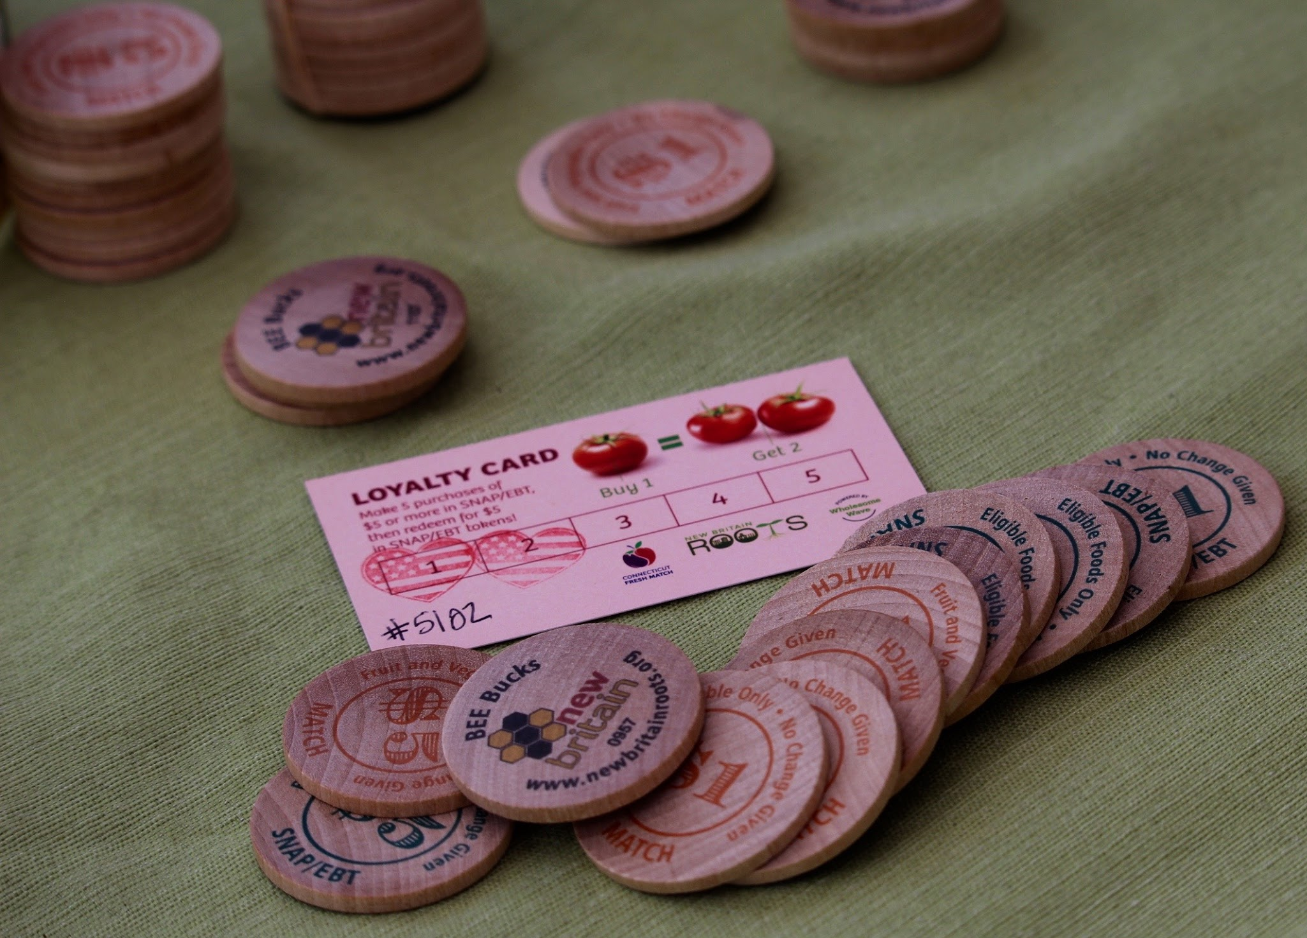
BEE BUCKS

Slide 15
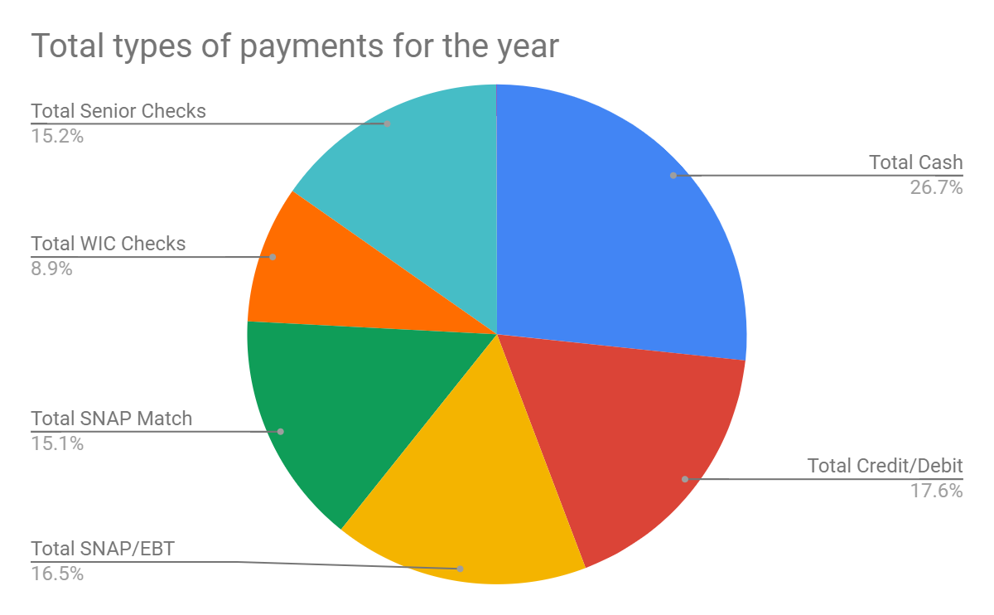
Mobile market results (2021)
Served 1,785 customers
58% of shoppers are low-income
55% of SNAP Customers returned to the market to shop at least 2 or more times throughout the season
$2,344 was matched in SNAP sales

Slide 16
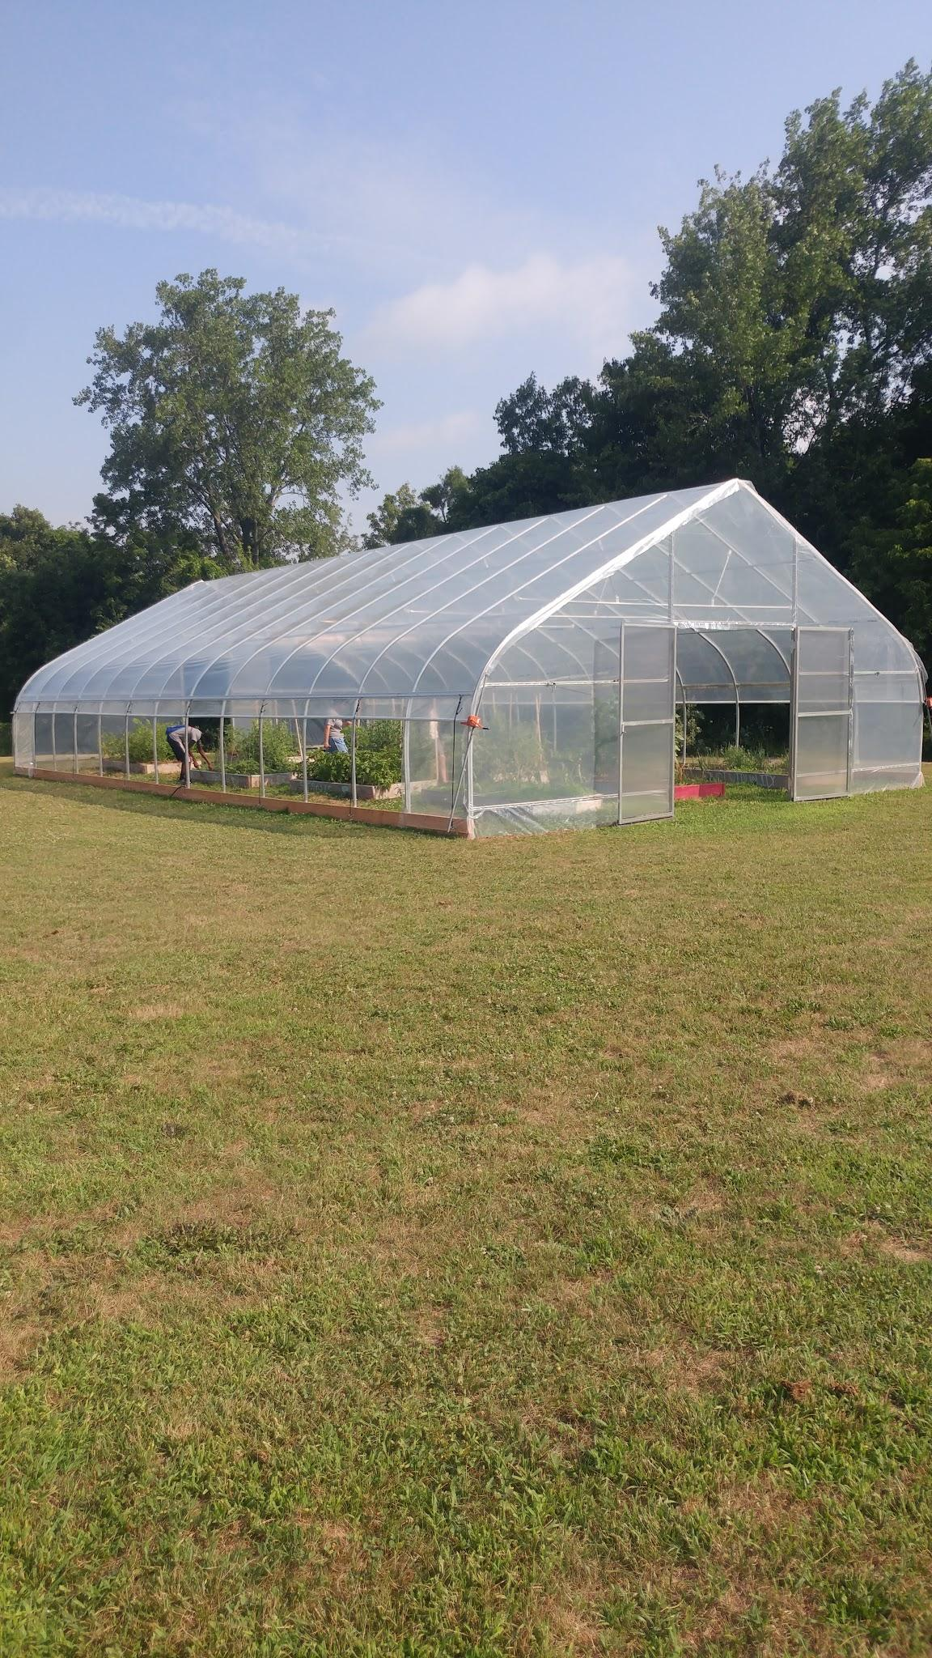

Slide 17
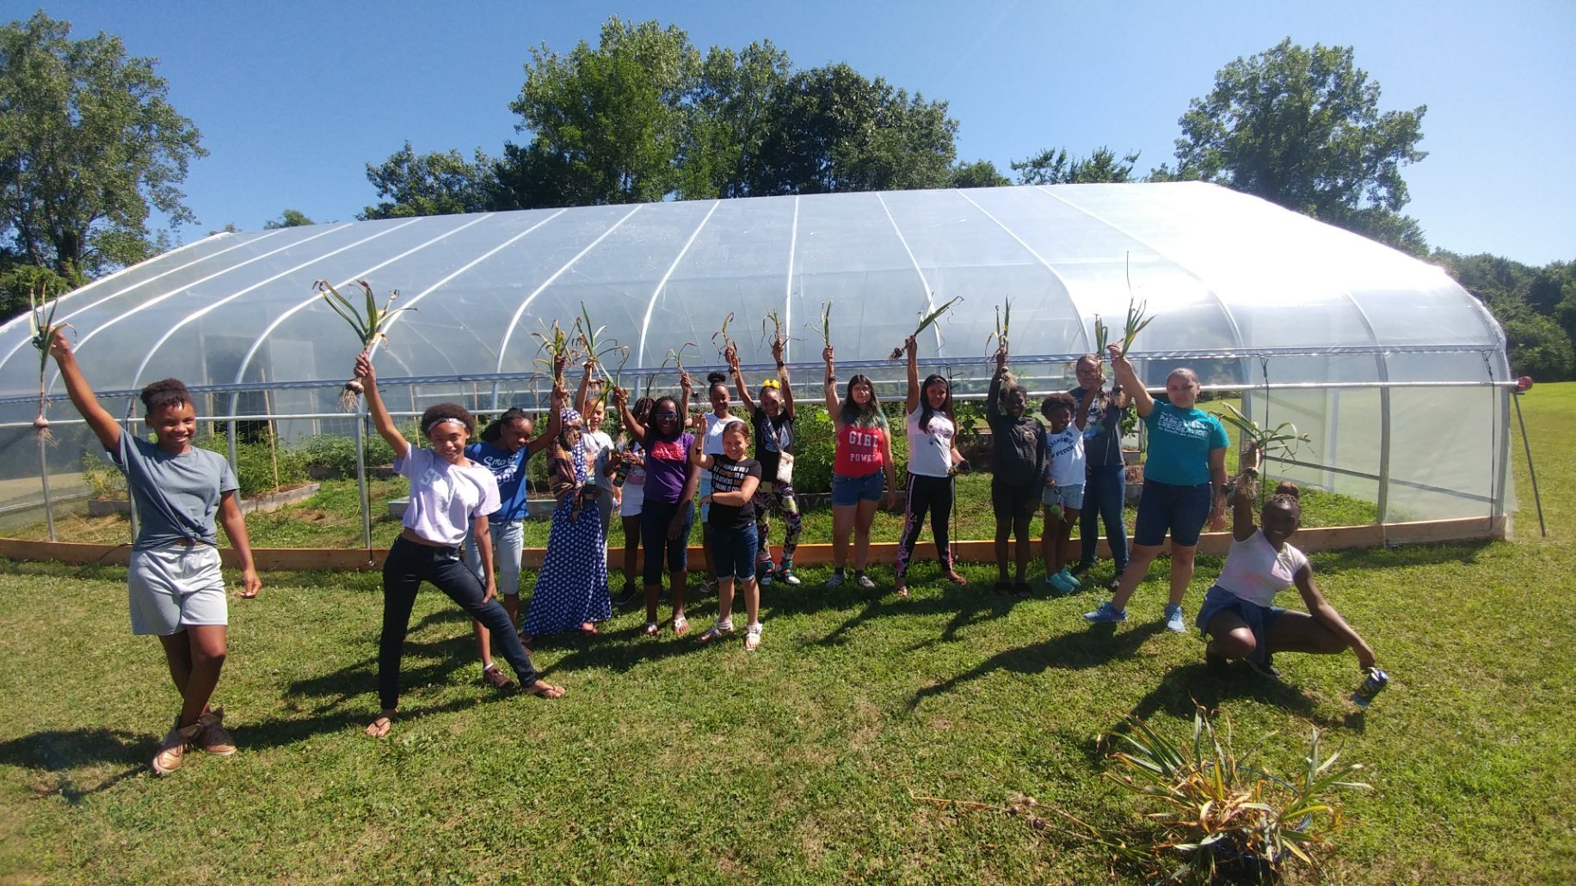

Slide 18
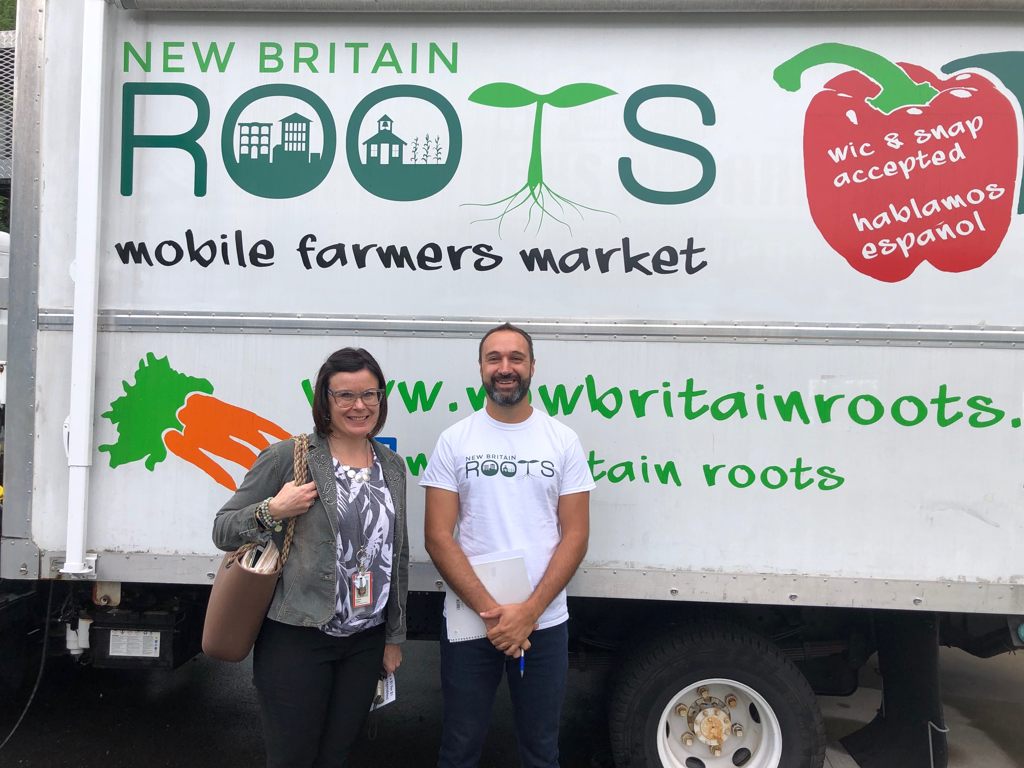
Contact us
Joey Listro
Executive Director
joey@newbritainroots.org
newbritainroots.org
facebook.com/newbritainroots/

