Slide 1
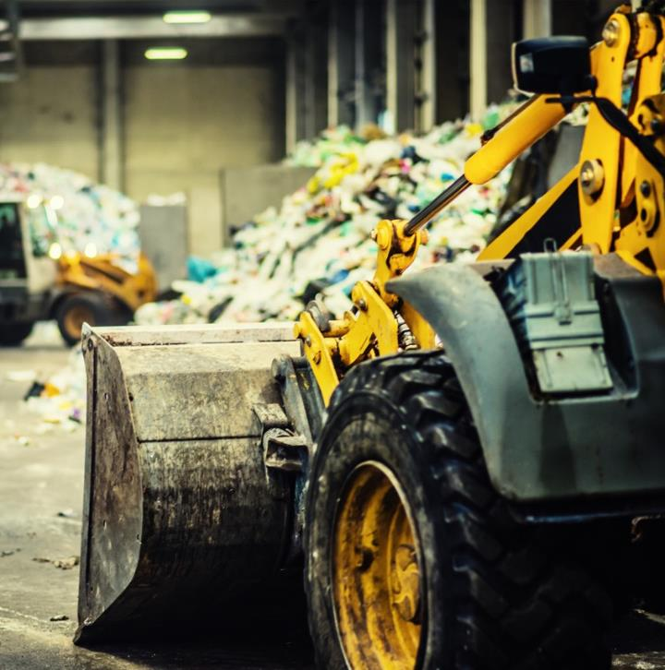
CCSWA
Executive Committee Meeting
October 16, 2023

Slide 2
Today’s Agenda
Call to Order/Introductions
Public Comment
Approval of 08/21/23 Minutes
Report from CCSWA Chair
Finance Committee – Nomination/Next Steps
Bylaw/Ordinance Discussion
CRCOG Staff Reports
CCSWA Next Steps
Other Business

Slide 3
Call to Order/Introductions

Slide 4
Public Comment
Public Comment

Slide 5
Approval of 08/21/23 Minutes
Central CT Solid Waste Authority (CCSWA) Minutes
Executive Committee
Monday, August 21, 2023
2:00 p.m. EST
Members and Designees
Kathleen Blonski Farmington Town Manager
Russ Arnold Farmington Public Works/CCSWA Treasurer
Mike Looney Hartford Public Works/CCSWA Chair
Dave Steuber Hartford – Chief of Staff to Mayor/CCSWA SW Tonnage Rep
Tim Bockus Manchester Public Works/CCSWA Recycling Tonnage Rep
Kasia Purciello Manchester Assistant Town Manager
Tom Roy Simsbury Public Works/CCSWA Vice-Chair
Fred Presley Wethersfield Town Manager/CCSWA Secretary
Staff
Matt Hart CRCOG Executive Director
Pauline Yoder CRCOG Chief Operating Officer
Guests
Jim Sandler Hartford Solid Waste Task Force/Sandler Mara
Brian Popovich USA Recycle
James Sanchez Hartford – 6th District State Representative
Ed (Guest)
The hybrid CCSWA Executive Committee Meeting was called to order by Michael Looney, CCSWA Chair, at 2:02 p.m.
Roll Call and Introductions were done.
There was no public comment.
July 17, 2023 CCSWA Meeting Minutes will be reviewed and approved at Full CCSWA Membership Meeting in September.

Slide 6
Approval of 8/21/23 Minutes
5. Michael Looney, CCSWA Chair, provided a brief introduction of the CCSWA Officers and an update of CCSWA next steps through 2024 (e.g., foundational, organizational, operational, and programmatic).
Discussion and Q&A of the following matters included:
Review/approve CRCOG/CCSWA MOU – admin. fee calculations, membership tiers, CCSWA Budget, annual COLA, and quarterly billing – based on 2 yr. agreement (thru June 30, 2025) and approximately 5 hrs./week commitment. Tim Bockus (Manchester) moved to approve, seconded by Tom Roy (Simsbury). Motion carried unanimously to approve CRCOG/CCSWA MOU, as amended;
Review/revise model Ordinance – changes to CCSWA municipal ordinance(s) would trigger amendment of CCSWA by-laws – large task to research/review all current ordinances. Motion was made by Russ Arnold (Farmington) and seconded by Tom Roy (Simsbury) to table the Ordinance matter until next CCSWA Executive Committee Meeting in October;
Review/revisit CCSWA by-laws, including bringing in technical assistance and CRCOG assistance – Motion was made by Tom Roy (Simsbury) and seconded by Russ Arnold (Farmington) to table CCSWA by-laws matter to provide time to research, review, and discuss with RRS – To be discussed/presented at CCSWA Executive Committee Meeting in October;
Impanel a CCSWA Finance Committee to address CCSWA membership, dues, tiered structure, and budget, to be further discussed at Full CCSWA Meeting in September;
Create a CRCOG webpage dedicated to CCSWA;
Review/revisit CRCOG Waste Management and Diversion Study, including role of CCSWA and next steps to grow membership, establish common programs/services, and build on current interest and momentum in waste management in alignment with/guidance from CTDEEP relative to State’s MSW and recycling self-sufficiency goals; and
Programmatic recommendations for CCSWA, including textile recycling, food waste (schools), organics, facilities/infrastructure, permitting, anaerobic digestion, and impacts of programs/services (e.g., costs, incentives) to build economies of scale.

Slide 7
Approval of 8/21/23 Minutes
7. Next Steps
Discussion of Executive Committee and Full CCSWA Membership Meeting action items
Review of 2023 Meeting Calendar (Executive Committee and Full CCSWA Membership) – Motion made by Tom Roy, seconded by Russ Arnold and passed unanimously to approve 2023 CCSWA Meeting Schedule
RWA Grant, Request for Addtl. Info. – Pauline Yoder provided brief update on status of RWA Grant application, RFAI deadline, and potential funding
Ordinance – research, review, and amend, as needed
CCSWA Chair, Michael Looney, to work collaboratively with CRCOG, Executive Director, Matt Hart, to meet with CTDEEP – strategic and programmatic next steps, targets, and goals
Establish meeting to discuss incentives for members to serve as host community(ies) – schedule for upcoming year at CCSWA December Annual Meeting
8. Motion made by Tom Roy (Simsbury) to adjourn and seconded by Tim Bockus (Manchester). Meeting adjourned at 2:59 p.m. ET.
CCSWA EXEC COMMITTEE MTG-20230821_140228-Meeting Recording.mp4

Slide 8
Report from CCSWA Chair

Slide 9
Finance Committee
Nomination/Approval of Ellen Zoppo-Sasso (Enfield)
Establishment of Finance Committee Meetings
Next steps

Slide 10
Discussion – Bylaws and Concurrent Ordinance
CCSWA Chair and CRCOG reviewed current/governing bylaws and concurrent ordinance
and propose the following:
CGA 103b-Sections 273aa to 273-00 governs Waste Authorities in CT
Two paths of action:
PATH ONE – Amend/Enact New Ordinance
Will require ALL current and new CCSWA Members to enact new Concurrent Ordinance
Ability to amend bylaw language including Membership, Tiers, Voting, Dues and more
PATH TWO – No changes to current Ordinance
Only new CCSWA members must enact existing Ordinance (no amendment since 2010)
Limitations to bylaw changes governed by existing Ordinance language
Can make minimal changes to bylaws, including committee structure, annual meeting date

Slide 13
CRCOG Staff Reports/Updates

Slide 14
Proposed Next Steps
Finance Committee Meeting (e.g., Budget)
Bylaw/Ordinance – amend/maintain?
Develop Initial Operations/Program Plan
Organics/Food Waste/Recycling
Bidding (residential/organics?)
4. Member Recruitment – Legacy vs. New Members, dues structure, etc.
5. Annual Meeting – December 18th, 2023
-Exec Committee - 1:00 p.m. to 2:00 p.m.
-Full CCSWA Membership - 2:00 p.m. to 3:00 p.m.

Slide 15
Other Business

Slide 16
Wrap Up
Final Thoughts & Questions??

Slide 17
Thank
You.
You.

