Slide 1
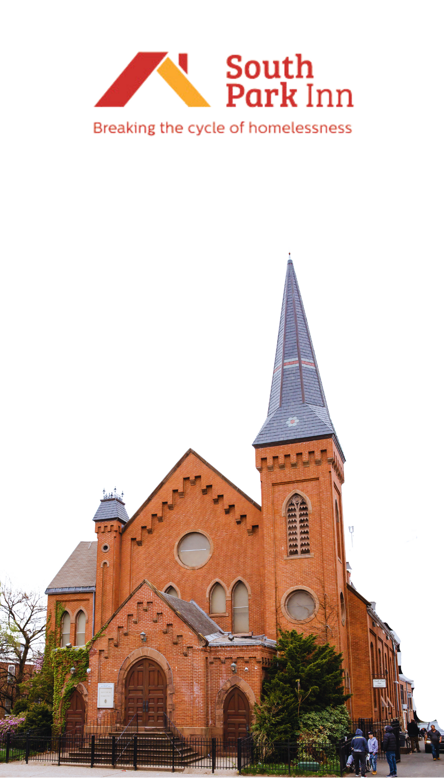


Since 1984

Slide 2

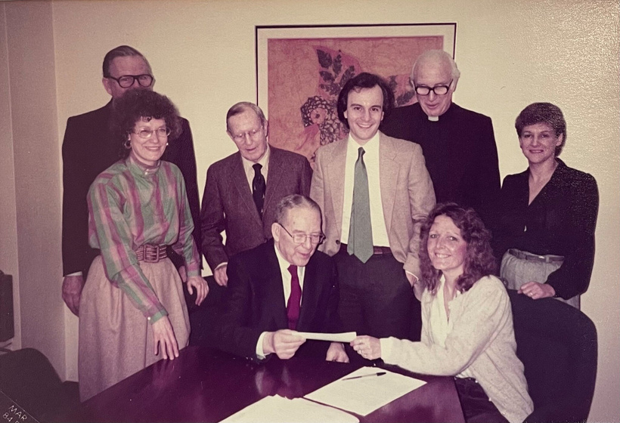
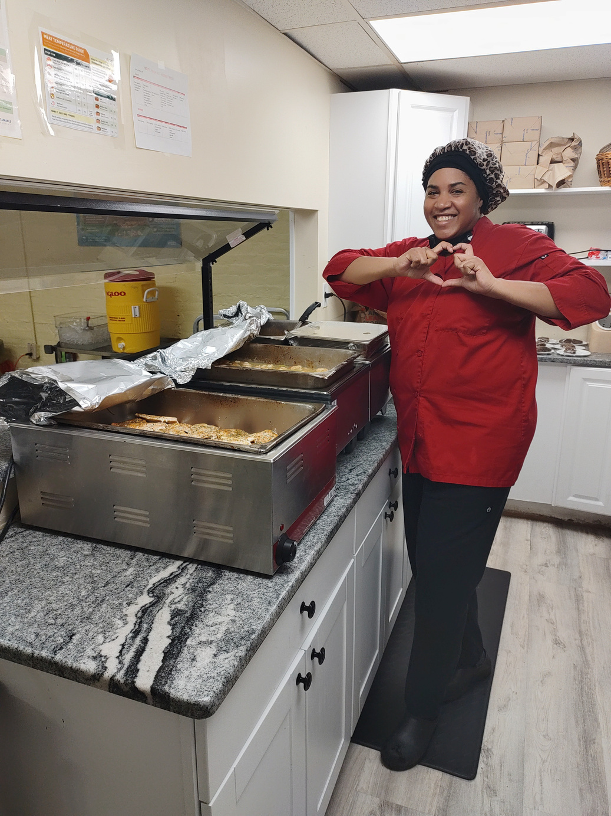
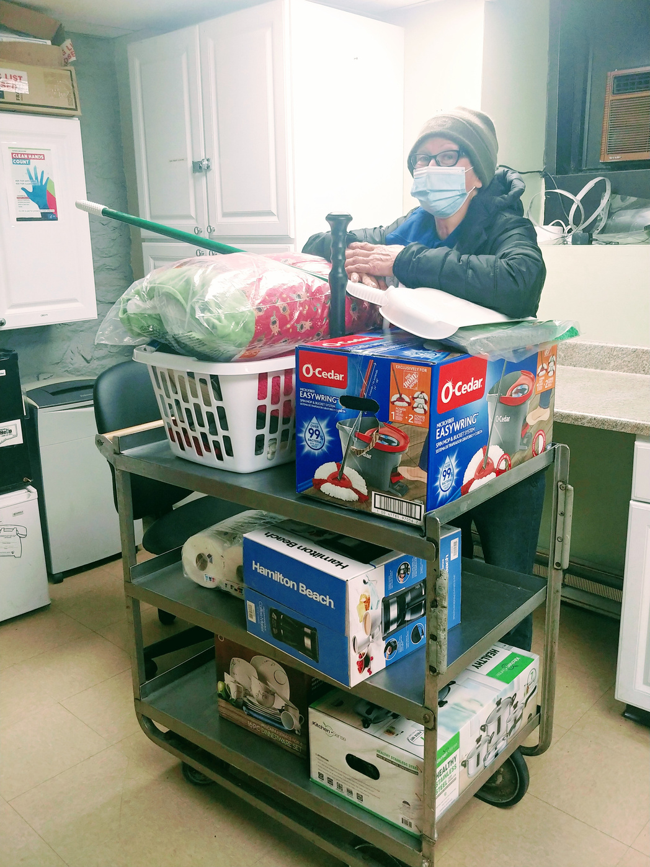
History & Mission
105 Beds
344 Unique
Individuals served in 2023
In the early 1980s, a group of Hartford residents, concerned with increasing rates of homelessness and a shortage of affordable housing, purchased and renovated the former South Park Methodist Church.
Today, South Park Inn’s mission is to improve our community by providing equal access to shelter and solutions for all people to make homelessness rare, brief, and non-recurring.

Slide 3
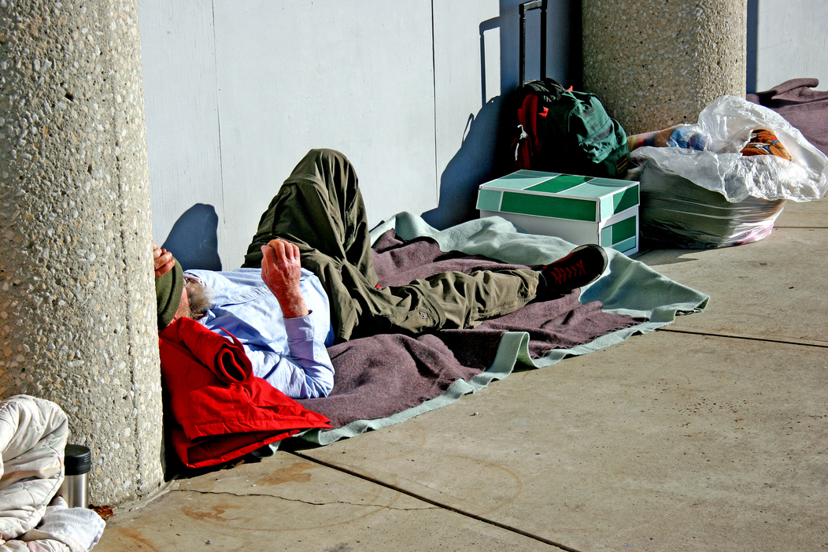
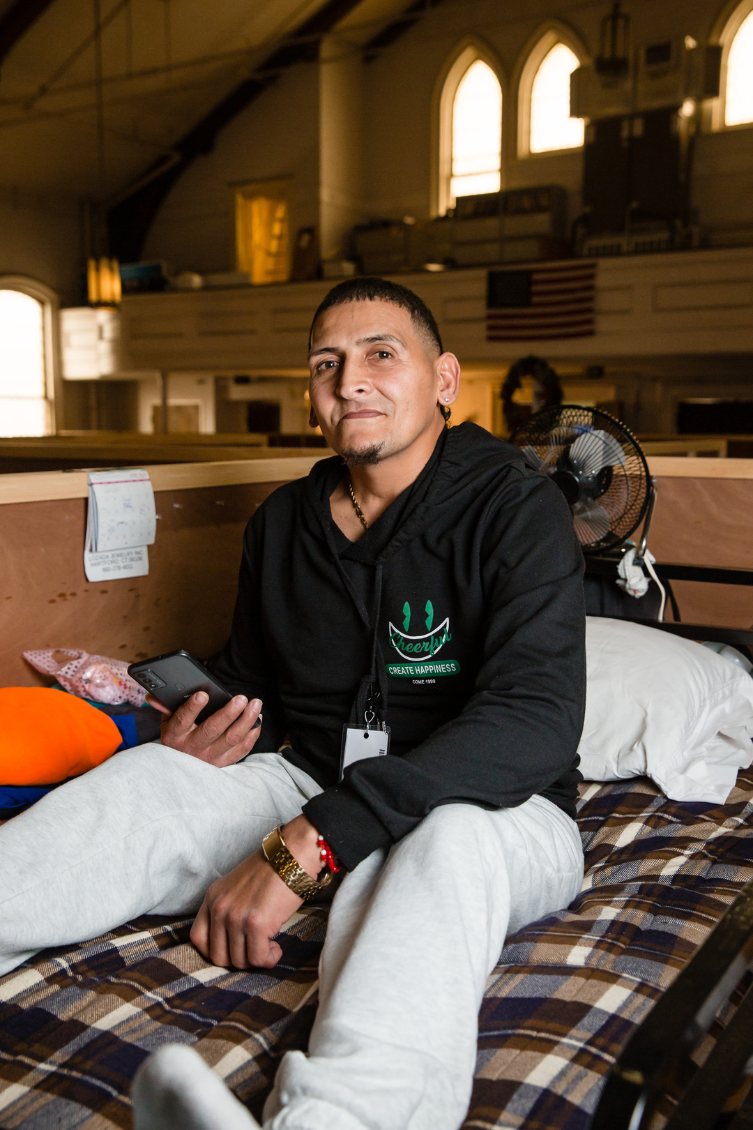
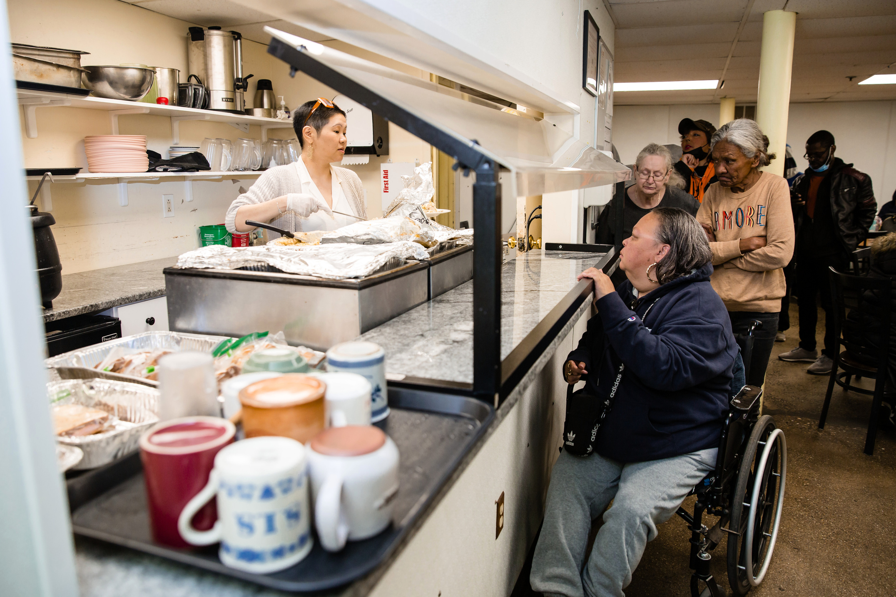
24/7/365
EMERGENCY
SHELTER
Low barrier, high impact.

Slide 4
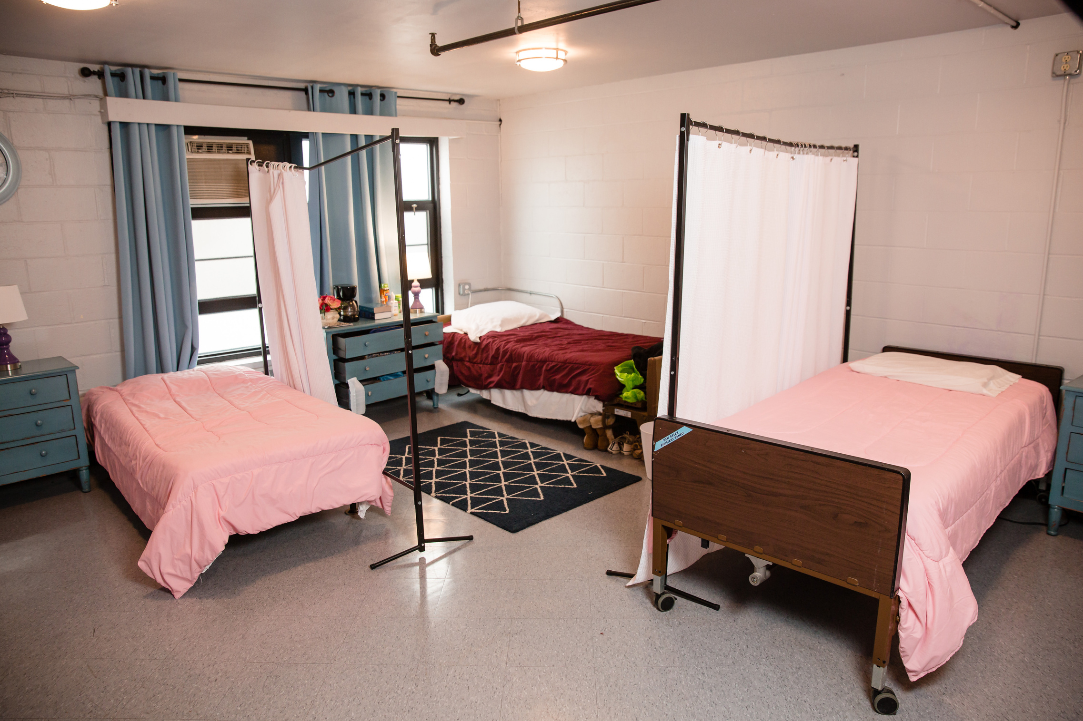

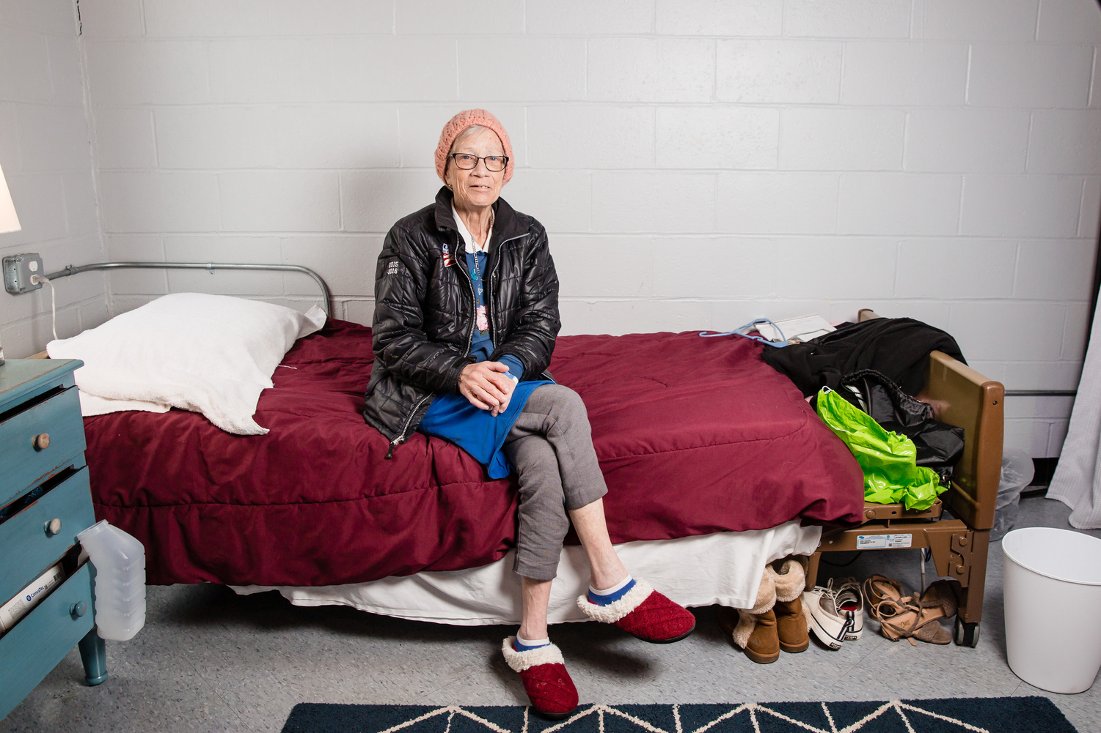
RESPITE
is healing care
A place to recover from addiction,
illness, broken limbs, etc.
People experiencing homelessness are more vulnerable to disease, infection, chronic stress, and other disabling conditions, especially when discharged directly from hospitalization into homelessness.

Slide 5
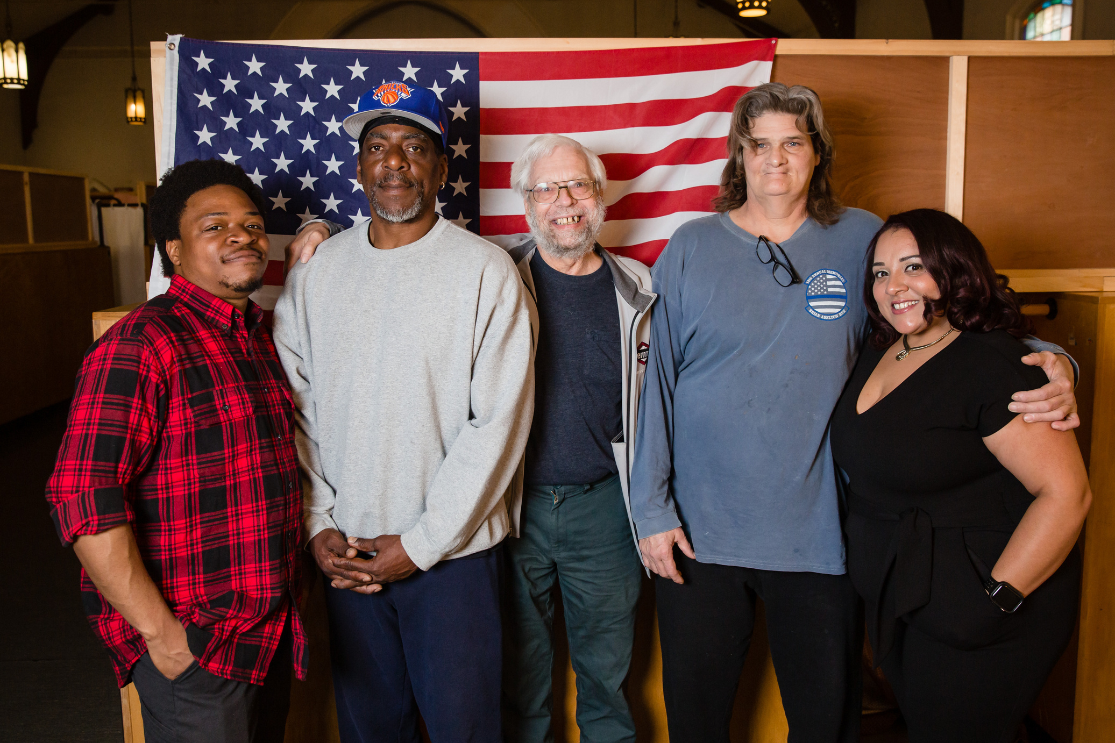
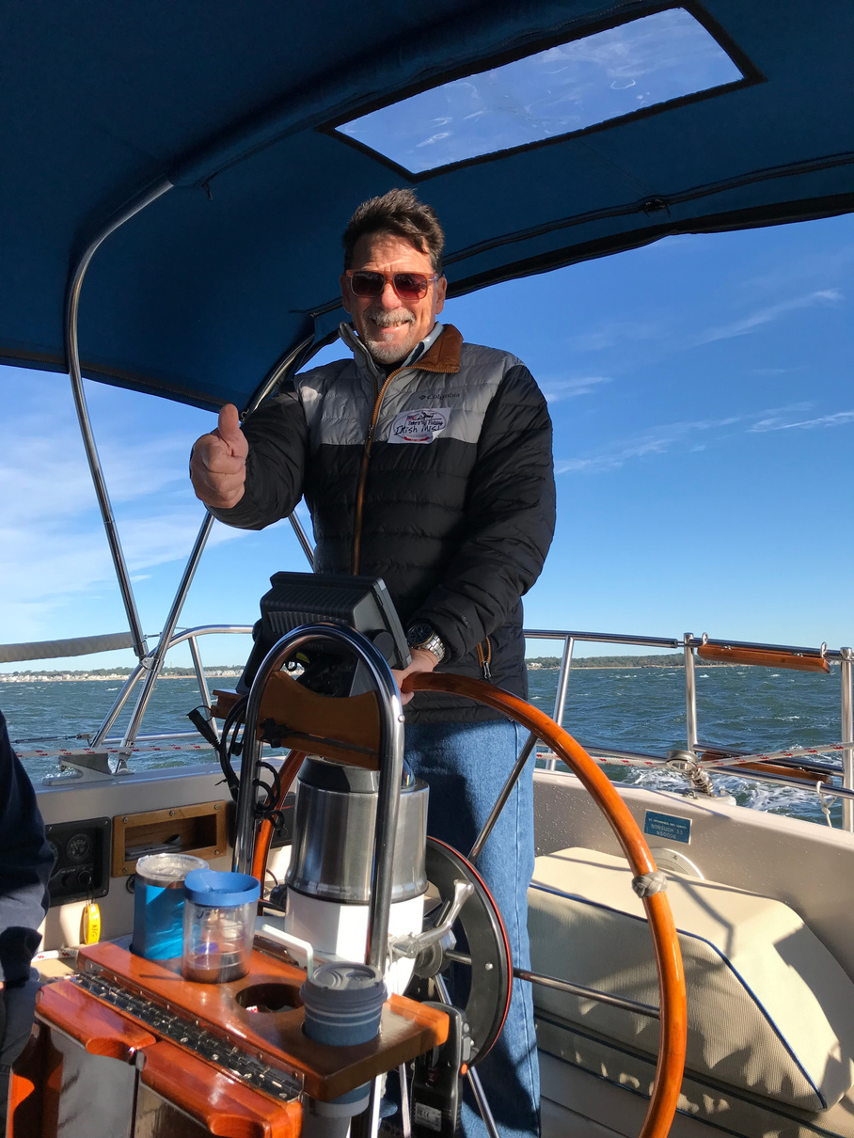
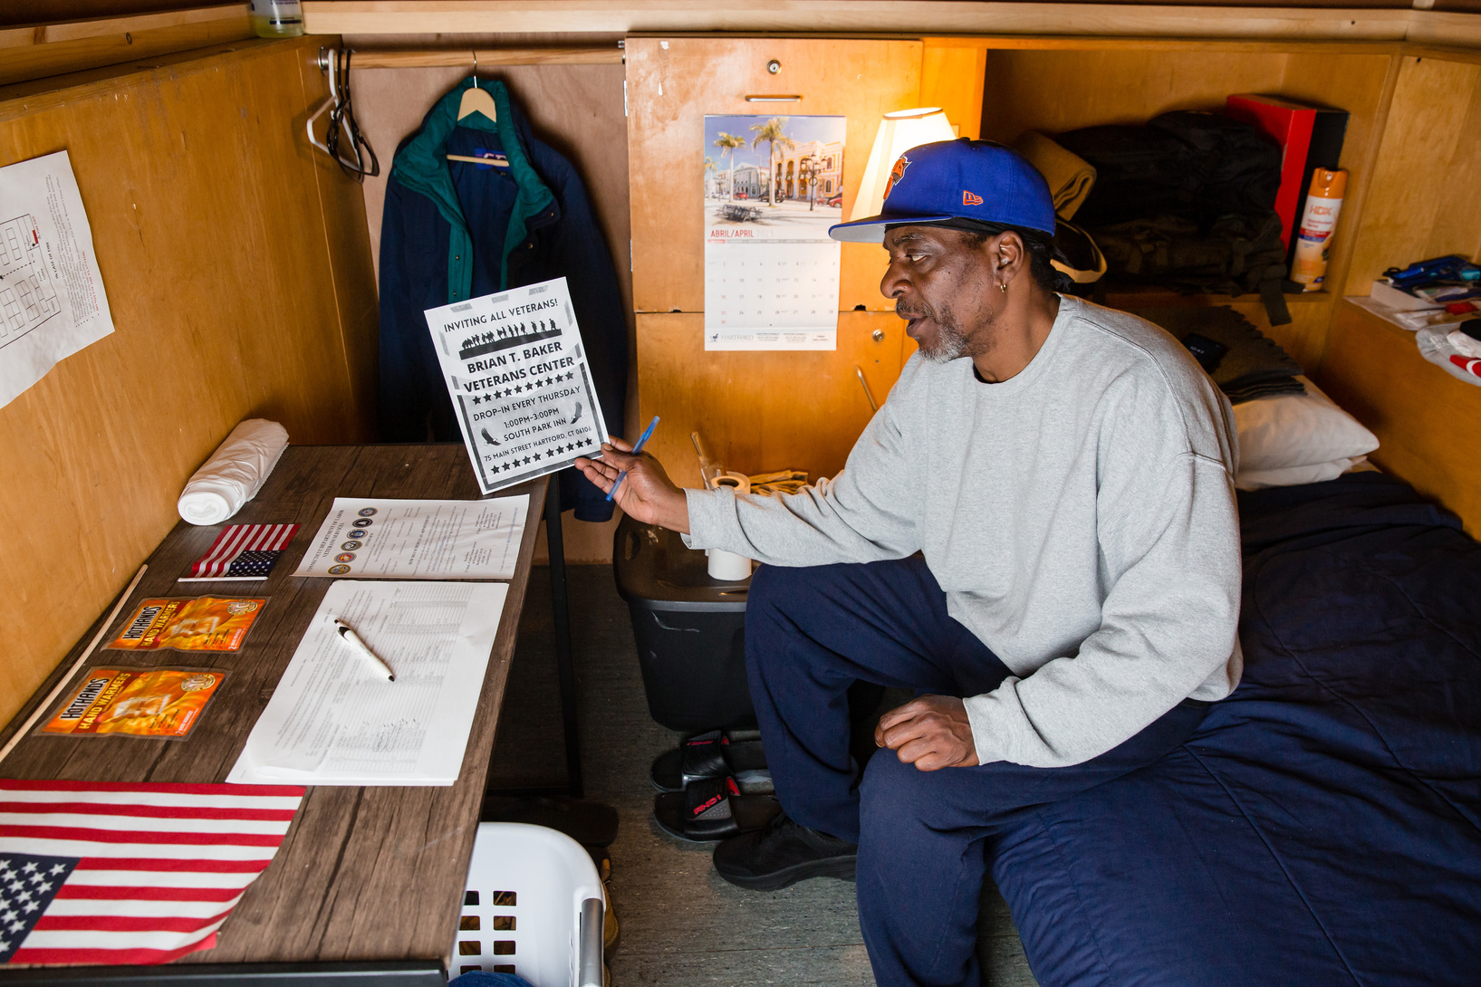
Veterans
Freedom and security are everyone's responsibility
15 BEDS
RESERVED FOR THOSE WHO SERVED

Slide 6
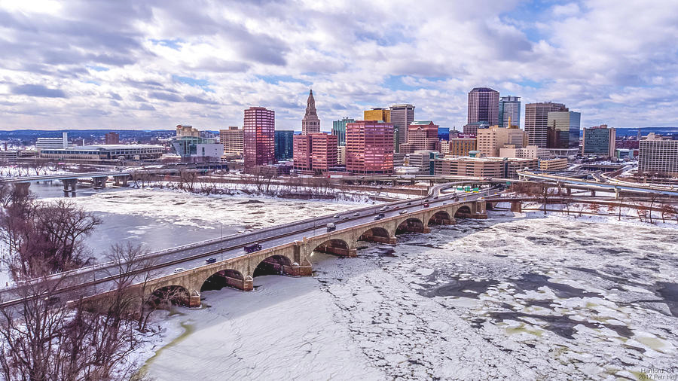
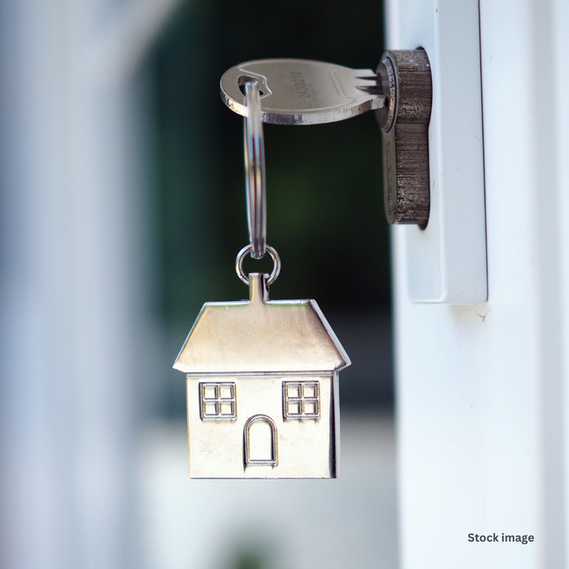
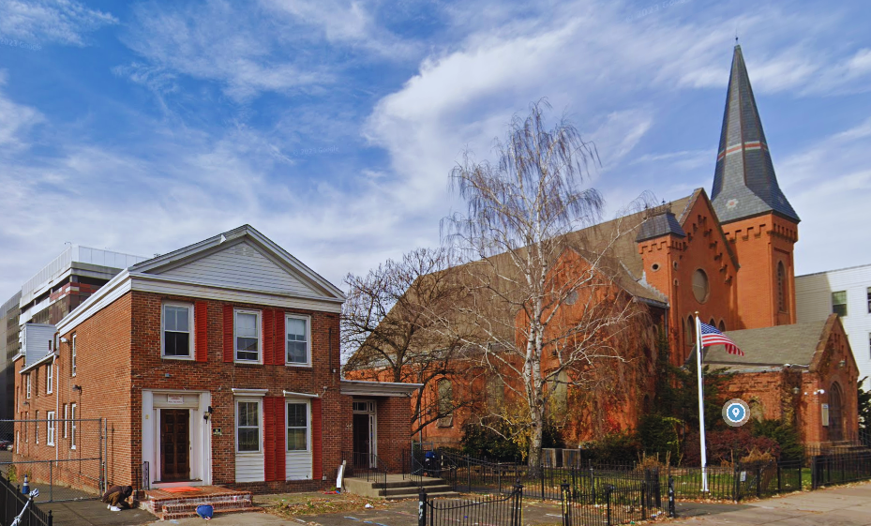
THE FUTURE
EXPANDING
SPI’S FOOTPRINT
More Space.
More people we can help.
Even more of an impact.

Slide 7
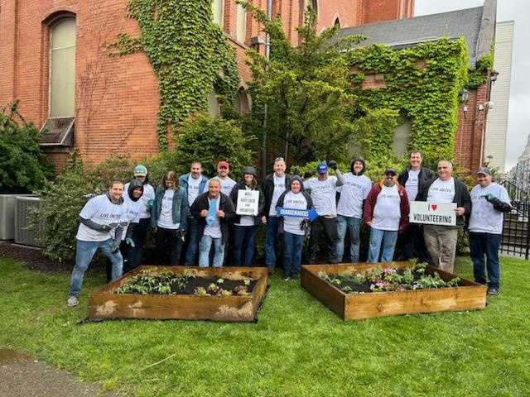
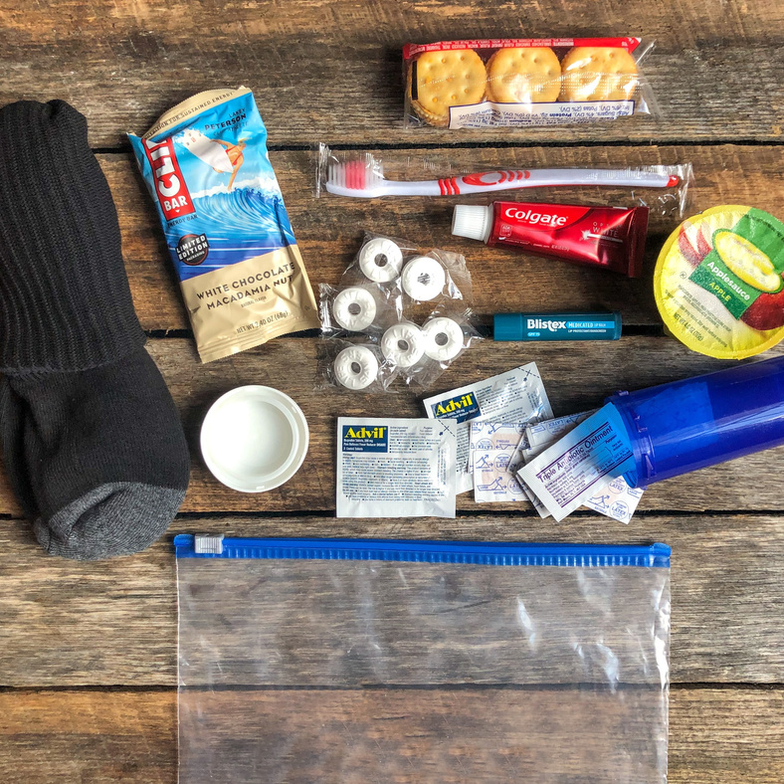
VOLUNTEERS
THIS WORK GETS DONE BECAUSE OF VOLUNTEERS AND DONORS LIKE YOU!

Slide 8
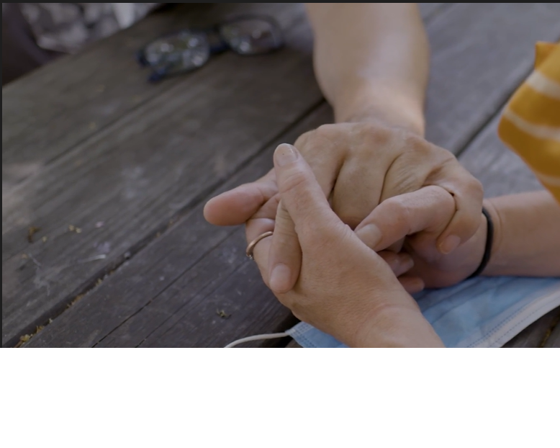
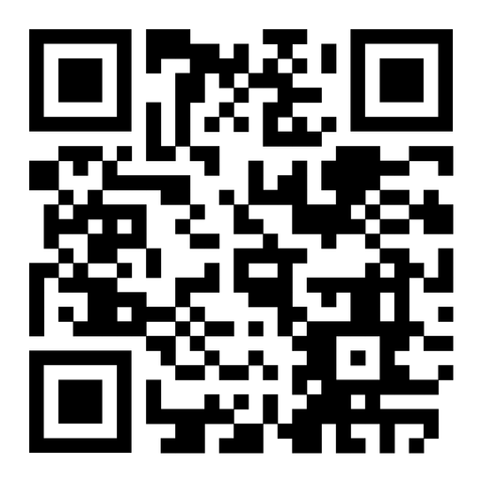
HOW YOU CAN CONTINUE TO HELP
DONATE TO THE YEAR-END APPEAL
Comforting hands
A woman recovering in the Respite Program this spring, holding hands with her boyfriend.
THANK YOU
E-NEWSLETTER SIGN UP: SOUTHPARKINN.ORG

