Slide 1
Capital Region Council of Governments June 30, 2023 Audit Presentation
January 10, 2024

Slide 3
Agenda:
Terms of the Engagement
Executive Summary
Financial Highlights
Federal and State Single Audit
Governance Communication
Upcoming GASB Pronouncements
Notes:
Our message to clients
We are who we are today because we listen closely to our clients. Those we serve want to be confident that when they need help — personally or professionally, today or in the future — we will bring relevant expertise. Therefore, we continuously advance a diverse team to deliver integrated capabilities across an ever-broadening spectrum of wealth advisory, outsourcing, and public accounting needs.
When asked what we do by prospects or friends, we say:
CLA escalates industry specialization to a new level. We believe that to serve you best, we must cultivate hyper-specialized industry professionals who understand not only your financial operations, but your entire organizational model and goals.
As the world changes, so do your opportunities and challenges. We constantly build our capabilities across our three integrated business lines so that when you have a need, we’re right next to you, ready to help.
As one of the nation’s leading professional service firms, CLA has never let up on our commitment to serve clients of all sizes and locations.
We have unparalleled expertise in serving private businesses and their owners. We believe that, over a lifetime, we can help them build wealth and create a lasting impact and legacy.
We align ourselves to leaders within nonprofits, health care organizations, governmental entities, financial institutions, and Fortune 1000 companies to help them advance their goals and realize their purpose.

Slide 4
Terms of the Engagement
Financial Statement and Single Audit

Slide 5
Terms of the Engagement:
Express opinions on whether the basic financial statements are presented in accordance with GAAP
Express an “in relation” to opinion on the schedule of expenditures of federal awards and schedule of expenditures of state financial assistance.
Express an opinion on compliance related to major federal and state award programs
Provide a report on internal control over financial reporting and compliance with laws, regulations, contracts and grants
Provide a report on internal control over compliance related to major federal and state award programs
Notes:
Our message to clients
We are who we are today because we listen closely to our clients. Those we serve want to be confident that when they need help — personally or professionally, today or in the future — we will bring relevant expertise. Therefore, we continuously advance a diverse team to deliver integrated capabilities across an ever-broadening spectrum of wealth advisory, outsourcing, and public accounting needs.
When asked what we do by prospects or friends, we say:
CLA escalates industry specialization to a new level. We believe that to serve you best, we must cultivate hyper-specialized industry professionals who understand not only your financial operations, but your entire organizational model and goals.
As the world changes, so do your opportunities and challenges. We constantly build our capabilities across our three integrated business lines so that when you have a need, we’re right next to you, ready to help.
As one of the nation’s leading professional service firms, CLA has never let up on our commitment to serve clients of all sizes and locations.
We have unparalleled expertise in serving private businesses and their owners. We believe that, over a lifetime, we can help them build wealth and create a lasting impact and legacy.
We align ourselves to leaders within nonprofits, health care organizations, governmental entities, financial institutions, and Fortune 1000 companies to help them advance their goals and realize their purpose.

Slide 6
Executive Summary
Audit Results

Slide 7
Executive Summary
Financial Statements
Unmodified opinion on the financial statements
Emphasis of matter paragraph – GASB No. 96 – Subscription Based Information Technology Arrangements
No findings reported in report on internal control and compliance
Federal Single Audit
Unmodified opinion on the financial statements
No findings reported in report on internal control and compliance
State Single Audit
Unmodified opinion on the major state programs
No compliance findings or significant deficiencies in internal control over compliance

Slide 8
Financial Highlights
Overview

Slide 9
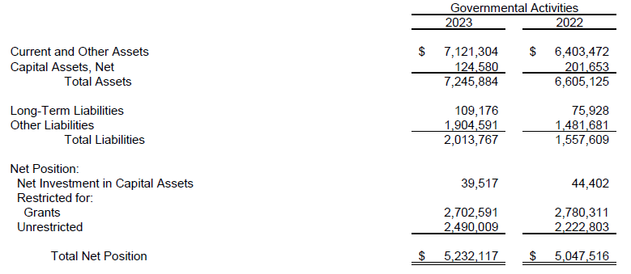
Financial Highlights
Government Wide Financial Statements

Slide 10
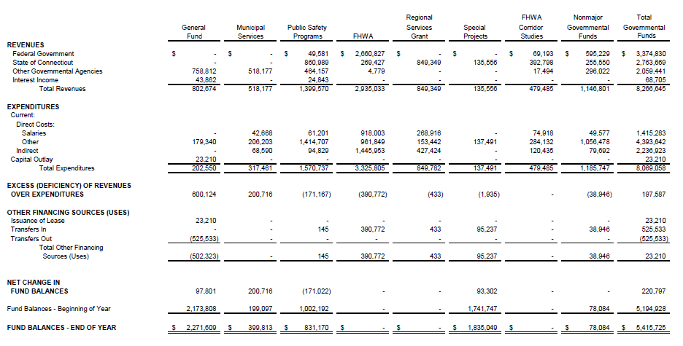
Financial Highlights – Governmental Funds

Slide 11
Financial Highlights
General Fund
Fund balance $2.27M
Unassigned $2.13M – portion of fund balance available for spending at CRCOG’s discretion
Nonspendable $141K for Prepaids

Slide 12
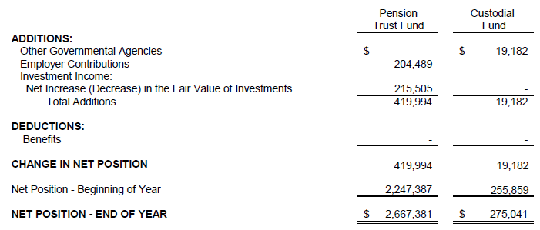
Financial Highlights – Fiduciary Funds

Slide 13
Federal and State Single Audit
Overview

Slide 14
Federal Single Audit:
Total federal awards expended - $4.77M
Major programs
Highway Planning and Construction
Unmodified opinion on major program compliance
No compliance or internal control findings
Notes:
Our message to clients
We are who we are today because we listen closely to our clients. Those we serve want to be confident that when they need help — personally or professionally, today or in the future — we will bring relevant expertise. Therefore, we continuously advance a diverse team to deliver integrated capabilities across an ever-broadening spectrum of wealth advisory, outsourcing, and public accounting needs.
When asked what we do by prospects or friends, we say:
CLA escalates industry specialization to a new level. We believe that to serve you best, we must cultivate hyper-specialized industry professionals who understand not only your financial operations, but your entire organizational model and goals.
As the world changes, so do your opportunities and challenges. We constantly build our capabilities across our three integrated business lines so that when you have a need, we’re right next to you, ready to help.
As one of the nation’s leading professional service firms, CLA has never let up on our commitment to serve clients of all sizes and locations.
We have unparalleled expertise in serving private businesses and their owners. We believe that, over a lifetime, we can help them build wealth and create a lasting impact and legacy.
We align ourselves to leaders within nonprofits, health care organizations, governmental entities, financial institutions, and Fortune 1000 companies to help them advance their goals and realize their purpose.

Slide 15
State Single Audit:
Total state awards expended - $1.64M
Major programs:
Regional Performance Incentive
Unmodified opinion on major program compliance
No compliance or internal control findings
Notes:
Our message to clients
We are who we are today because we listen closely to our clients. Those we serve want to be confident that when they need help — personally or professionally, today or in the future — we will bring relevant expertise. Therefore, we continuously advance a diverse team to deliver integrated capabilities across an ever-broadening spectrum of wealth advisory, outsourcing, and public accounting needs.
When asked what we do by prospects or friends, we say:
CLA escalates industry specialization to a new level. We believe that to serve you best, we must cultivate hyper-specialized industry professionals who understand not only your financial operations, but your entire organizational model and goals.
As the world changes, so do your opportunities and challenges. We constantly build our capabilities across our three integrated business lines so that when you have a need, we’re right next to you, ready to help.
As one of the nation’s leading professional service firms, CLA has never let up on our commitment to serve clients of all sizes and locations.
We have unparalleled expertise in serving private businesses and their owners. We believe that, over a lifetime, we can help them build wealth and create a lasting impact and legacy.
We align ourselves to leaders within nonprofits, health care organizations, governmental entities, financial institutions, and Fortune 1000 companies to help them advance their goals and realize their purpose.

Slide 16
Governance Communication
Summary

Slide 17
Governance Communication:
New standards adopted – GASB 96 Subscription Based Information Technology Arrangements (SBITA)
Right to Use Subscription Asset, Subscription Liability
Significant Estimates
Capital Assets – Useful lives
No disagreements with management
Management did not consult with other accountants
No difficulties encountered in performing the audit
No uncorrected misstatements
No independence issues
Notes:
Our message to clients
We are who we are today because we listen closely to our clients. Those we serve want to be confident that when they need help — personally or professionally, today or in the future — we will bring relevant expertise. Therefore, we continuously advance a diverse team to deliver integrated capabilities across an ever-broadening spectrum of wealth advisory, outsourcing, and public accounting needs.
When asked what we do by prospects or friends, we say:
CLA escalates industry specialization to a new level. We believe that to serve you best, we must cultivate hyper-specialized industry professionals who understand not only your financial operations, but your entire organizational model and goals.
As the world changes, so do your opportunities and challenges. We constantly build our capabilities across our three integrated business lines so that when you have a need, we’re right next to you, ready to help.
As one of the nation’s leading professional service firms, CLA has never let up on our commitment to serve clients of all sizes and locations.
We have unparalleled expertise in serving private businesses and their owners. We believe that, over a lifetime, we can help them build wealth and create a lasting impact and legacy.
We align ourselves to leaders within nonprofits, health care organizations, governmental entities, financial institutions, and Fortune 1000 companies to help them advance their goals and realize their purpose.

Slide 18
Upcoming GASB Pronouncements
Summary

Slide 19
GASB Standards:
Implementation Year 2024:
Statement 99 – Omnibus 2022 (various)
Statement 100 – Accounting Changes and Error Corrections
Implementation Year 2025:
Statement 101 – Compensated Absences
Notes:
Our message to clients
We are who we are today because we listen closely to our clients. Those we serve want to be confident that when they need help — personally or professionally, today or in the future — we will bring relevant expertise. Therefore, we continuously advance a diverse team to deliver integrated capabilities across an ever-broadening spectrum of wealth advisory, outsourcing, and public accounting needs.
When asked what we do by prospects or friends, we say:
CLA escalates industry specialization to a new level. We believe that to serve you best, we must cultivate hyper-specialized industry professionals who understand not only your financial operations, but your entire organizational model and goals.
As the world changes, so do your opportunities and challenges. We constantly build our capabilities across our three integrated business lines so that when you have a need, we’re right next to you, ready to help.
As one of the nation’s leading professional service firms, CLA has never let up on our commitment to serve clients of all sizes and locations.
We have unparalleled expertise in serving private businesses and their owners. We believe that, over a lifetime, we can help them build wealth and create a lasting impact and legacy.
We align ourselves to leaders within nonprofits, health care organizations, governmental entities, financial institutions, and Fortune 1000 companies to help them advance their goals and realize their purpose.

Slide 20
Questions?

