Slide 1
Regional Planning Commission
Welcome to a CRCOG Zoom Meeting
We have muted attendees upon entrance. We will unmute people either individually or for everyone depending on the situation.
For our public meetings, we will be taking a roll-call of attendance based on who we identify as being on the call and then ask those we cannot identify to state their name and town.
Each time you speak, you must identify yourself with your name and town prior to making your point.
If you are abstaining or objecting to an action item, please state your name and town.
Meeting materials are available at CRCOG.org

Slide 2
Regional Planning Commission
Welcome and Introductions
Adoption of Minutes: March 21, 2024 (attachment)
Vote to Set the Date and Time of the 2024 Plan of Conservation and Development Public Hearing
CRCOG Staff Updates
Report on Zoning and Subdivision Referrals
What's New in My Town (Break Out Rooms Depending on Attendance)
Other Business

Slide 3
1. Welcome & Introductions

Slide 4
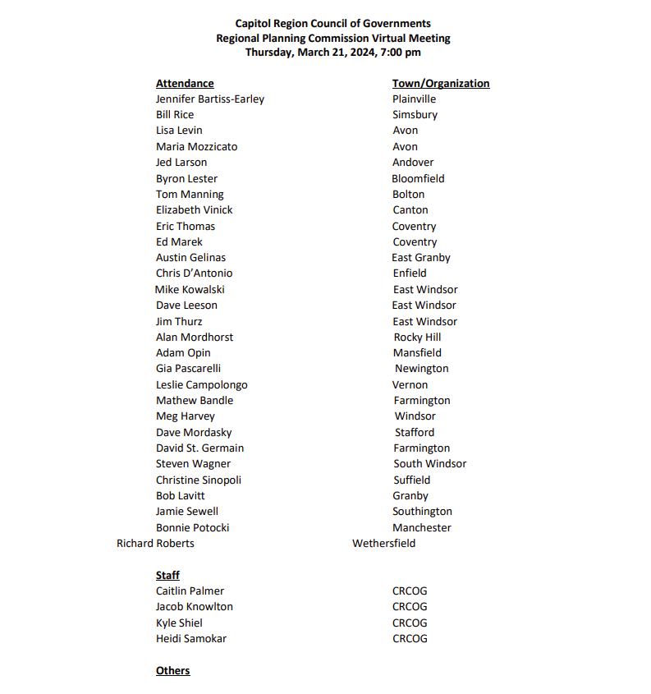
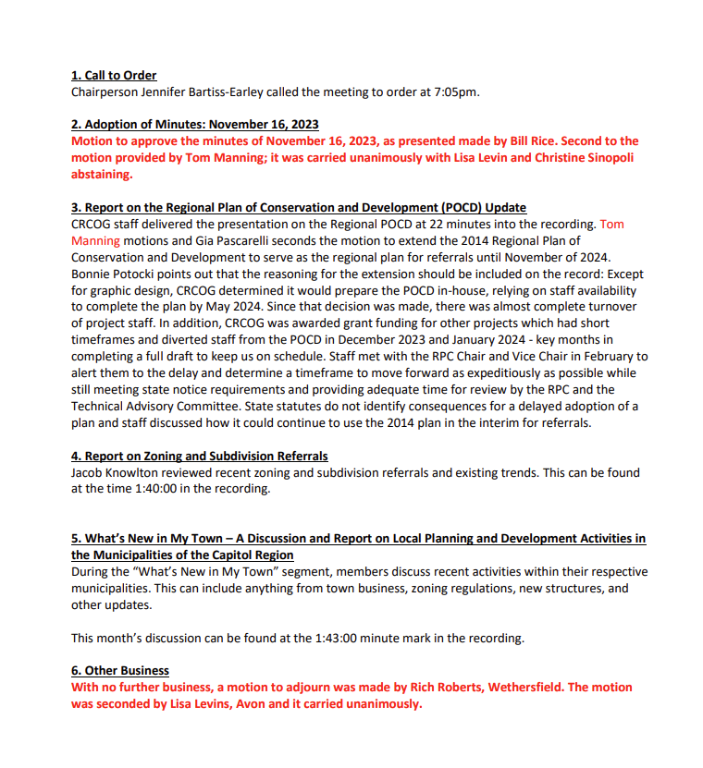
2. Adoption of Minutes: 3/21/2024

Slide 5
3. Vote to Set the 2024 POCD Update Public Hearing
Notes:
Enfield: Utalized the sustainability triangle to form a resiliency chapter with language that was extremely validating of the human experience, covering equity very well: I'm excited to see how it applies to their land-use decisions in the future.

Slide 6
4. CRCOG Staff Updates
New Staff!
Climate
Housing
Warehousing
Stormwater
Micromobility
Notes:
Enfield: Utalized the sustainability triangle to form a resiliency chapter with language that was extremely validating of the human experience, covering equity very well: I'm excited to see how it applies to their land-use decisions in the future.

Slide 7
4. CRCOG Staff Updates – New Staff!
Sonya Carrizales
Environmental Planner
Kim Bishop
Economic Development Coordinator
Notes:
And for those of you familiar or involved with SCT – we also are joined this summer by 2 Fellows – Adrian Huq and Brett Hurley – if you want contact information for anyone, just request that in the chat

Slide 8
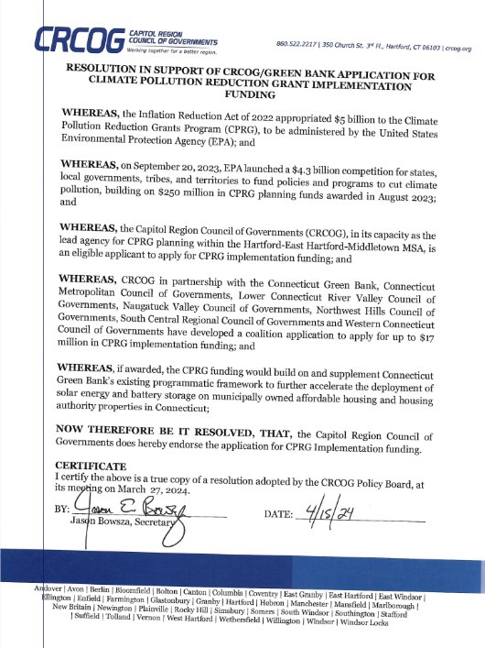
4. CRCOG Staff Updates – Climate Action Planning
Priority Climate Action Plan
Completed! Approved by EPA
Comprehensive CAP
Due next Summer
Reviewing 80+ actions
$17.7M Implementation Grant Application
Contact Kyle:
kshiel@crcog.org
Notes:
The MSA received $1M in funding through the Climate Pollution Reduction Grant program to conduct climate action planning work – CRCOG is the lead agency for the MSA (our region plus RiverCOG+)
Kyle continuing to lead the climate planning work we’re doing
Completed the priority CAP earlier this year – identified 6 priority actions
Building off one of those, we submitted as lead applicant for a coalition of 7 COGs and implementation grant application to help install and remove barriers to solar panel installation
Currently working on the CCAP, all the actions that didn’t make it into the priority plan are now being reviewed and will need to be measured for their potential to reduce GHGs

Slide 9
4. CRCOG Staff Updates – Regional Housing Strategy
A toolkit to:
Help municipalities implement their Affordable Housing Plans & tackle housing-related challenges
Identify regional roles in creating affordable housing
Preparing Scope of Work / Request for Qualifications (RFQ)
Deeper dive into data, clear & compelling guidance documents, one-pagers, tools for public, trainings, & more.
Anticipate releasing the RFQ this Summer
Contact Heidi:
hsamokar@crcog.org
NVCOG Housing and School Enrollment Webinar
https://nvcogct.gov/what-we-do/land-use/education-training/
Notes:
https://nvcogct.gov/what-we-do/land-use/education-training/
PUT IN CHAT

Slide 10
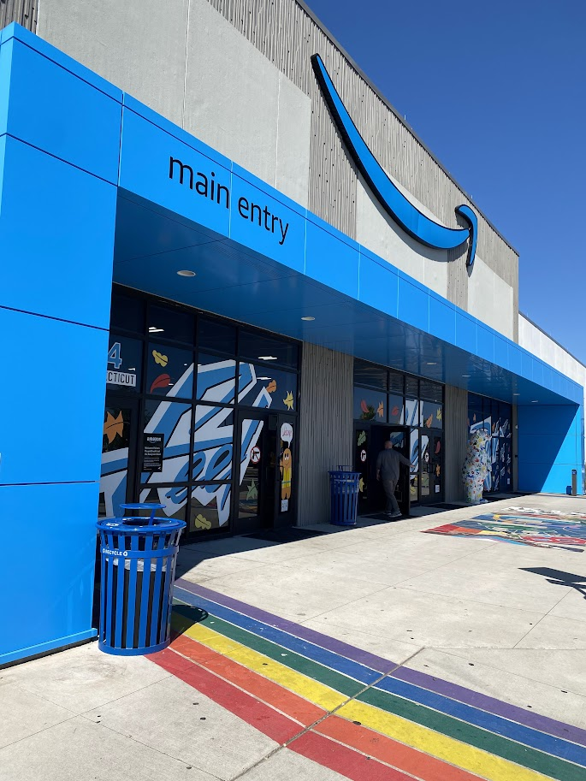
4. CRCOG Staff Updates – Warehousing Study
RFP released in Mayand have received 3 submissions, select by end of July
Better understanding of trip generation, environmental, brick-and-mortar retail impacts as well as transportation infrastructure and land development needs for warehouse and distribution centers
Goal to help state, regional, and local policymakers better understand the challenges and opportunities presented by the growth in e-commerce and associated logistics and warehousing centers
Contact Kyle:
kshiel@crcog.org

Slide 11
4. CRCOG Staff Updates – Stormwater & Hazard Mitigation
DEEP Grant to explore a regional stormwater authority/utility - project kick-off likely in Fall 2024
FEMA remapping Farmington River floodplains, event later this year
Resilient 2.0 identifying vulnerable areas for further technical assistance
Hazard Mitigation & Climate Adaptation Plan - awaiting FEMA approval then local adoption begins
Contact Heidi:
hsamokar@crcog.org

Slide 12
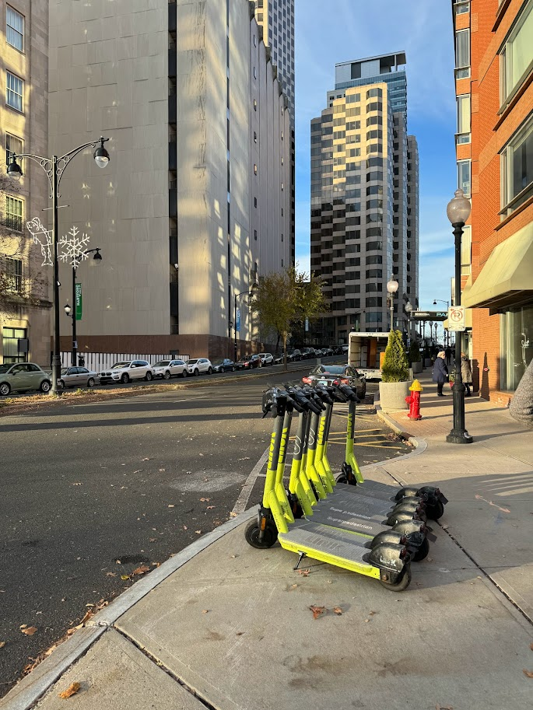
4. CRCOG Staff Updates - Micromobility
RFP released seeking a new vendor to provide micromobility services
Resolution to Policy Board later this month
1st Phase – Hartford, New Haven, New Britain pilot (Spring)
2nd Phase – other interested CRCOG and Capitol Region Purchasing Council towns

Slide 13
5. Report on Zoning and Subdivision Referrals
Notes:
Enfield: Utalized the sustainability triangle to form a resiliency chapter with language that was extremely validating of the human experience, covering equity very well: I'm excited to see how it applies to their land-use decisions in the future.

Slide 14
6. What’s New in My Town

Slide 15
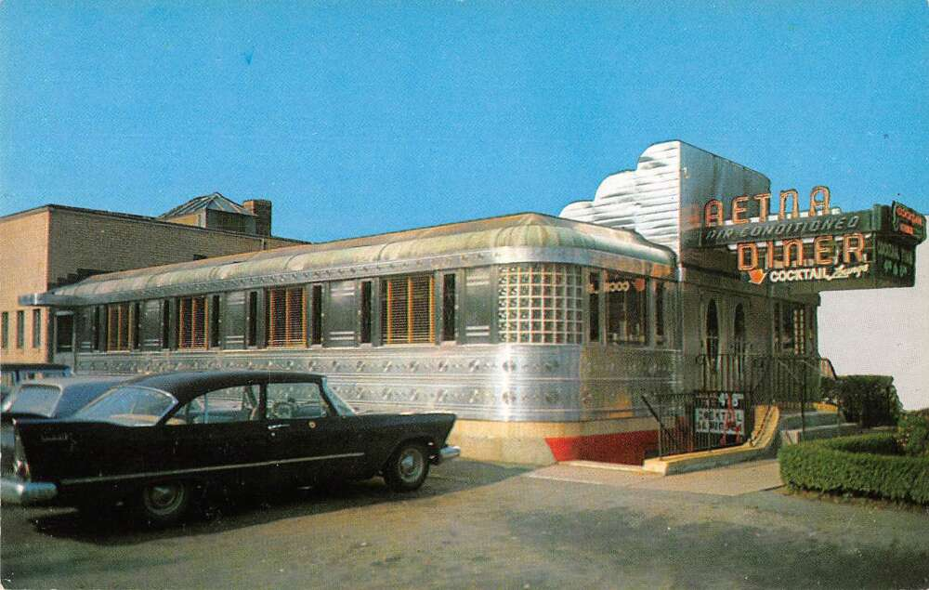
7. Other Business

