Slide 1
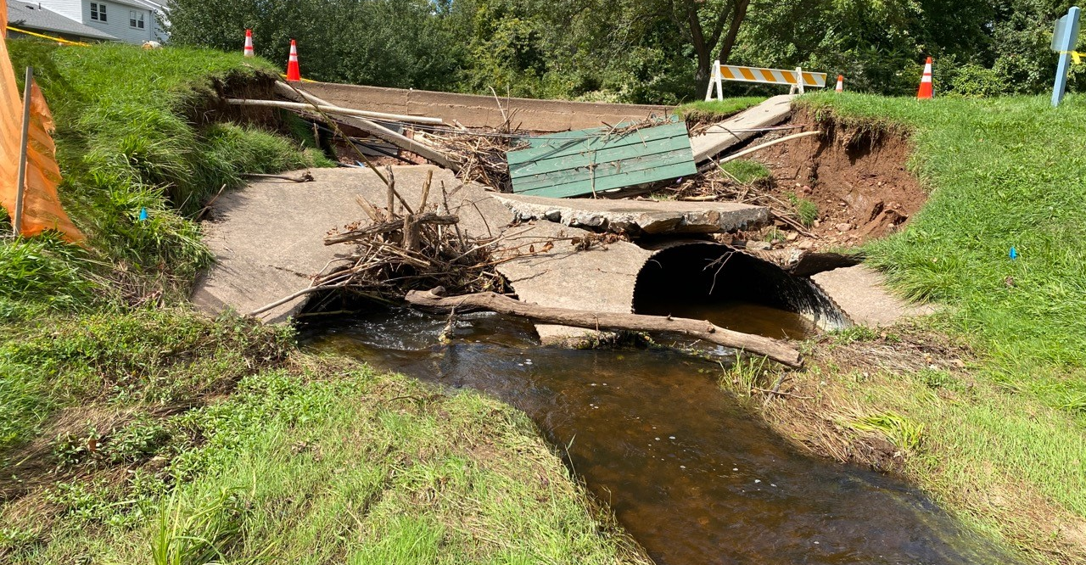
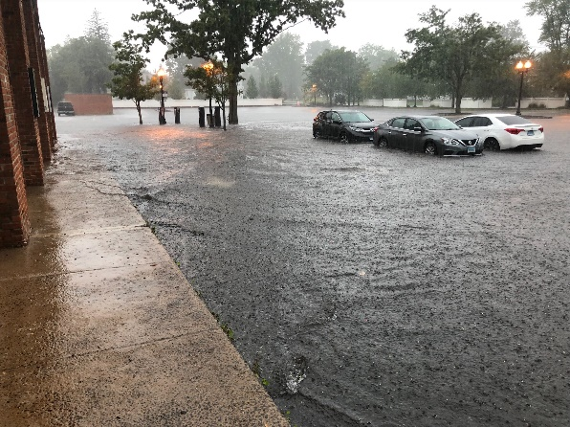
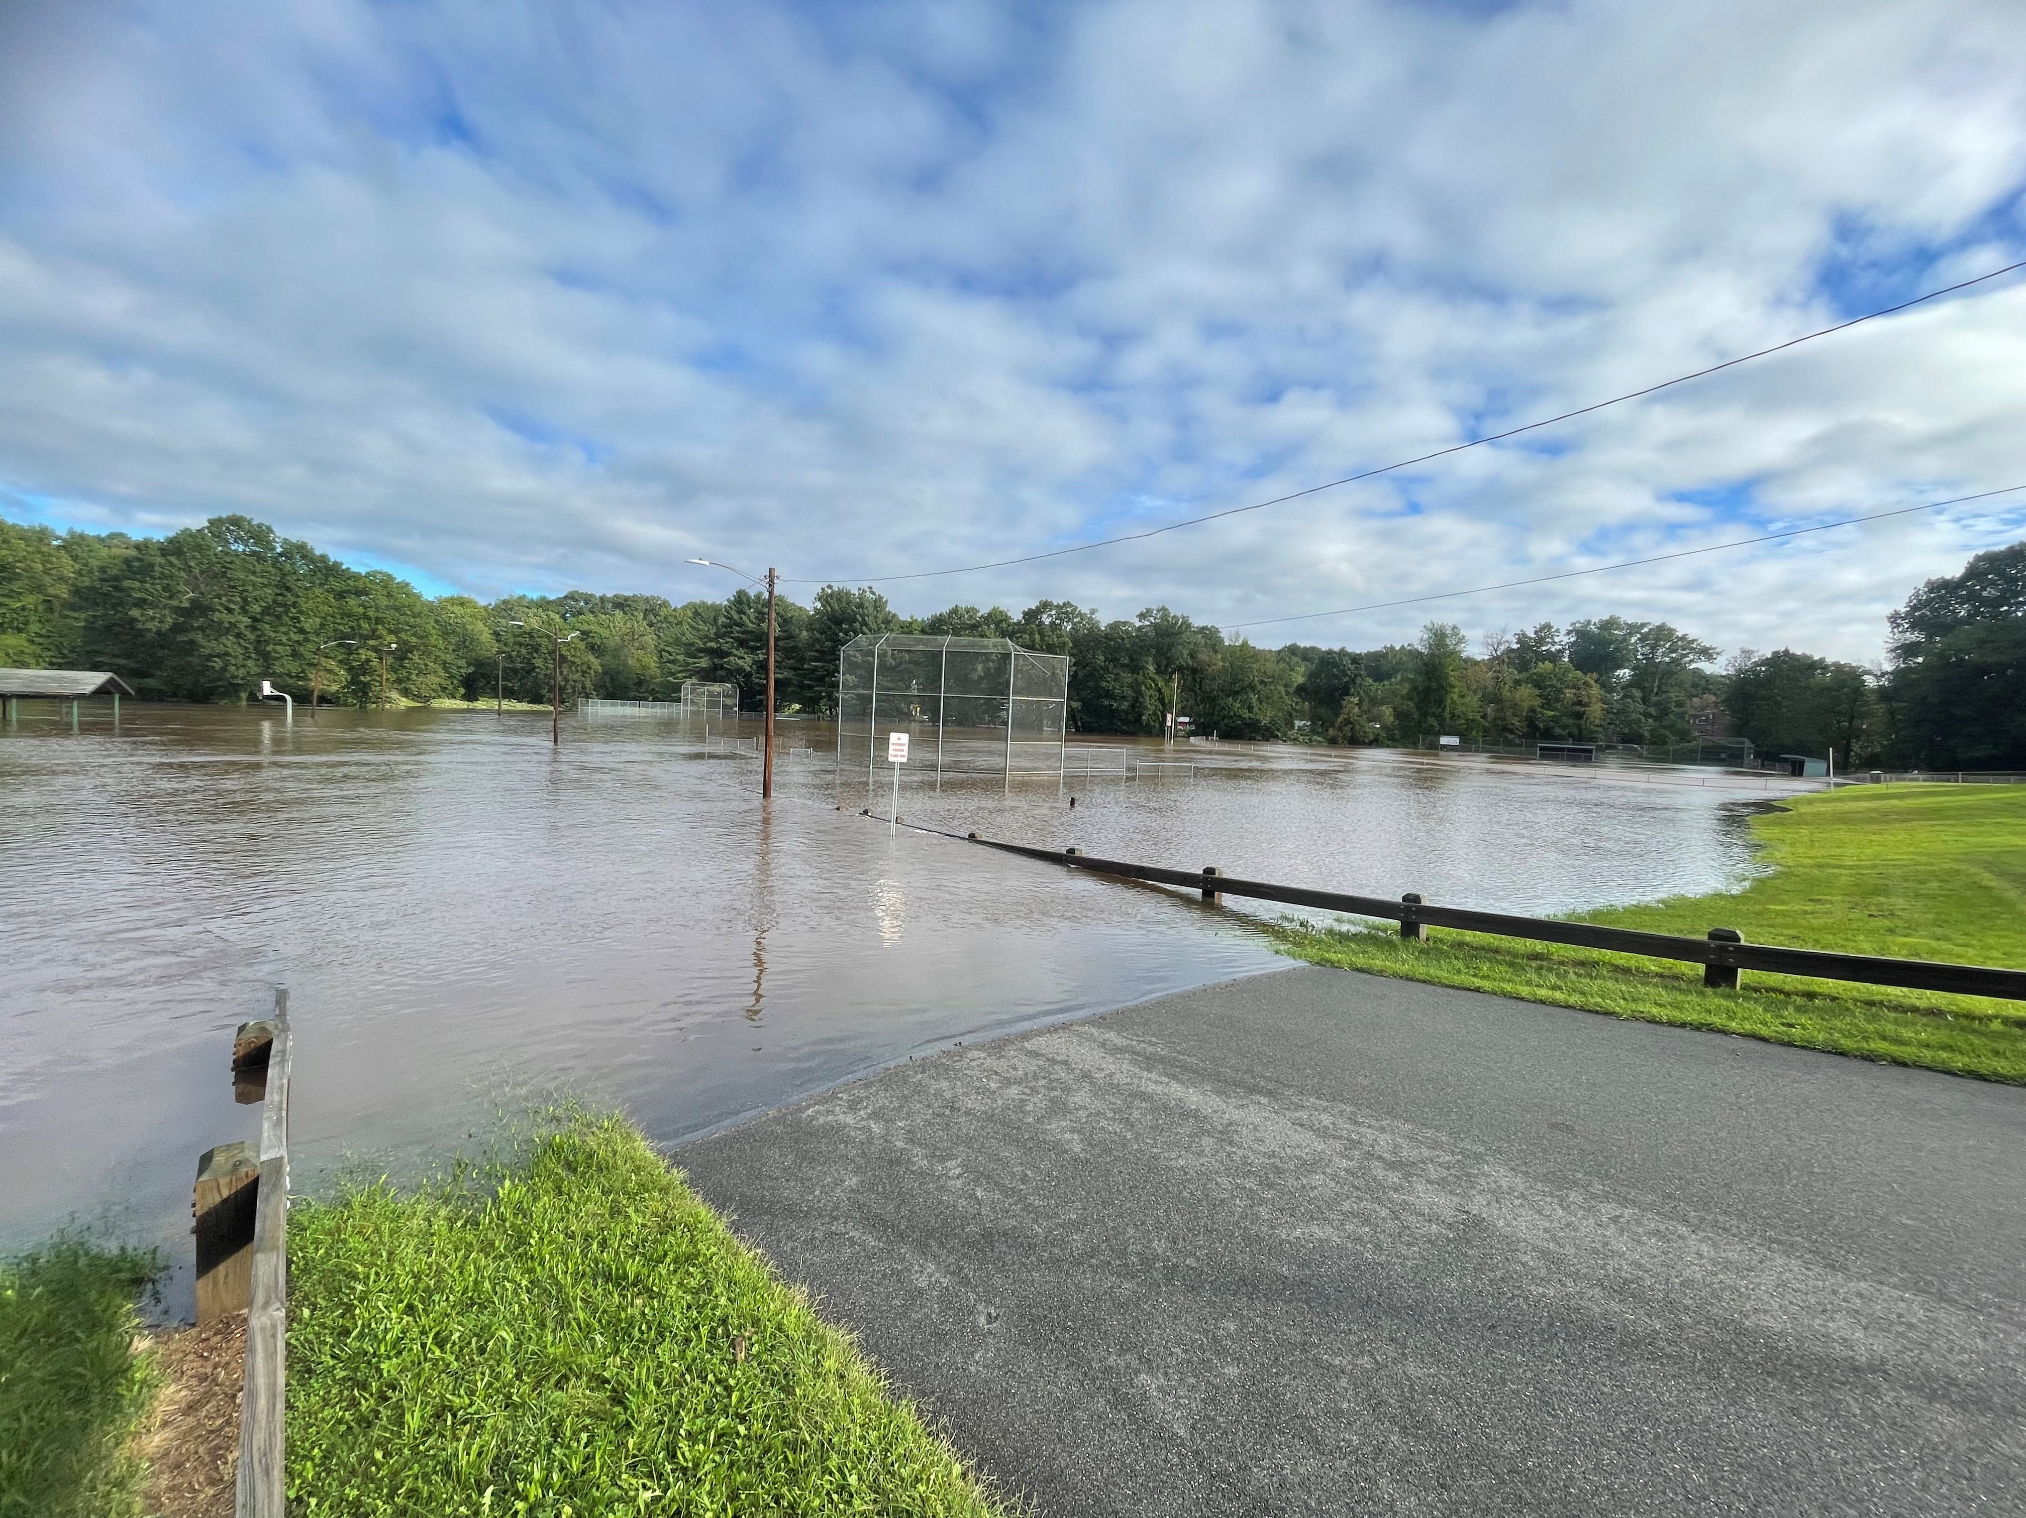
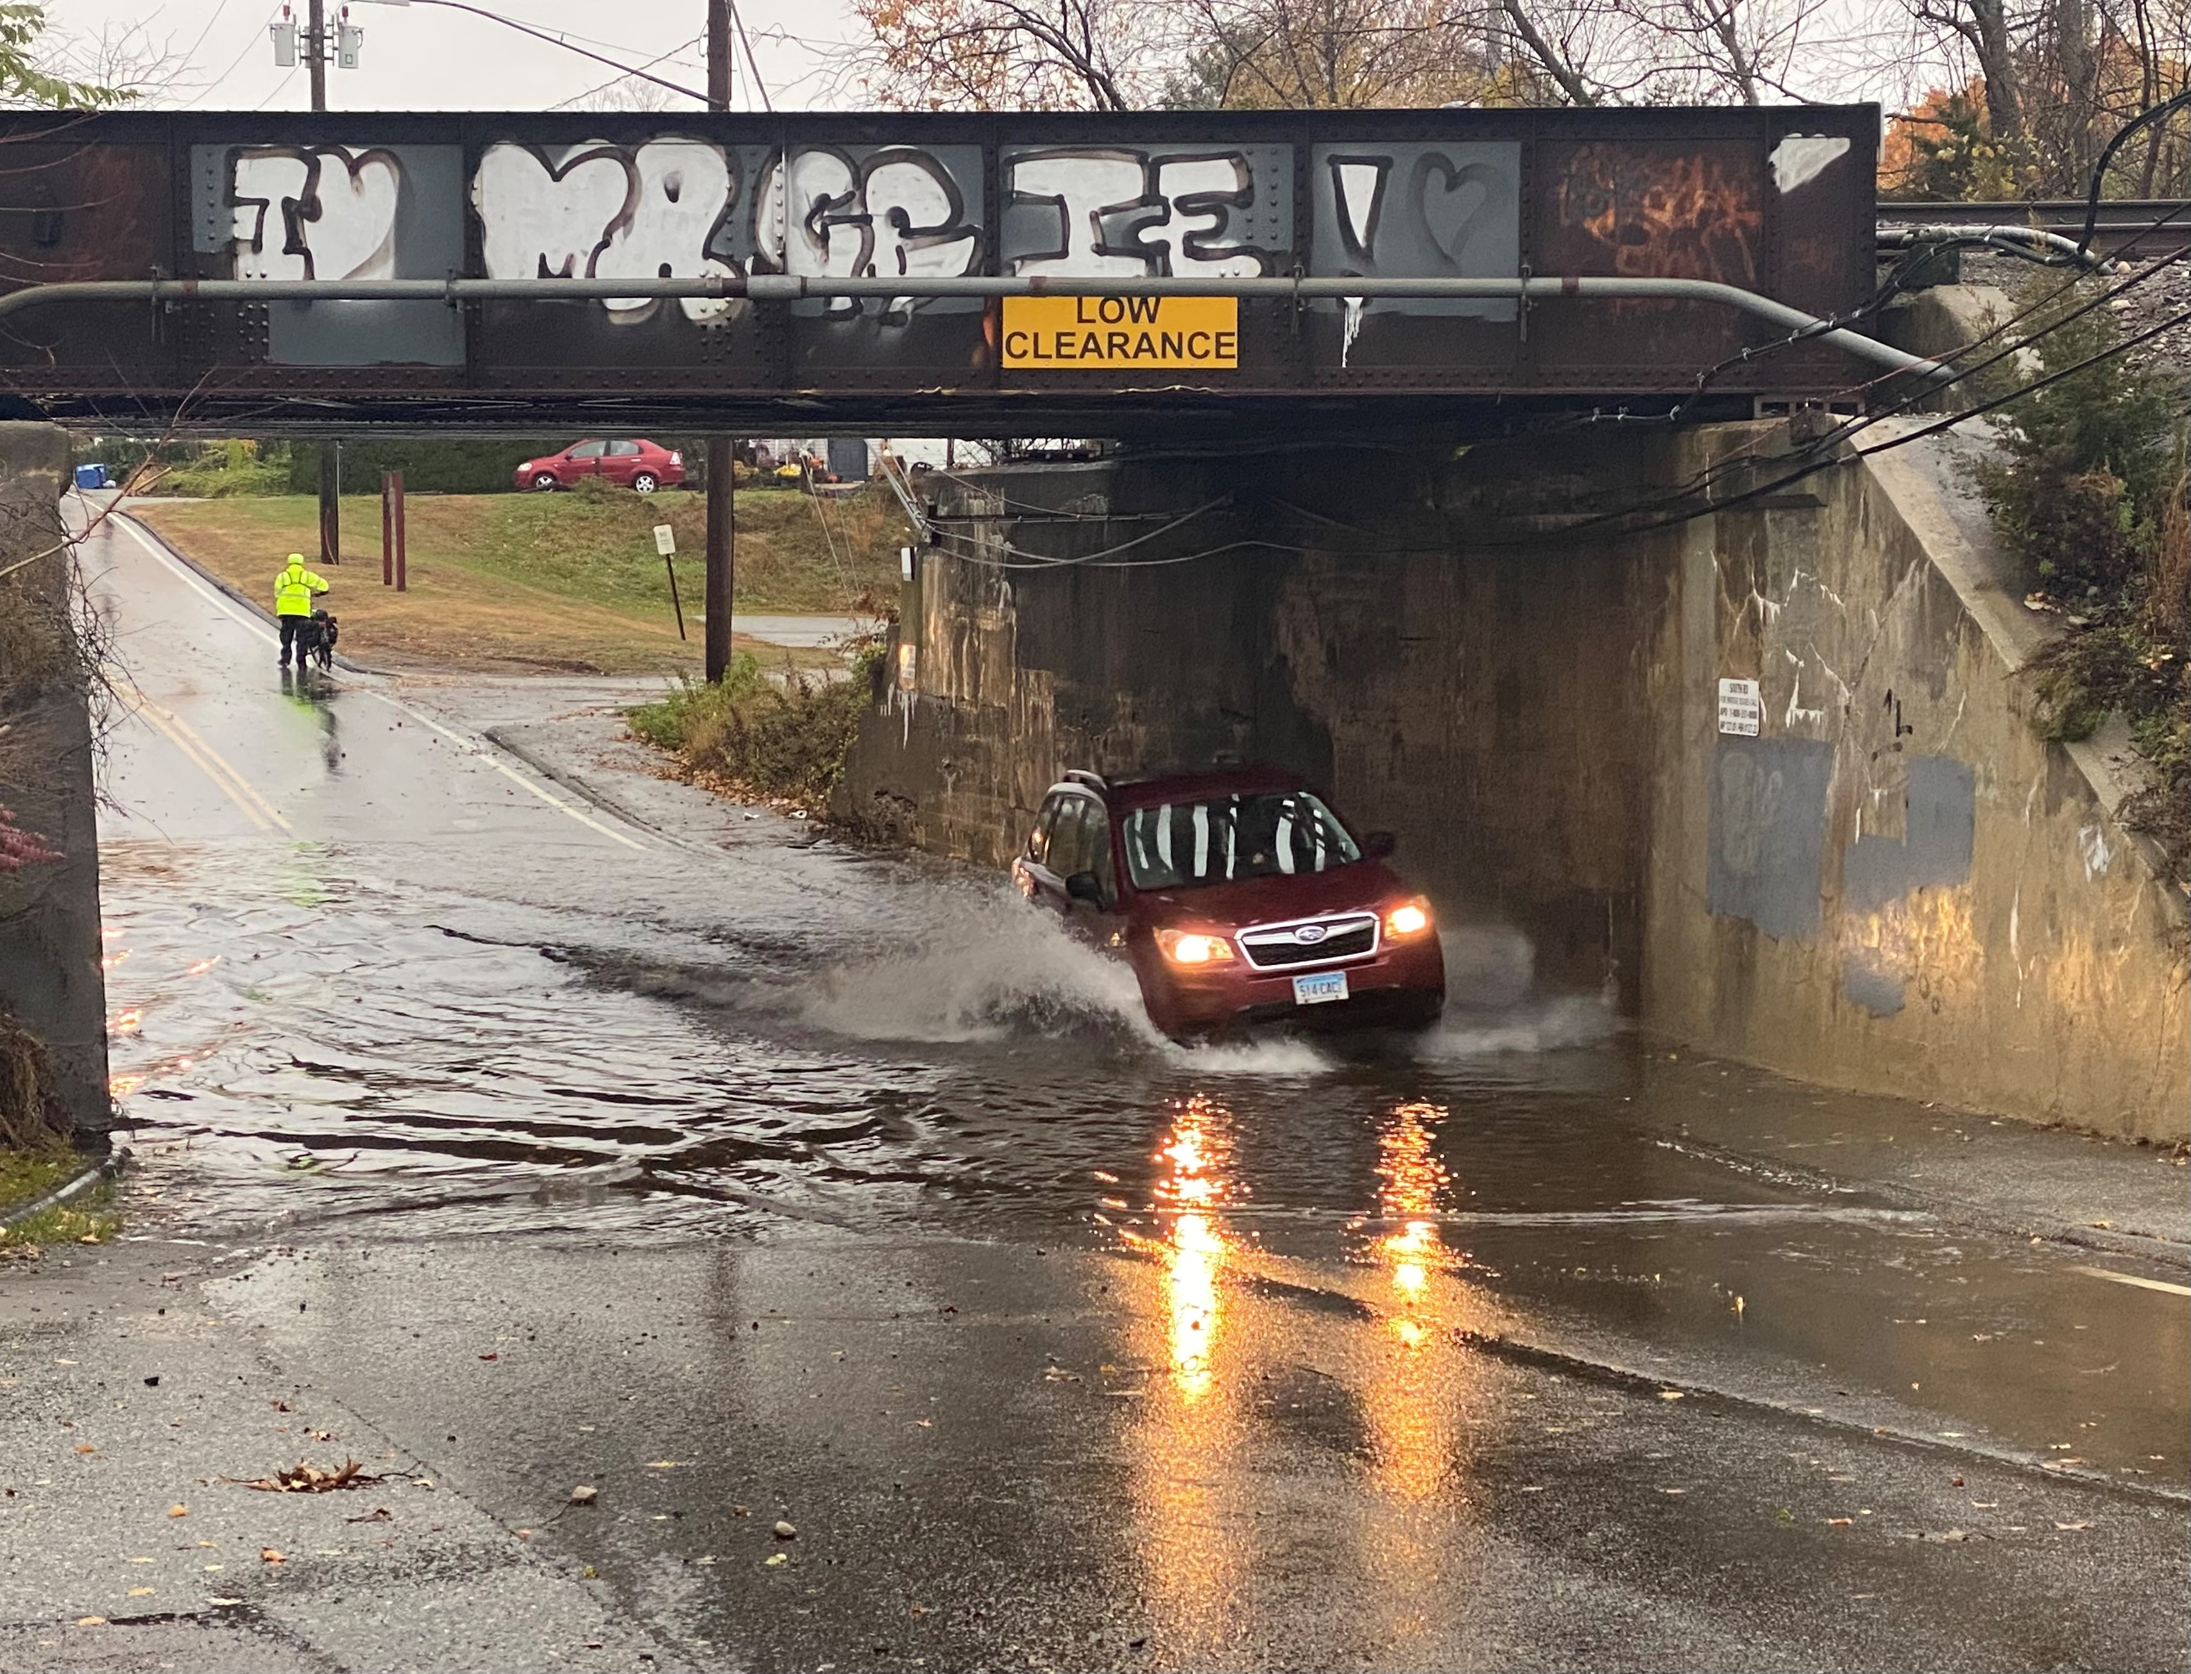
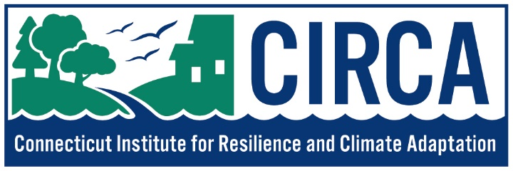
“RESILIENT CONNECTICUT 2.0” Update
Expanding a Climate Adaptation and Resilience
Planning Process in the Capitol Region
Presentation for the Policy Board
March 27th, 2024

Slide 2
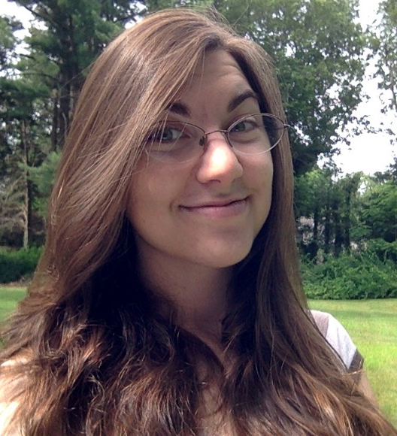
MEET THE PLANNING TEAM
Mary Buchanan, PhD
Community Resilience Planner
Support as needed:
John Truscinski, CFM
Director of Resilience Planning
Yaprak Onat, PhD
Director of Research
Nicole Govert, MS
Community Resilience Planner

Slide 3
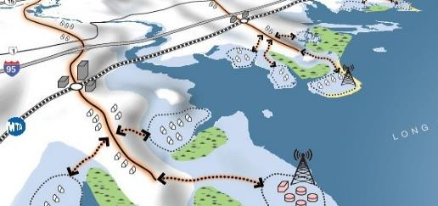
WHAT IS RESILIENT CONNECTICUT?
Resilient Connecticut 1.0 was funded by the National Disaster Resilience Competition and focused on regional resilience and adaptation planning for flooding and extreme heat in Fairfield and New Haven Counties.
Emphasized transit-oriented development, affordable housing, critical infrastructure, and regional assets.
Developed Social Vulnerability Index (SVI), Climate Change Vulnerability Index (CCVI), Zones of Shared Risks (ZSR), and Resilience Opportunity Areas (ROARs)
Resilient Connecticut 2.0 extends this effort using State funds.
Increases flexibility to address the climate concerns unique to other regions.
CRCOG is a partner in the deployment of the program in north-central Connecticut

Slide 4
RESILIENT CONNECTICUT METHODOLOGY
A Climate Change Vulnerability Index (CCVI) was developed statewide
Flood Vulnerability
Heat Vulnerability
Flooding can be coastal, riverine, or pluvial (heavy rain)
Considers where extreme heat is more likely as well as inability to seek respite
Sensitivity X Exposure
Adaptive Capacity
Vulnerability =

Slide 5
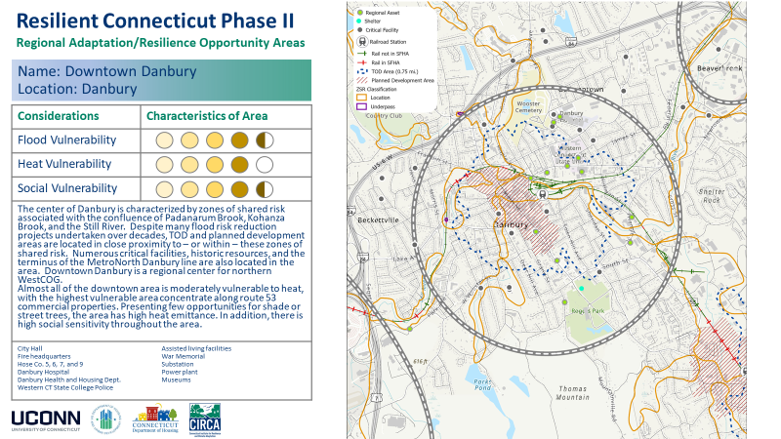
RESILIENT CONNECTICUT METHODOLOGY
Climate Challenges were Recognized as Opportunities to Address Unmet Needs
Overlapping
Social vulnerability
Flood vulnerability
Heat vulnerability
Regional assets
Infrastructure
Critical facilities
Historic resources
TOD potential

Slide 6
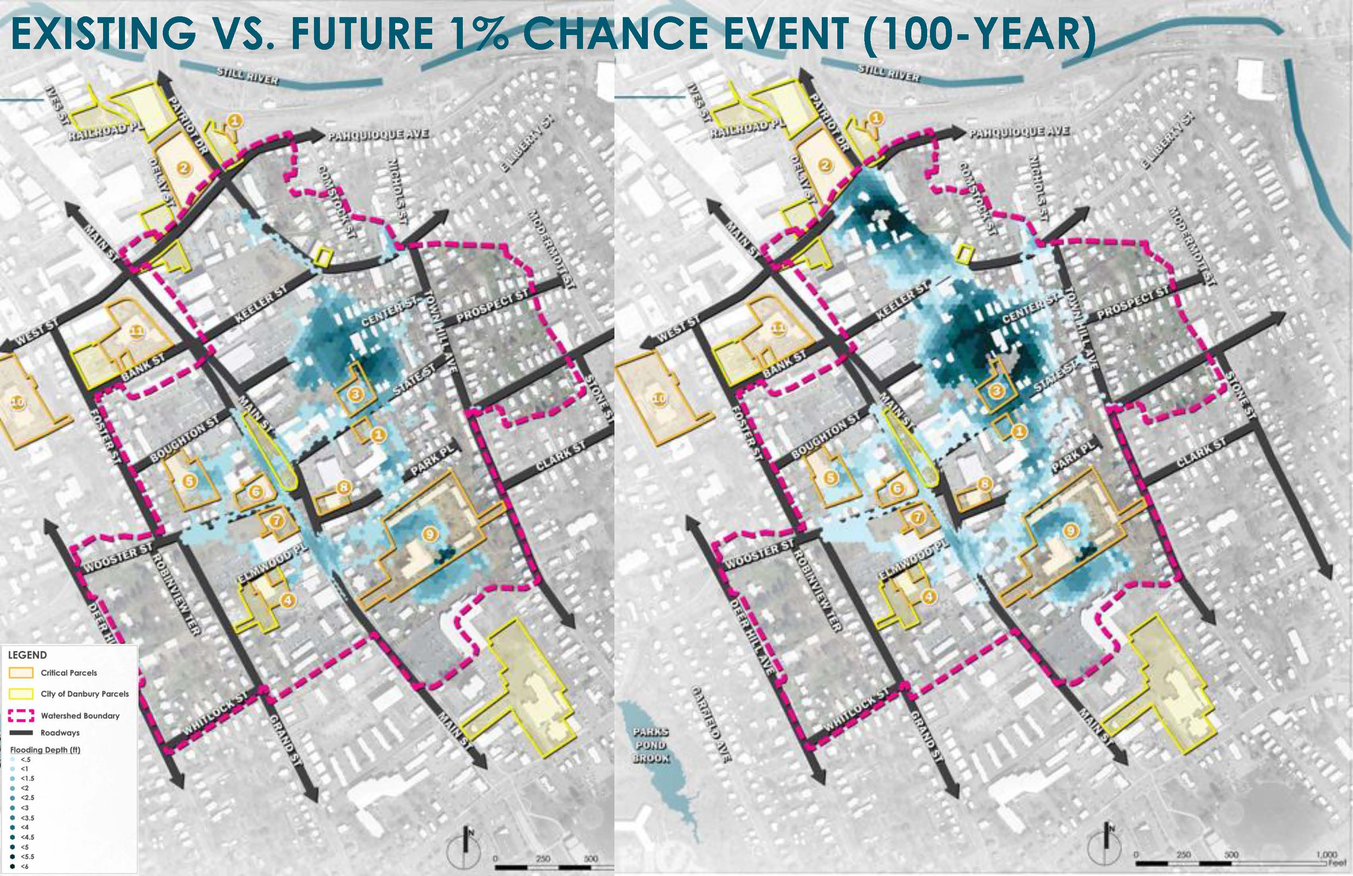
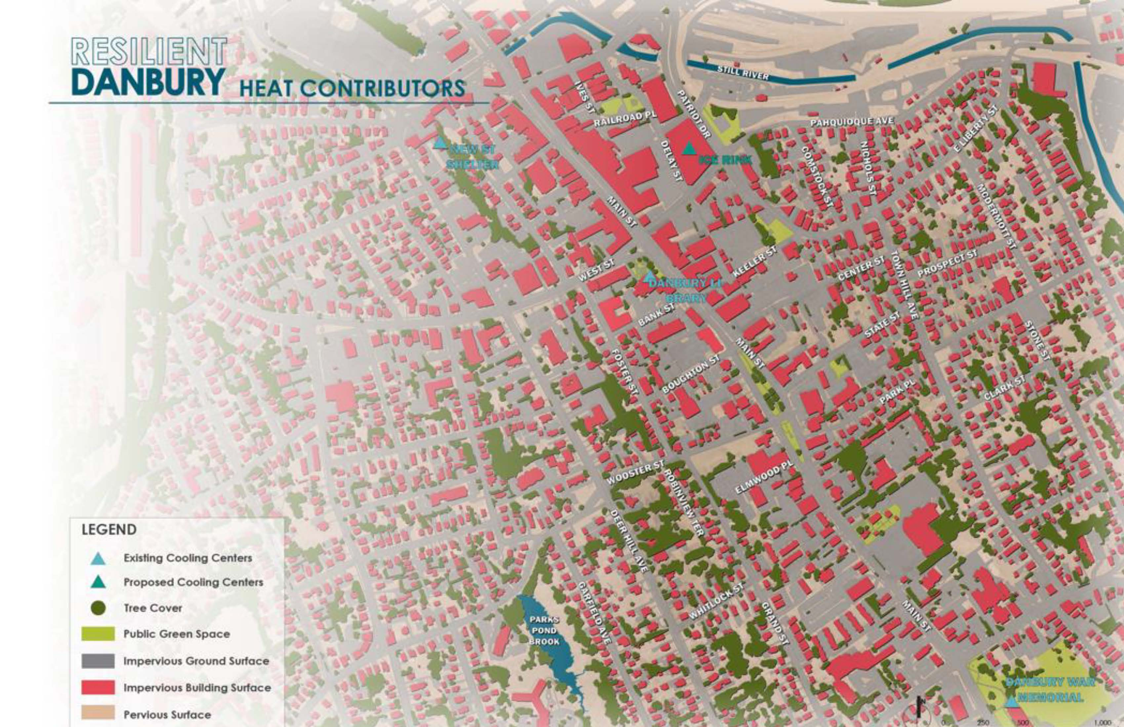
RESILIENT CONNECTICUT METHODOLOGY
Some of These Opportunity Areas Are Proceeding to Studies and Concept Designs

Slide 7
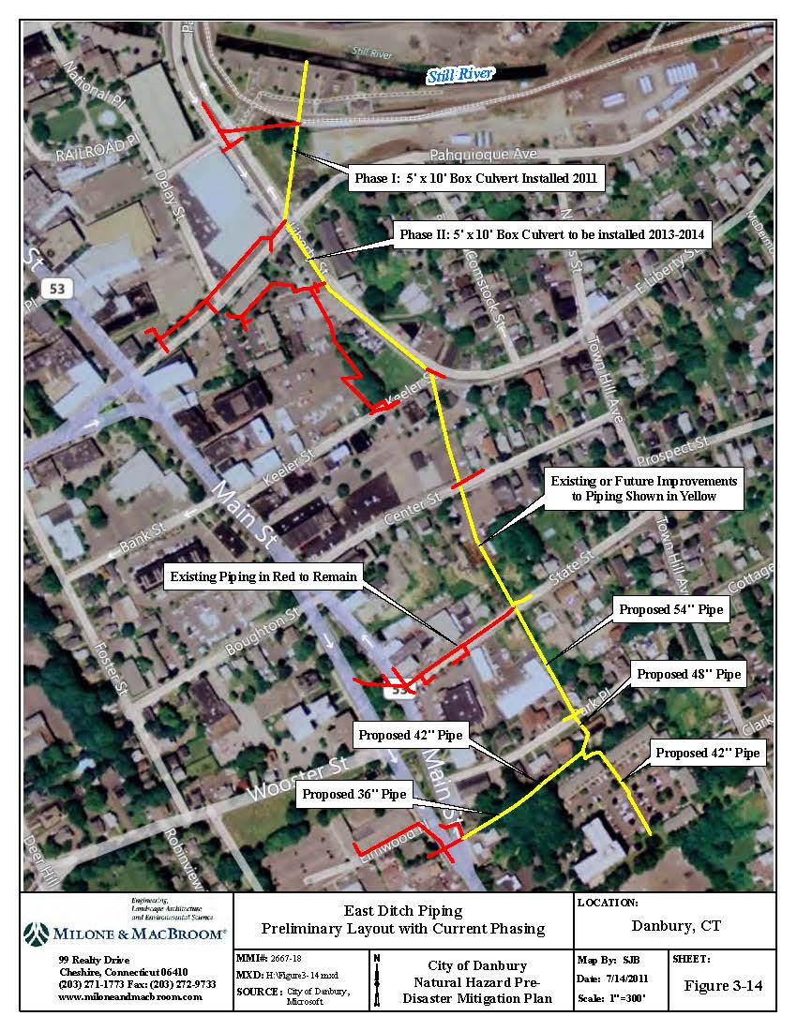
REMEMBER THE GOAL
Opportunity Areas Proceeding to Concept Design from the planning phase
Danbury – Flood mitigation, identification of cooling center, and green infrastructure for co-benefits
Norwalk – Resilient corridors and heat mitigation in South Norwalk
Fairfield – Addressing flooding railroad underpasses and advancing green infrastructure
Stratford – Re-envisioning flood solutions for the South End
Ansonia – “Whole downtown resilience” through heat mitigation and TOD connectivity across river
Branford – Using railroad grade and flood gate for flood protection
New Haven – Egress through areas of flood risk (underpasses, bridges, etc.) and heat mitigation for the Fair Haven neighborhood

Slide 8
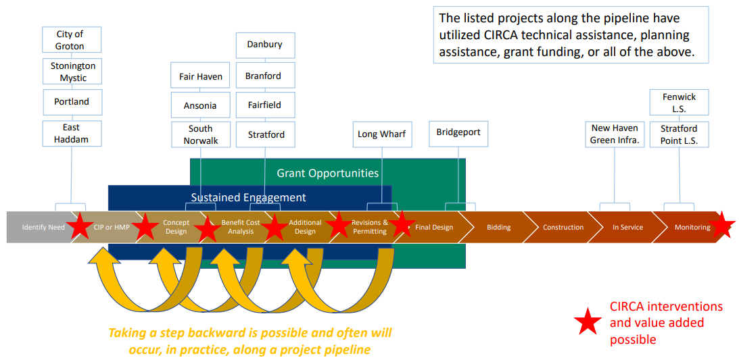
Goal: Help populate the State’s “Resilience Project Pipeline”
Resilient CT 2.0 was expanded into RiverCOG and SCCOG with projects starting soon
And now: CRCOG!

Slide 9
WHAT IS RESILIENT CONNECTICUT?
Resilient Connecticut 1.0 was funded by the National Disaster Resilience Competition and focused on regional resilience and adaptation planning for flooding and extreme heat in Fairfield and New Haven Counties.
Emphasized transit-oriented development, affordable housing, critical infrastructure, and regional assets.
Developed Social Vulnerability Index (SVI), Climate Change Vulnerability Index (CCVI), Zones of Shared Risks (ZSR), and Resilience Opportunity Areas (ROARs)
Resilient Connecticut 2.0 extends this effort using State funds.
Increases flexibility to address the climate concerns unique to other regions.
CRCOG is a partner in the deployment of the program in north-central Connecticut

Slide 10
How We ID ROARS in CRCOG
Questions we asked:
Where do you see intersections of assets and flood-related challenges?
Where do you see intersections of assets and extreme heat-related challenges?
Does your municipality face any examples of unique climate driver typologies and challenges? Examples:
Vulnerable populations at risk for flooding and extreme heat
Clusters of critical facilities at risk for flooding and extreme heat
Lack of cooling centers or respite from extreme heat events
Redevelopment pressures and Transit-Oriented Development (TOD) at risk
Unresolved and emerging flood concerns like those of summer 2021
Sewer infrastructure and treatment plants at risk

Slide 11
CRITERIA FOR IDENTIFYING ROARS IN CRCOG
Factor | Potential Criteria to Count | Zones of Shared Risk | Mod-High Flood | Mod-High Heat
Regional Assets | One or more; use DECD and COG-provided data | Must be inside | Yes | Yes
Critical Facilities | Two or more | Must be inside | Yes | Yes
Resilient Corridors | Collectors and arterials; including State-owned | Must intersect | Yes | No
Transit Oriented Development | Rail and busway passenger stations | Must intersect | Yes | Yes
Historic Resources | One district or >10 structures | Must be inside | Yes | Yes
Existing Affordable Housing | Two or more assets | Must be inside | Yes | Yes
WWTP | Serving SV/EJ customers | Must be inside | Yes | No
Public Water Supply Watersheds | Serving SV/EJ customers | Must intersect | Yes | No
Public Water Supply Wells | Serving SV/EJ customers | Must be inside | Yes | No
Private Dams | Class A or lower; not State-owned | Must be upstream | Yes | No
Brownfields | Two or more | Must be inside | Yes | Yes
Septic Systems | >10 single family homes (>2,000 gpd) | Must be inside | Yes | No
Home elevation unmet needs | SV/EJ Census Tracts | Must be inside | Yes | No

Slide 12
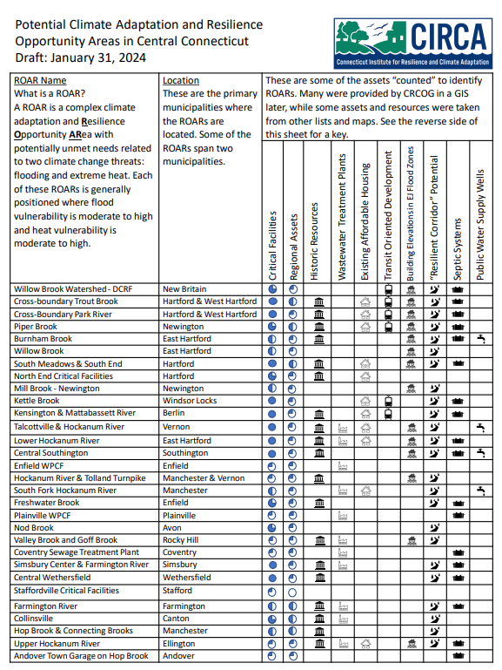
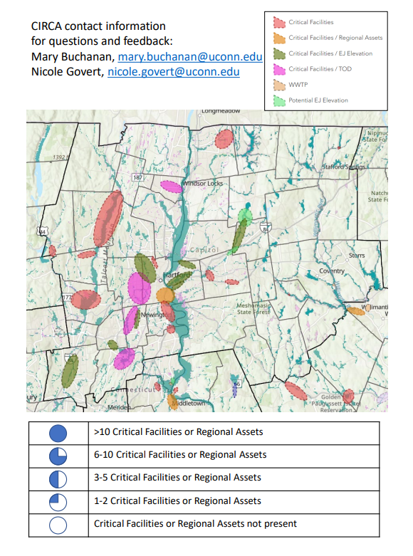
RESILIENCE OPPORTUNITY AREA INFO SHEET

Slide 13
Upcoming Projects in the CRCOG Region
CIRCA will be a partner on two DEEP Climate Resilience Fund projects that overlap with ROARs within the CRCOG Region and meet Resilient Connecticut goals:
Willow Brook Watershed – New Britain
Kennedy Brook & Kane Brook – Hartford / West Hartford
We are also looking to do 2-3 more projects in the CRCOG region.
These project sites have not yet been selected.
We’d like your input!

Slide 14
CIRCA’s Municipal Contacts
Town | Contact Name
Andover | Eric Anderson
Avon | Bruce Appell
Berlin | Rich Cop
Bloomfield | Jon Colman
Bolton | Patrice L. Carson
Canton | Chris Arciero
Columbia | Jennifer LaVoie
Coventry | James Drumm
East Granby | Kenneth Beliveau
East Hartford | Steve Hnatuk
East Windsor | Ruthanne Calabrese
Ellington | Lisa Houlihan
Enfield | Lauren Whitten
Farmington | Arnold Russell
Glastonbury | Jonathan Luiz
Granby | Abigail St. Peter Kenyon
Hartford | Christopher Hayes
Hebron | Matthew Bordeaux
Manchester | Emma Peterson
Mansfield | Adam Libros
Town | Contact Name
Marlborough | Peter Hughes
New Britain | Mark Moriarty and Raul Ortiz
Newington | Paul Dickson
Plainville | Mark S. DeVoe
Rocky Hill | Mike Garrahy
Simsbury | Thomas Roy
Somers | Todd Rolland
South Windsor | Marco Mucciacciaro
Southington | Mark Sciota
Stafford | Jim Desso
Suffield | Bill Hawkins
Tolland | David Corcoran
Vernon | Michael Purcaro
West Hartford | Duane Martin
Wethersfield | Denise Bradley
Willington | Stuart Cobb
Windsor | Suzanne Choate
Windsor Locks | Phil Sissick

Slide 15
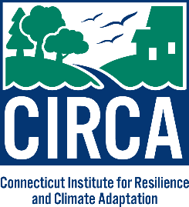
NEXT STEPS: CONTACT US!
Let CIRCA know if your municipality would be interested in doing a project in one of the identified areas! This would involve…
Working with CIRCA to develop the scope of work
Serving on an advisory committee to work with the selected consultants
Participating in community outreach efforts
Mary Buchanan, PhD
mary.buchanan@uconn.edu
Nicole Govert, MS
nicole.govert@uconn.edu

